Slide 1





Endorsed by
School program for grades 4 to 6
Notes:
Today, we’re going to spend some time talking about food allergy.

Slide 2
Modules
Module 1
About food allergy
Module 2
About allergic reactions and anaphylaxis
Module 3
Managing food allergy
Module 4
Being a food allergy ally

Slide 3
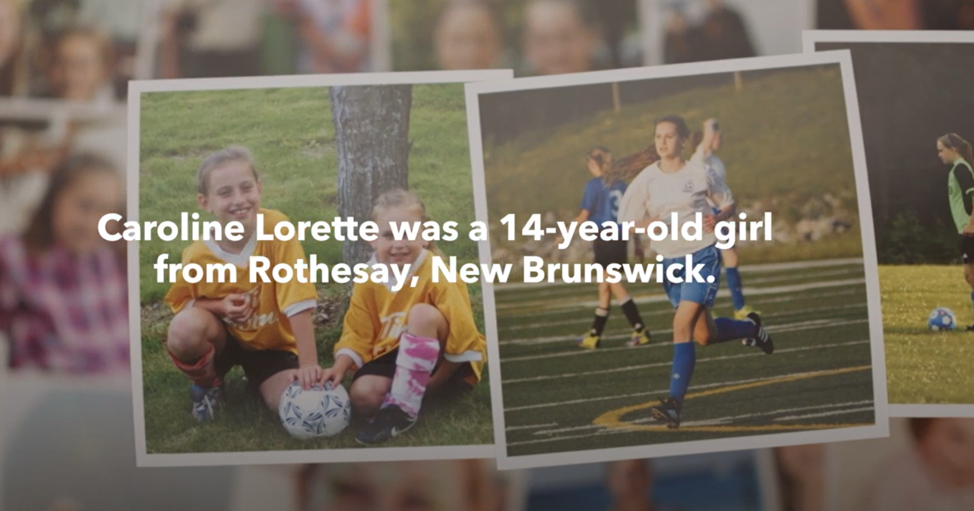

Meet Caroline
foodallergycanada.ca/MeetCaroline
Notes:
Prompt: Show the video
Note to teacher:
These notes are for the teacher, they don’t need to be read aloud as the video explains all of this:
Caroline Lorette was a sweet, happy girl who lived in New Brunswick. She loved to play sports, dance, and spend time with her friends and family; she had food allergies too.
At age 14, Caroline died because she accidentally ate something that she was allergic to. Her family wants to make sure everybody knows more about food allergy. This is a good idea, as people of all ages are living with food allergy. And while fatality is rare, it can happen.
In the video, Caroline’s death is referred to as “passed away”. Students may not understand this gentler way of referring to death depending on their own life experiences with death and how it may have been discussed within their own family. Therefore, if clarification is needed with your students, please take a moment to discuss with them.
The following note is from the Lorette family. If questions come up from your students about Caroline's story, you can share these details at your discretion:
Caroline’s story was that of a perfect storm of events resulting in her death. There were co-factors involved like recent exercise and hormonal changes; co-factors in general can influence the severity of an allergic reaction to a food. At the time, the advice given to us for treating allergic reactions was to take the antihistamine Benadryl® and only use an epinephrine auto-injector like EpiPen® if 100% sure anaphylaxis was occurring.
Today, we know that epinephrine is the recommended first-line treatment for anaphylaxis, not antihistamines. Epinephrine is the only medication that can reverse symptoms of anaphylaxis. Even if unsure about a reaction, the best choice is to use the epinephrine auto-injector and not delay in giving a second dose if needed. This is why this program is so important, so everyone will know the proper way to treat anaphylaxis and save someone’s life. Education is key.

Slide 4


Module 1

Slide 5
Let’s talk about food allergy
Food allergy affects more than
3 million people in our country (about 500,000 are kids)
1-in-2 Canadian households
are impacted by food allergy
Celebrities with food allergies:
Alex Tagliani (NASCAR star)
Serena Williams (tennis star)
Ariana Grande (singer/actor)
Cree Cicchino
(Nickelodeon and Netflix star)
?
Do you know someone
with food allergy?
What are they allergic to?
What does it mean to have one?
?
Notes:
Food allergy affects more than 3 million people in Canada, and about 600,000 are kids.
1-in-2 households in Canada are impacted, including teachers and childcare workers, restaurant employees, coaches, parents, and others caring for or working with people with food allergy.
Prompt: Raise your hand if you know someone with a food allergy – it could be a classmate, a friend, someone in your family, a relative, or maybe you have one.
People with food allergies are just like everybody else, they just have to avoid certain foods so they don’t have an allergic reaction.
Food allergy usually happens in childhood but it can develop at any age. It is more common in young children than in older children or adults; some food allergies are outgrown while others are lifelong
An appointment with an allergy doctor (an allergist) is needed to determine if someone has outgrown a food allergy.

Slide 6

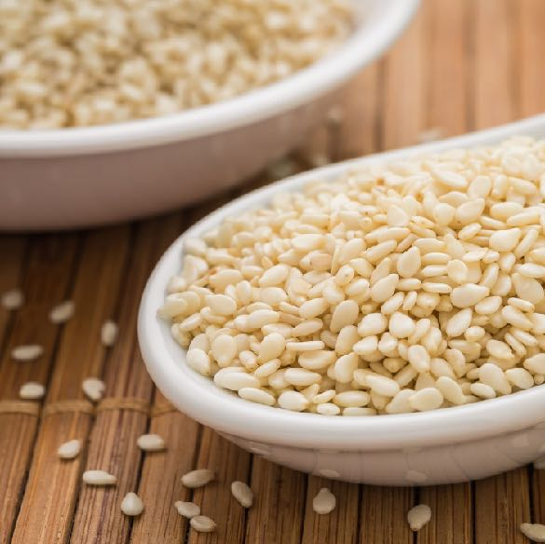




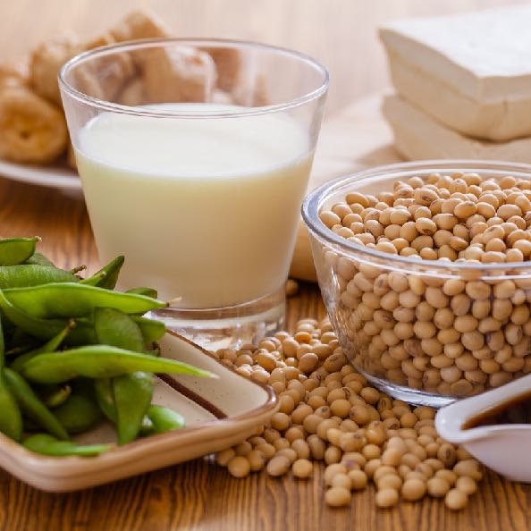

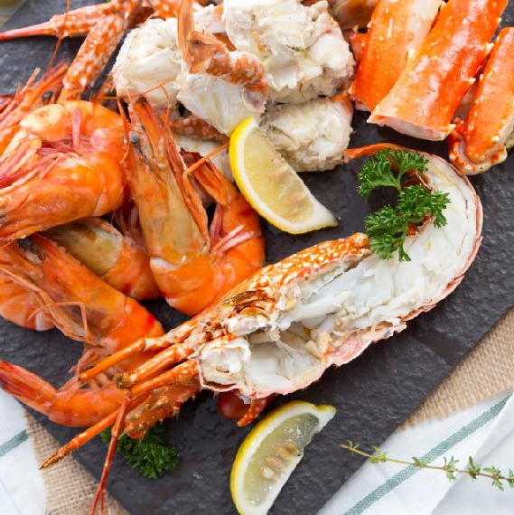

Most common food allergens
Peanut
Sesame
Egg
Tree nuts
Milk
Fish
Soy
Mustard
Crustaceans & Molluscs
Wheat & Triticale
(shellfish)
Notes:
Note to teacher: The food allergens appear one by one, click to reveal them.
These are the most common food allergens in our country: peanut, tree nuts, sesame, milk, egg, fish, crustaceans (like lobster, shrimp) and molluscs (like scallops, clams), soy, wheat and triticale, and mustard.
Health Canada refers to them as “priority food allergens” and there are rules around how they are labelled on a product.
For example, if a pre-packaged product like a box of cereal or a can of soup has one of these priority allergens as an ingredient, the priority allergen must be clearly labelled.
It is not true that only certain foods cause an allergic reaction. Certain foods cause the majority of allergic reactions, however, almost any food can cause a reaction. And you can be allergic to more than one food.

Slide 7
Caroline’s food allergies
Caroline had multiple food allergies,
meaning she was allergic to more than one food.
Tree nuts
Milk
Peanut
Egg
Crustaceans & Molluscs
(shellfish)

Slide 8

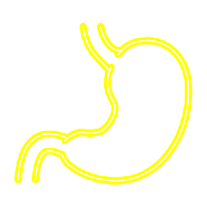
Food allergy vs food intolerance
Your body can react to a food in different ways.
Food
intolerance
more commonly involves your digestive
system
Food allergy involves your immune system
These are not
the same.
Notes:
Before we talk more about food allergy, do you know the difference between food allergy and food intolerance?
These are often confused, but they are different ways that your body can react to a food.
Food allergy involves your immune system, which is your body’s defense system and people with food allergy are at risk of having a severe allergic reaction.
It’s not the same as food intolerance which more commonly involves your digestive system, the system that helps your body get the nutrients and energy from the food you eat.
For example, you may know someone with lactose intolerance – this means they’re unable to fully digest lactose, a sugar found in dairy products like milk, cheese and yogurt.
People with food intolerances are not at risk of having a severe allergic reaction, however, they may also manage their intolerance by avoiding certain foods.

Slide 9
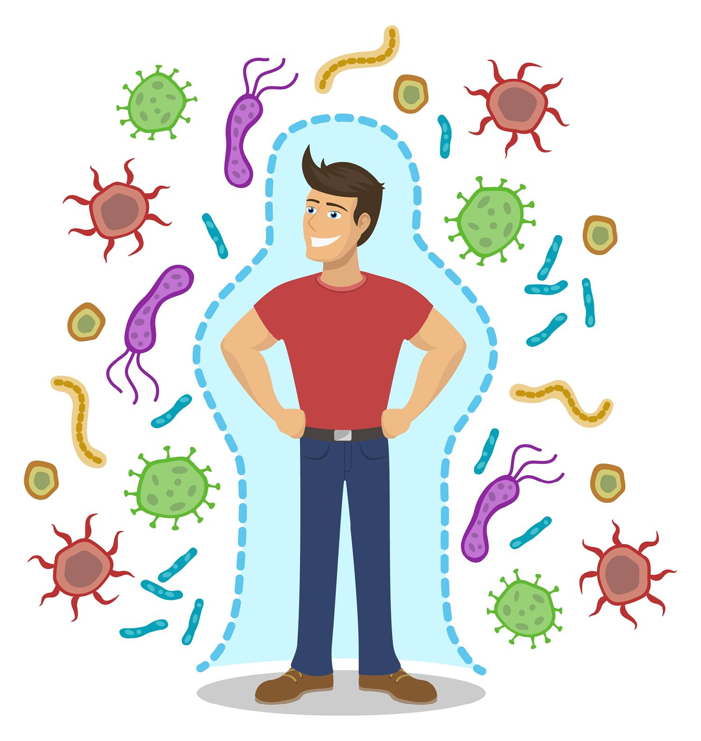
Your immune system
To be immune means
to be protected
Immune system = cells, tissues and organs working together to help protect
you against invaders
that seem harmful
Notes:
To be immune means to be protected against something.
Your body’s immune system is amazing!
It’s made up of different cells, tissues and organs that work together to help protect against invaders that seem harmful, like bacteria and parasites.

Slide 10
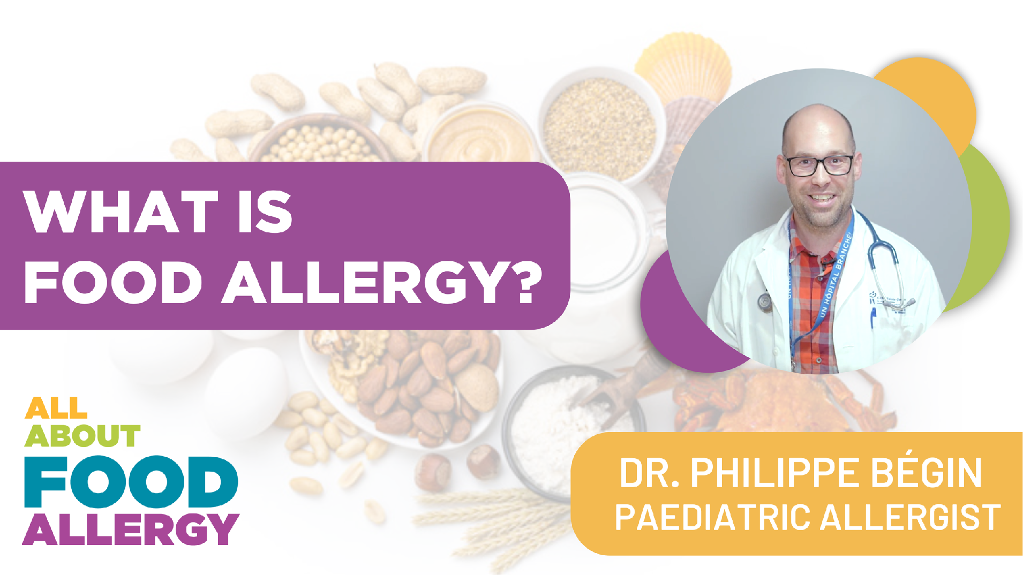

Watch the video
foodallergycanada.ca/Video1
Notes:
Prompt: Show the video

Slide 11



How IgE antibodies work
The immune system thinks
a food is
dangerous
IgE causes mast cells to release chemicals
The body makes IgE antibodies to protect itself
This leads to symptoms of an allergic reaction
Notes:
The video you watched explains how your immune system acts when you have a food allergy.
When your body is trying to protect itself from a food it thinks is dangerous, it makes antibodies called Immunoglobulin E or IgE.
This is where the mast cells that you’ve learned about come into play.
The IgE antibodies cause the mast cells to release chemicals (like histamine) into the bloodstream to defend against the food that’s causing the problem.
And this is what leads to the symptoms of an allergic reaction.

Slide 12
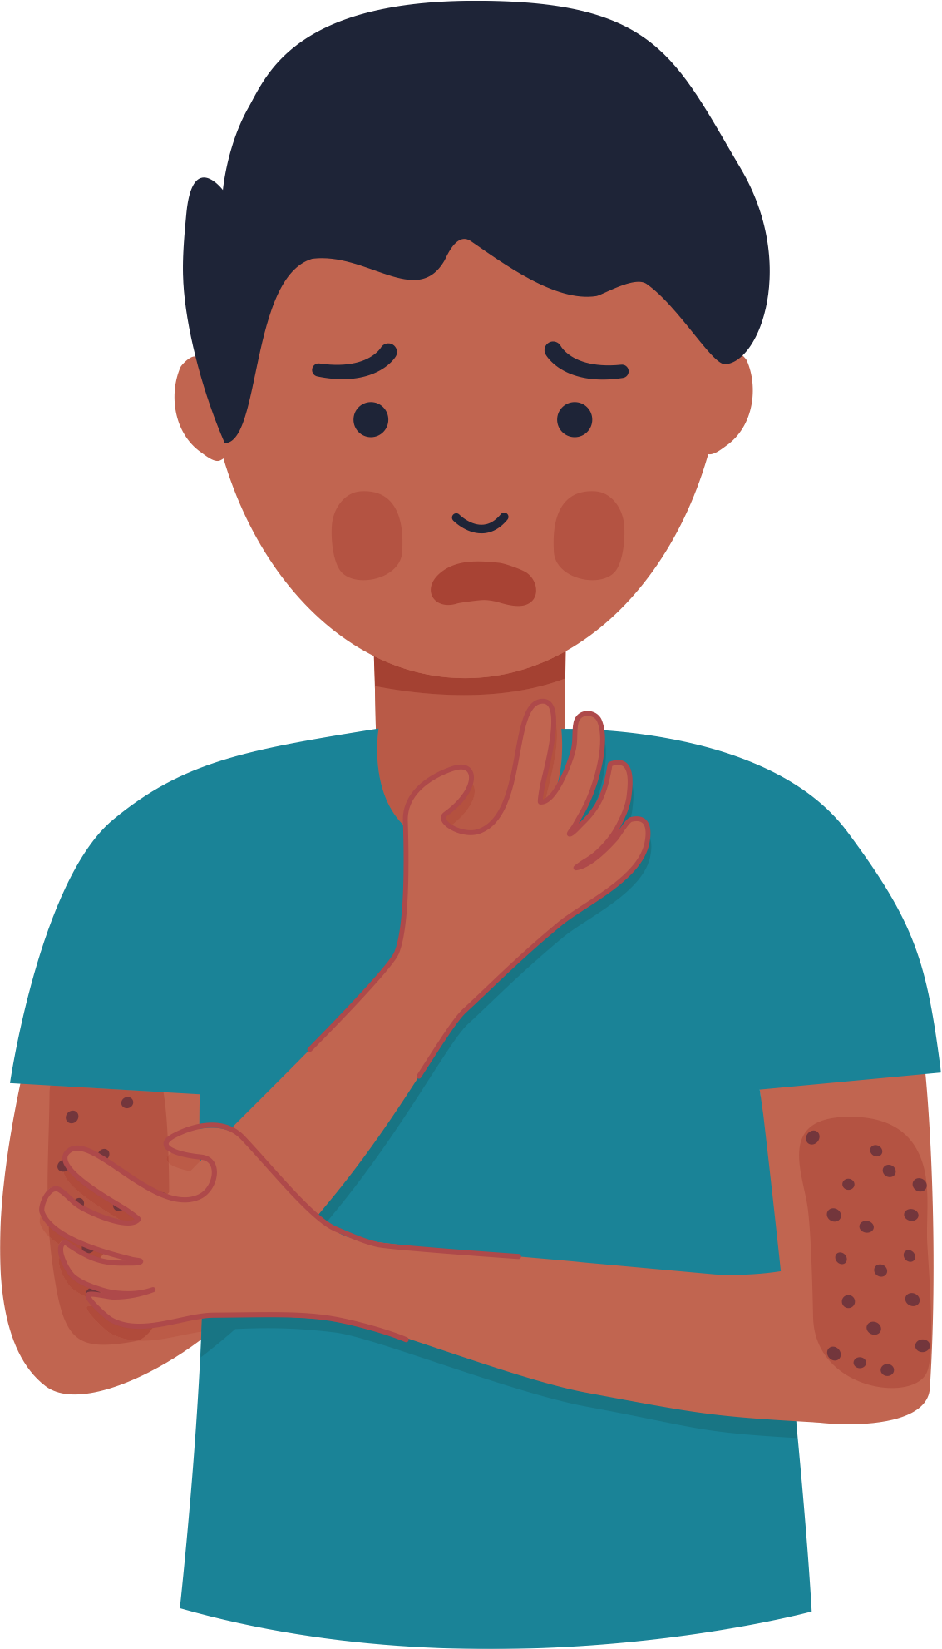

Module 2

Slide 13
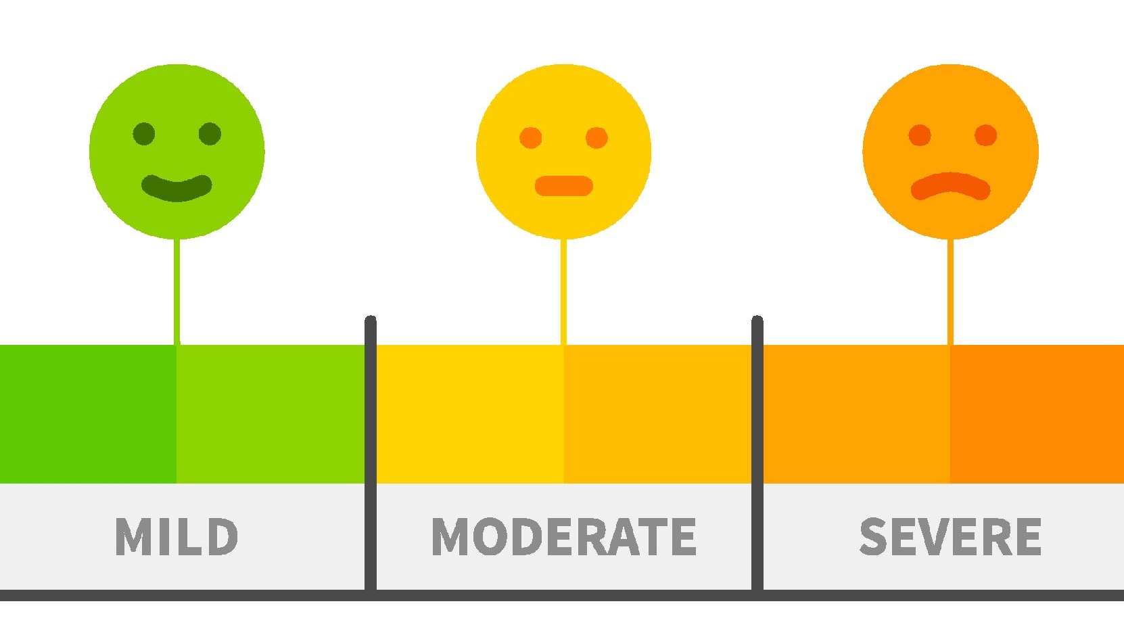

When an allergic reaction happens
You can have
different symptoms
Symptoms can range from mild to severe (anaphylaxis)
Severe allergic reactions need to be treated.
Notes:
When you accidentally eat something you’re allergic to, or a food that’s been contaminated with a food you are allergic to, you may experience an allergic reaction.
You might have mild symptoms, like a little bit of itching, or more severe symptoms such as trouble breathing or feeling like you’re going to faint.
Severe allergic reactions can be dangerous, so they always need to be treated quickly.
Is it okay for someone to eat a little bit of their food allergen? If you have a food allergy, it’s not okay to eat even a small amount as it can cause an allergic reaction. You should always assume it’s not okay unless your allergist or doctor tells you it is.

Slide 14
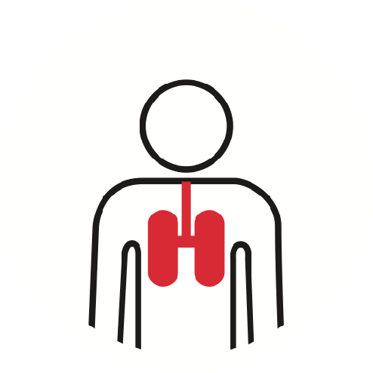

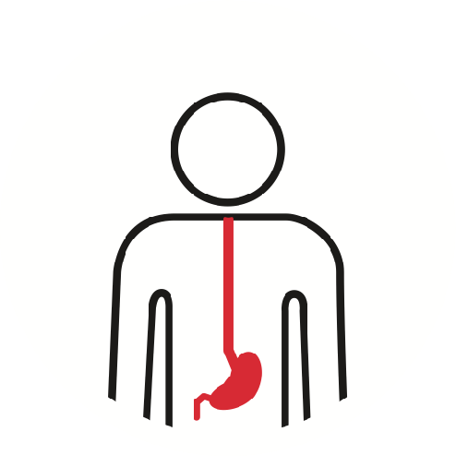


What is anaphylaxis?
The most serious type
of allergic reaction
Can affect different
parts of the body
Can happen quickly
Can be life-threatening
Anaphylaxis is a medical emergency.
Notes:
Anaphylaxis is the most serious type of allergic reaction, it can:
Affect different parts of the body like the lungs, stomach, and heart
Take place quickly – within minutes and sometimes it takes longer – within a few hours of eating a food
Be very dangerous, even life-threatening
For all these reasons, anaphylaxis is considered a medical emergency.

Slide 15
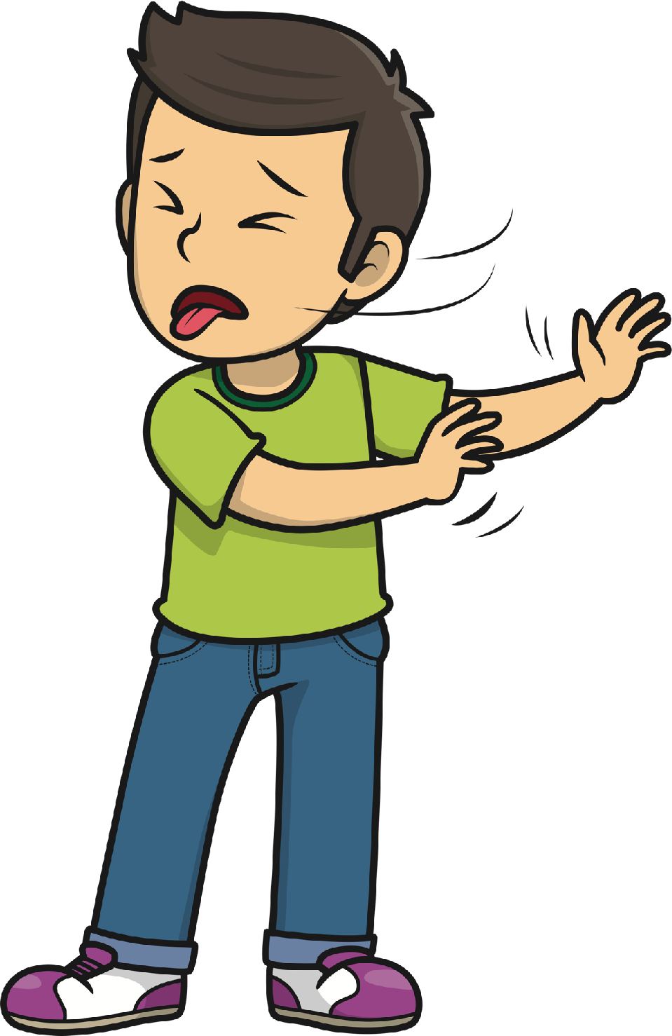
Can smelling a food cause a reaction?
No! The smell of a food alone
does not cause an allergic reaction
Food odour does not contain protein – which is what causes an allergic reaction
If someone smells the food they are allergic to, like peanut butter, it may make them feel anxious or uncomfortable.
Notes:
Did you know the smell of a food alone does not cause an allergic reaction? Reactions are caused by specific food proteins.
Since food smells or odours do not contain protein, they cannot cause allergic reactions.
However, if someone smells the food they are allergic to, it may make them feel very anxious or uncomfortable.
Note to teacher: Smelling a food odour is not the same as inhaling airborne proteins. In some cases, the inhalation of airbourne proteins can cause allergic reactions. For example, proteins can be transferred in the vapour or steam of sizzling fish or shellfish. Usually these reactions are mild, but sometimes people have had severe reactions.

Slide 16
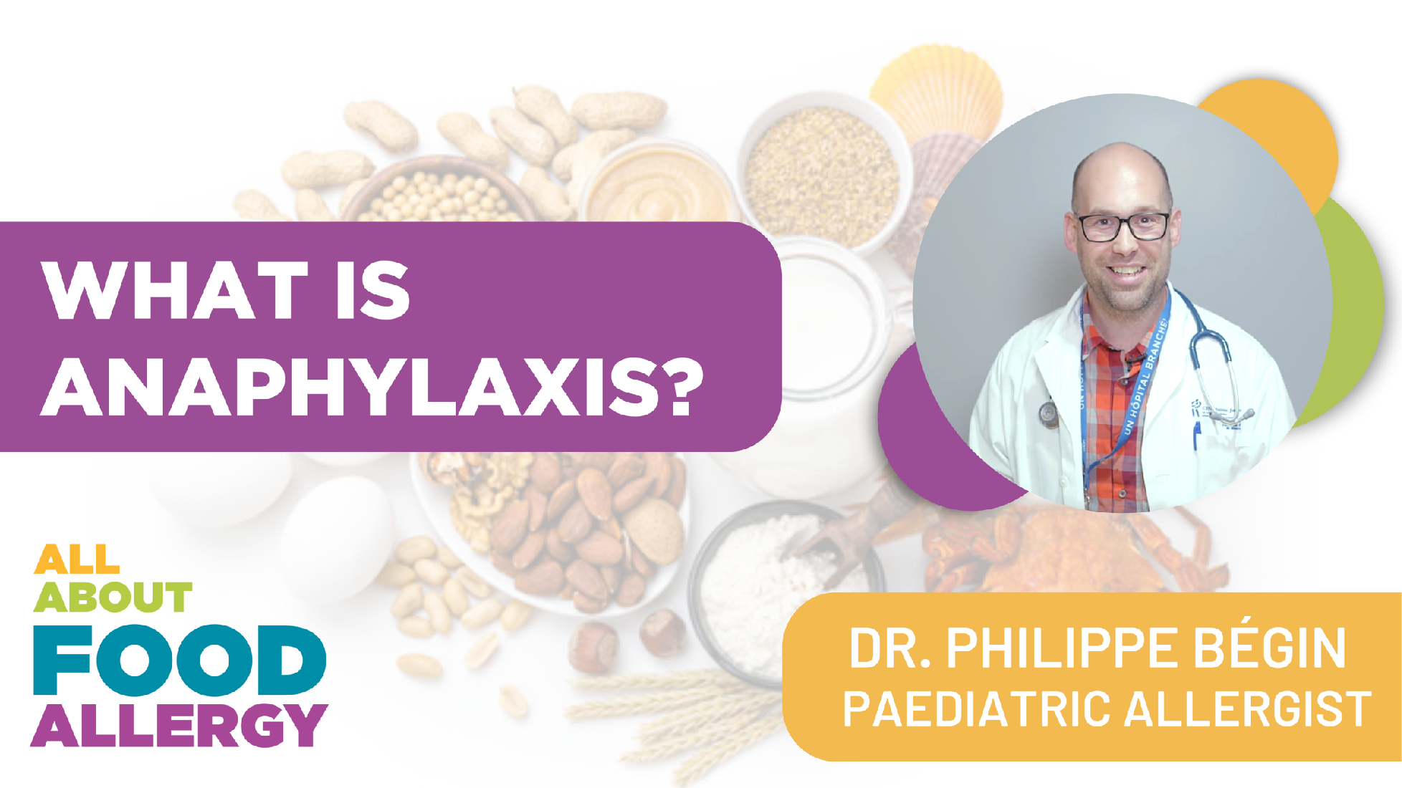
Watch the video
foodallergycanada.ca/Video2
Notes:
Prompt: Show the video

Slide 17
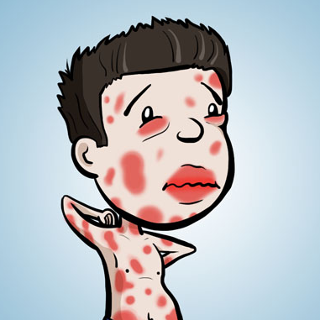
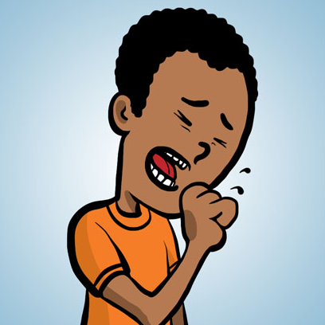
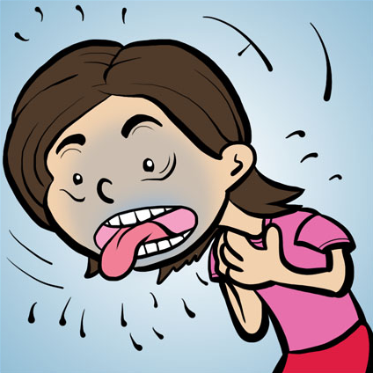
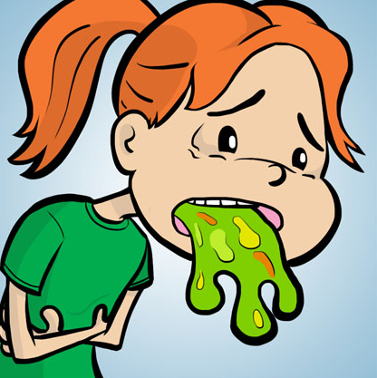
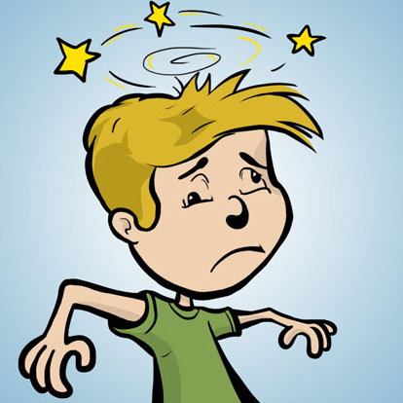
Signs and symptoms
Breathing
Stomach
Heart
Images courtesy of Kids’ CAP
Skin
hives, swelling, itching, warmth, redness
coughing, wheezing, shortness of breath,
chest pain or tightness, throat tightness,
hoarse voice, nasal congestion or hay fever-like symptoms (runny, itchy nose and watery eyes, sneezing), trouble swallowing, choking feeling
nausea, pain or cramps,
vomiting, diarrhea
paler than normal skin colour/blue colour,
weak pulse, passing
out, dizziness or lightheadedness
?
Did you know? Hives don’t always appear during anaphylactic reactions. Breathing or heart symptoms alone can be anaphylaxis.
Notes:
You can have different signs and symptoms with anaphylaxis.
Symptoms generally include two or more body systems: skin, breathing, stomach and heart. Breathing or heart symptoms alone can be anaphylaxis.
With anaphylaxis, your skin may be swollen or red, it may feel itchy or warm, or there may be lots of hives on your body. Hives look like red bumpy spots.
If your breathing system is affected, you may cough, wheeze (a whistling sound when you breathe), or feel like you cannot breathe. You may feel tightness or a pain in your chest. Your throat may feel tight or you may have trouble swallowing, or your voice may sound different.
If your stomach system is affected, you may feel sick to your stomach or nauseous or have stomach pain or cramps.
If your heart system is affected, your skin colour may look paler than normal or look “blue”, or you may feel lightheaded or dizzy.

Slide 18


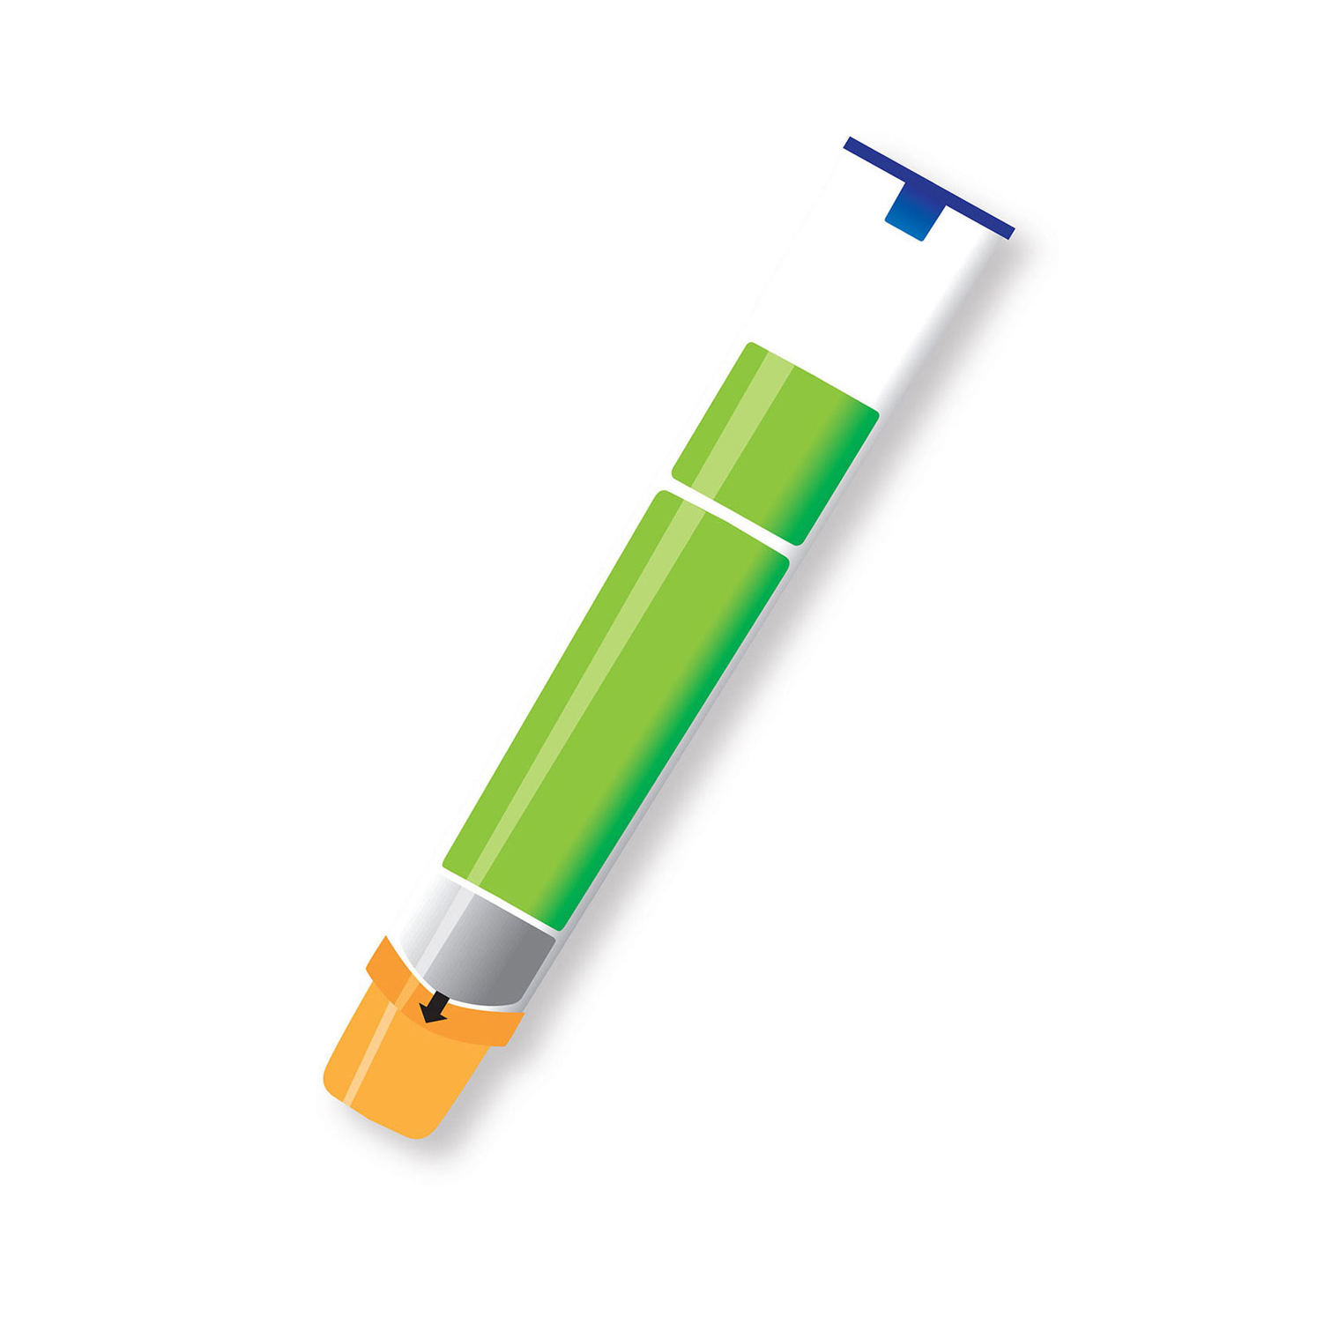
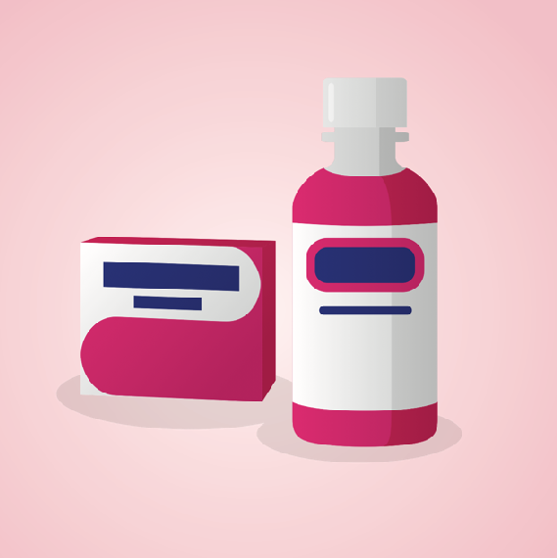
Treating anaphylaxis
Epinephrine is the best medicine to treat anaphylaxis – and should be used right away, don’t delay!
It reverses the symptoms of a reaction
Do not use antihistamines like Benadryl® instead of epinephrine
Epinephrine
is the medicine
form of the hormone adrenaline made
by your body.
Notes:
A medicine called epinephrine is the best one to treat anaphylaxis.
It is the medicine form of the hormone adrenaline, which is made by your body and released when you are faced with an exciting or stressful situation.
Adrenaline helps to protect you by increasing your heart rate and giving you a boost of energy.
Epinephrine helps your body respond by reversing the symptoms of an allergic reaction.

Slide 19
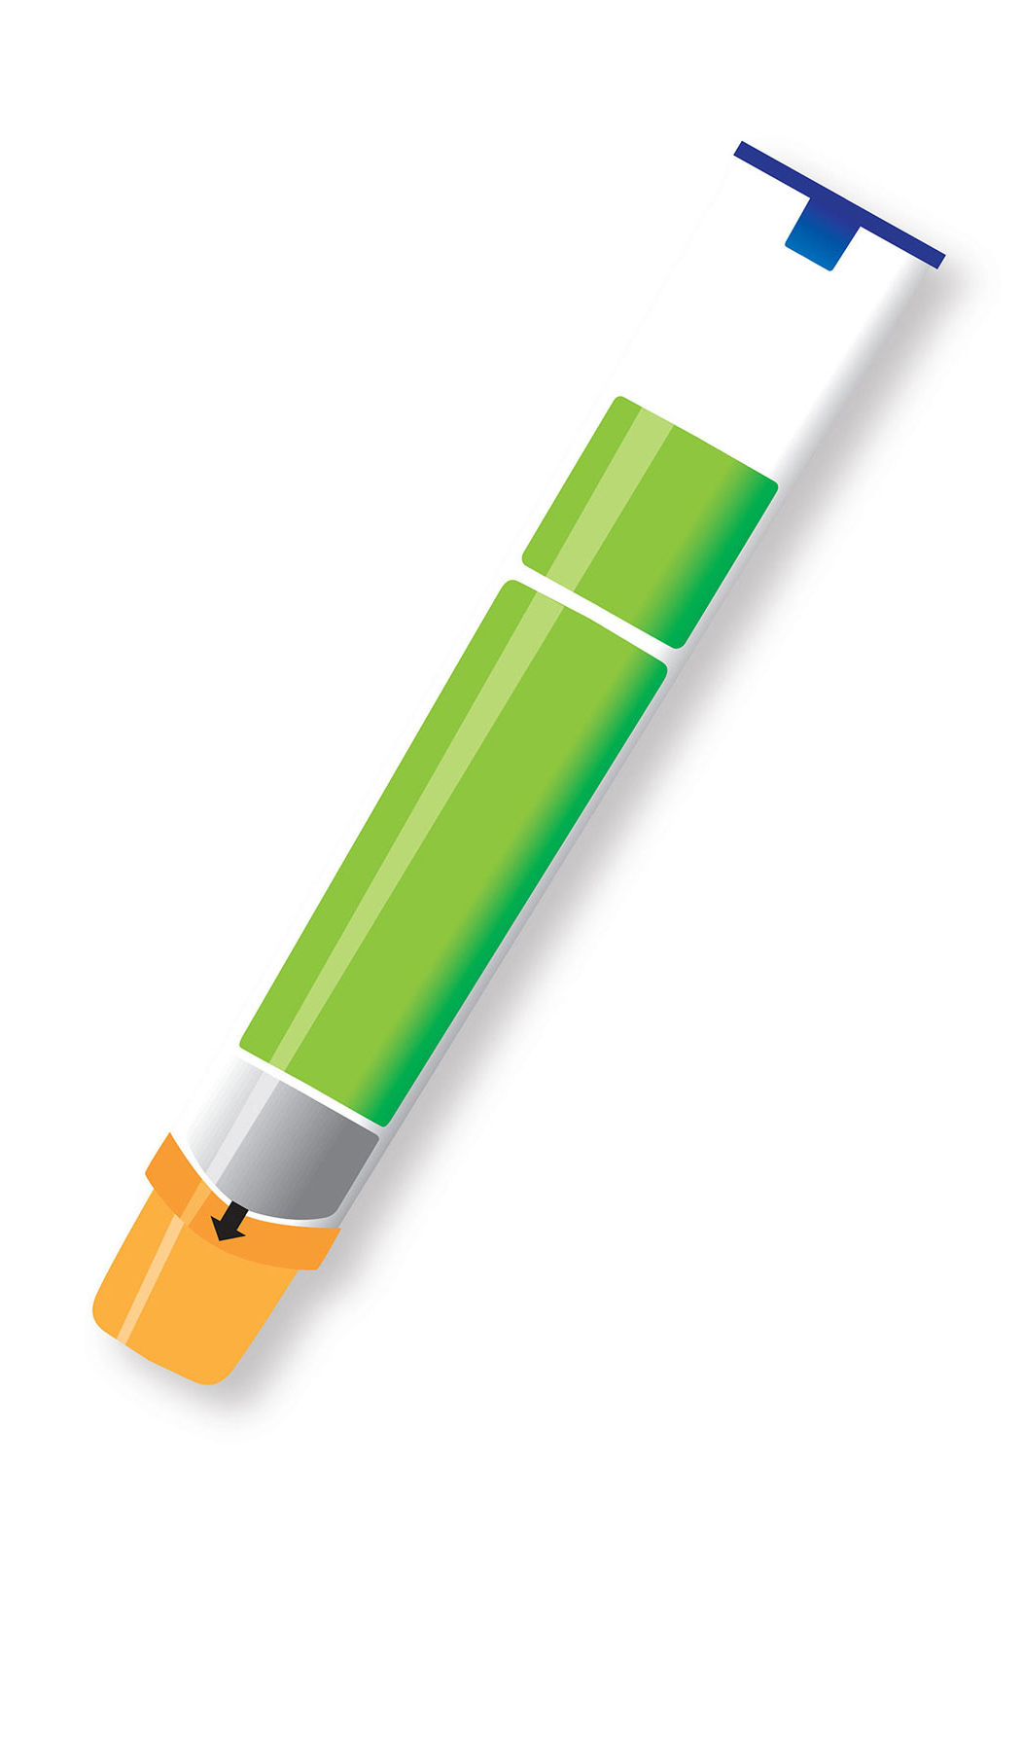
Epinephrine auto-injector
Device that contains epinephrine
Anyone can use them
They are safe to use
Go to hospital afterwards
EpiPen®
?
Did you know?
Epinephrine auto-injectors are injected into the mid-outer thigh and can even be given through clothes!
Notes:
An epinephrine auto-injector is a hand-held device that contains a dose of epinephrine; it is injected into the mid-outer thigh and can be given through clothes (one layer of clothes, avoiding seams and pockets).
It’s designed to be given by anyone, including people who are not medically trained.
Epinephrine is safe to use. Even if you’re unsure about a reaction, the best choice is to use the epinephrine auto-injector.
After someone receives epinephrine, they need to go to the hospital to get checked out for their reaction (not because epinephrine was used).
Currently in Canada, only EpiPen® auto-injectors remain available. In Fall 2024, some students may be carrying ALLERJECT®, until the supply runs out. Once the supply runs out, ALLERJECT devices will not be available in Canada.
To access the videos on how to use EpiPen and ALLERJECT devices, visit: https://foodallergycanada.ca/campaign/all-about-food-allergy-school-program-for-grades-4-6/video-how-to-use-an-epinephrine-auto-injector/

Slide 20
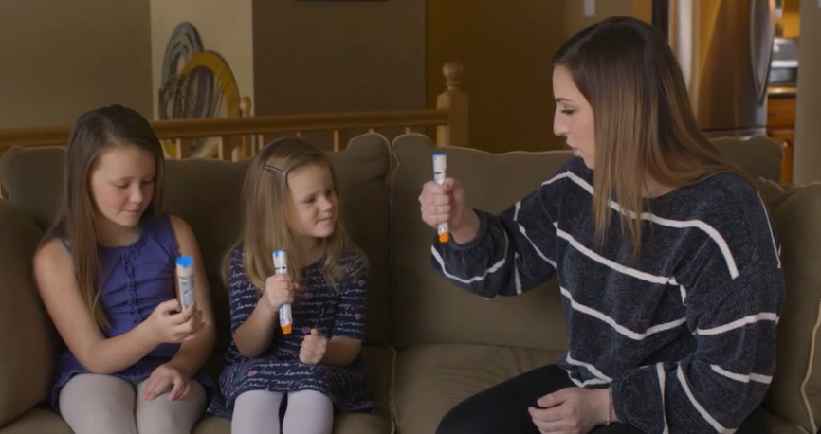
Let’s practice: watch this video
foodallergycanada.ca/EpiTraining
Notes:
Prompt: Show the video

Slide 21
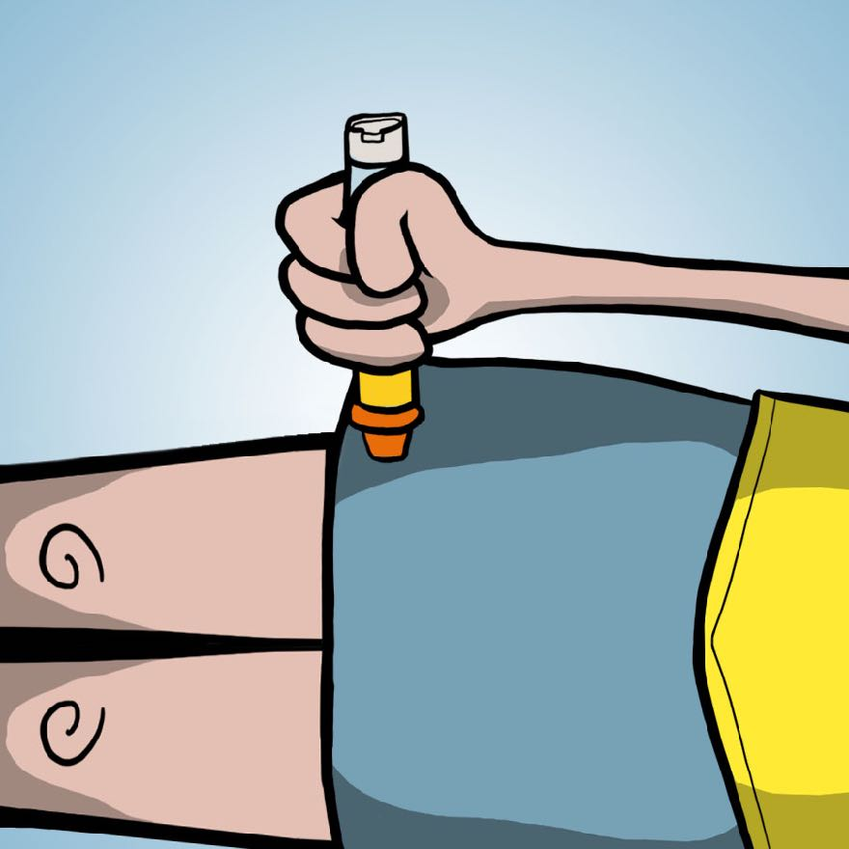
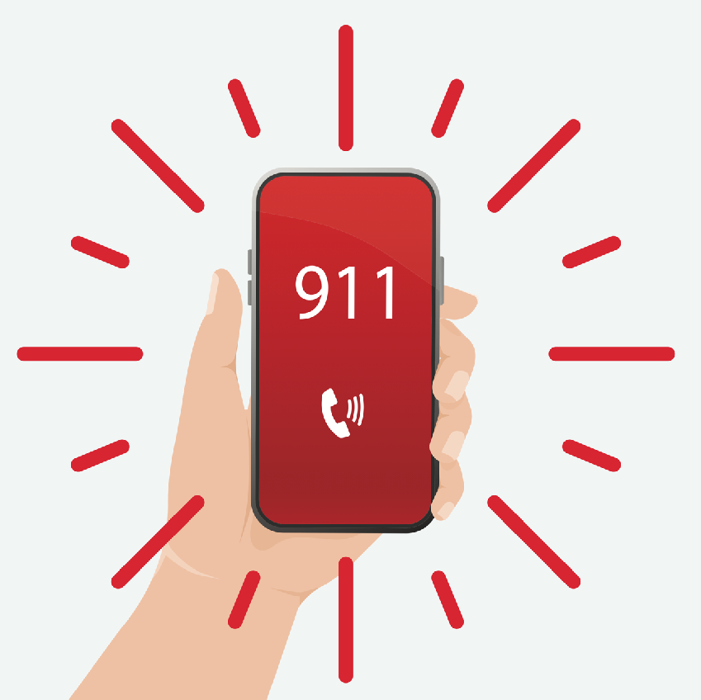
5 steps for treating anaphylaxis
Step 1
Step 2
Step 3
Images in steps 1 & 3 courtesy of Kids’ CAP
Give an epinephrine auto-injector
(e.g. EpiPen®) right away. Follow the instructions on the device.
Call 9-1-1 or your local EMS immediately and tell them someone is having an anaphylactic reaction.
Use a second auto-injector as early as 5 minutes after giving the first dose if there is no improvement in symptoms.
Notes:
While one person is using an epinephrine auto-injector, another person can be calling 9-1-1.
Even if unsure about a reaction, the best choice is to use the epinephrine auto-injector and not delay in giving a second dose if needed.
When you give any dose of epinephrine, you should always note what time it is

Slide 22
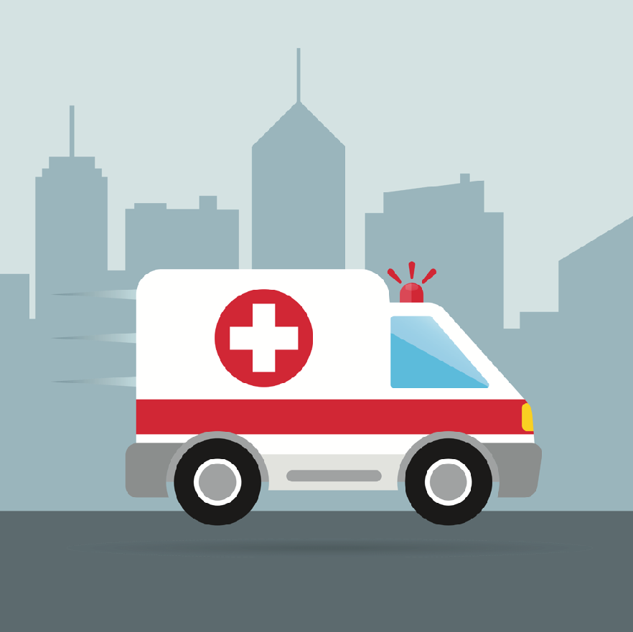
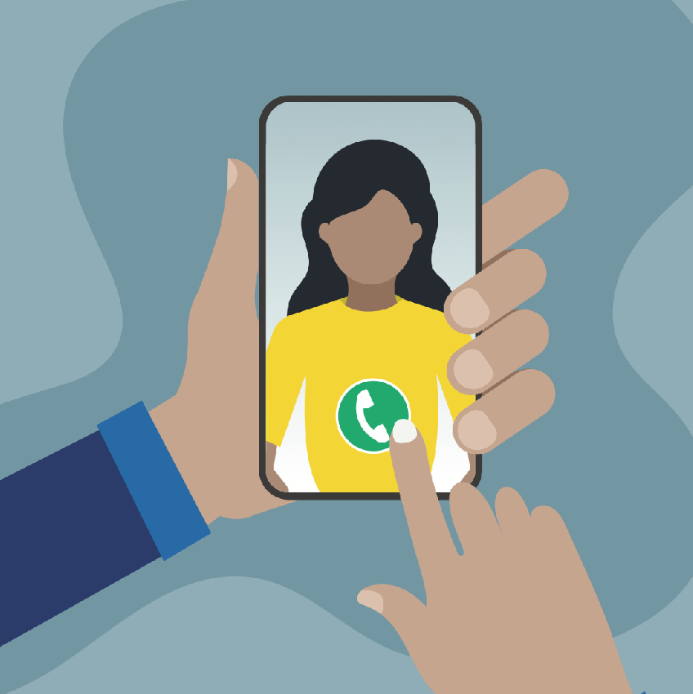
5 steps for treating anaphylaxis
Step 4
Step 5
The allergic reaction is the reason for going to the hospital, not because epinephrine has been used.
Go to the nearest hospital right away (ideally by ambulance),
even if symptoms are mild or have stopped. The reaction could get worse or come back.
Call emergency contact person (e.g. parent).
Notes:
It’s important to go to the hospital after receiving epinephrine.
There is a chance of a second reaction or symptoms that may not have completely gone away. Sometimes more epinephrine or other medicine is needed.
The allergic reaction is the reason for going to the hospital, not because epinephrine has been used.

Slide 23
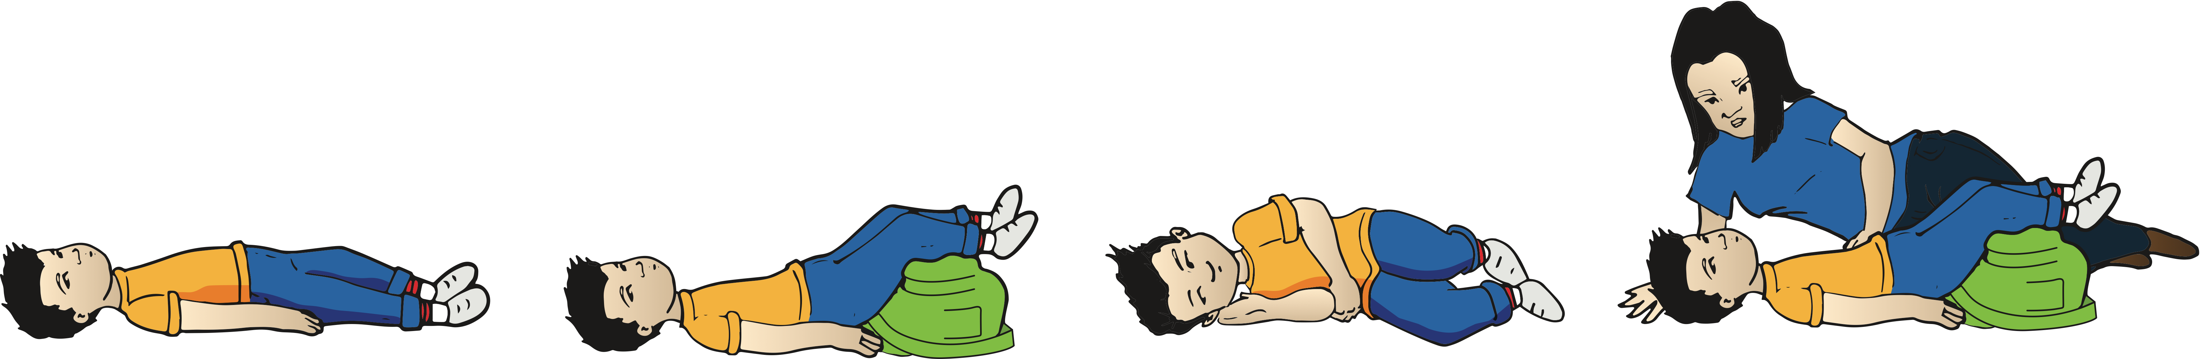
Body position is important
When giving epinephrine
Have a child sit or lie down. If having trouble breathing, they may prefer to sit.
You may find it helps to support or brace their leg to reduce movement before giving the epinephrine auto-injector.
During a reaction… If the child is lying down, do not have them sit up or stand suddenly during an anaphylactic reaction, even after receiving epinephrine. Sudden changes of position can be life-threatening.
Notes:
There are different body positions to think about when giving epinephrine and afterwards.
Before giving epinephrine: it may help to support or brace their leg to reduce movement.
If a child is lying down, do not have them sit up or stand suddenly during an anaphylactic reaction, even after receiving epinephrine.
Sudden changes of position may lower their blood pressure and actually worsen their condition, and be life-threatening.
After giving epinephrine, you can use anything that you have at hand to support their legs including backpacks, jackets, blankets, etc.
It may help to lie down with a young child to keep them calm.

Slide 24
Body position is important
After giving epinephrine
Place them on their back
(if not already lying down) and raise their legs. They may prefer to stay sitting
up if breathing is difficult.
If a child feels sick or is vomiting, place them on their side.
If unconscious, they should
also be placed on their side.
After giving epinephrine, it may be helpful to lie down with a young child to keep them calm.

Slide 25


Module 3

Slide 26
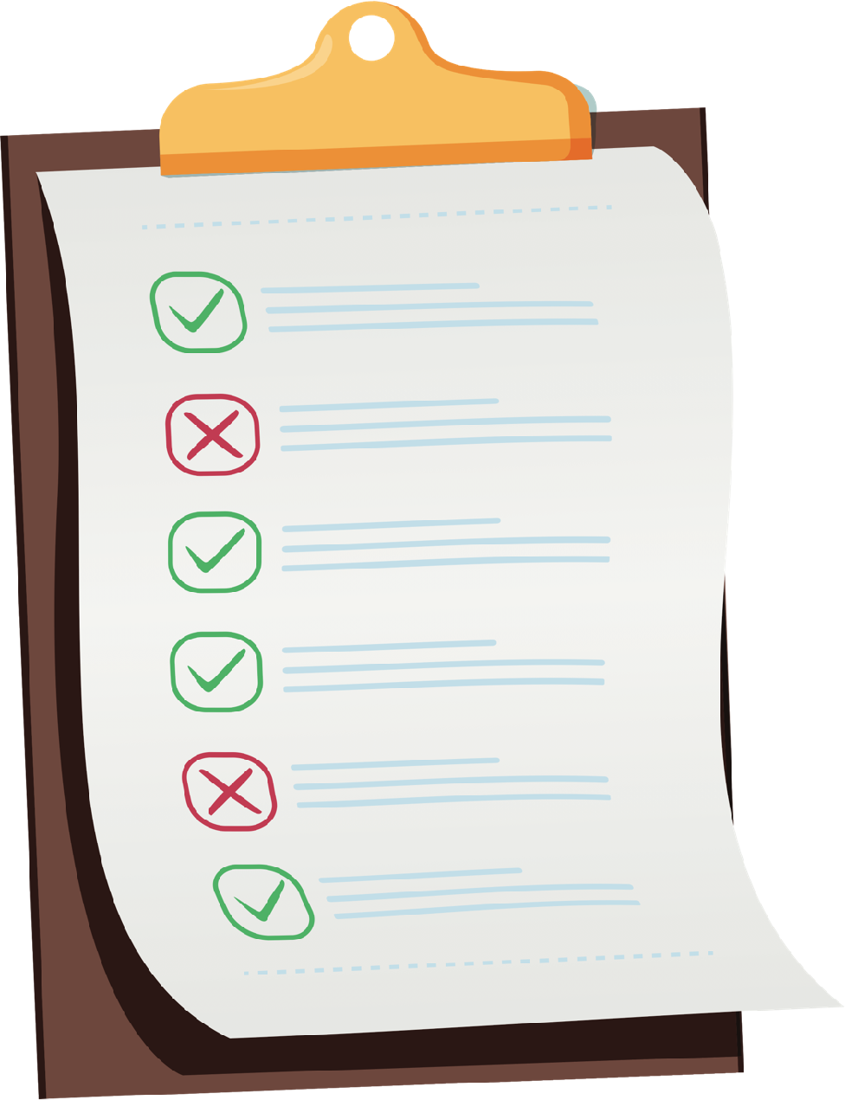

How does someone manage food allergy?
Avoid eating what they are allergic to
Knowing what is in their food
Being careful when making food
Properly washing hands and cleaning up after eating
Notes:
To help prevent a reaction, a person needs to avoid consuming what they are allergic to.
They can do this by knowing the ingredients in the food they plan to eat and drink.
Other safety steps are important, like being careful when making food, washing hands well before and after eating, and cleaning up after eating.
It is possible for someone to outgrow a food allergy although we don’t yet know why this happens. And because the person managing the food allergy is avoiding the food they are allergic to, they may not always know if they have outgrown a food allergy. The only way to know if someone has outgrown their food allergy is to have regular check ups with their food allergist (an “allergy” doctor) which might include tests to see if their body is still reacting to the allergen that they have been avoiding.

Slide 27
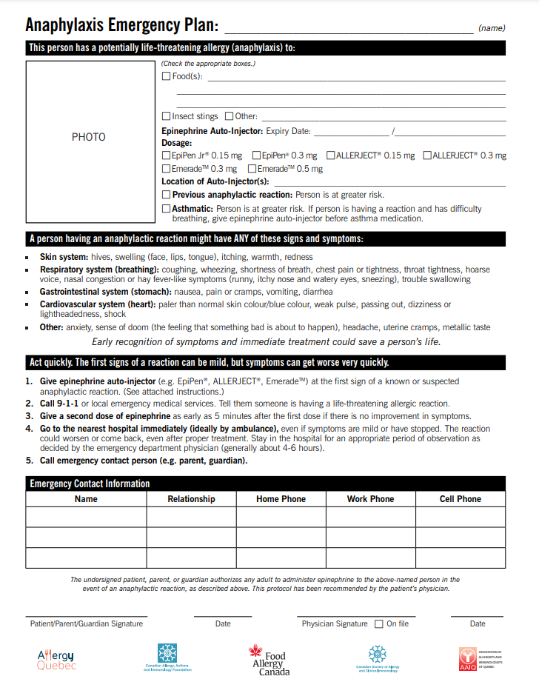

Anaphylaxis Emergency Plan
allergen(s)
medication,
expiration dates,
location of devices
asthma
Notes:
This form outlines important information:
Name, list of allergen(s), medication (dosage, expiry dates, location of devices), and whether the person has asthma.
Signs and symptoms to watch for
Steps to follow if a reaction occurs
Emergency contact information
Note to teacher: A template can be downloaded from foodallergycanada.ca/AEP however, your region’s document may look different. Be sure to check which form is used for your school/board/jurisdiction.

Slide 28
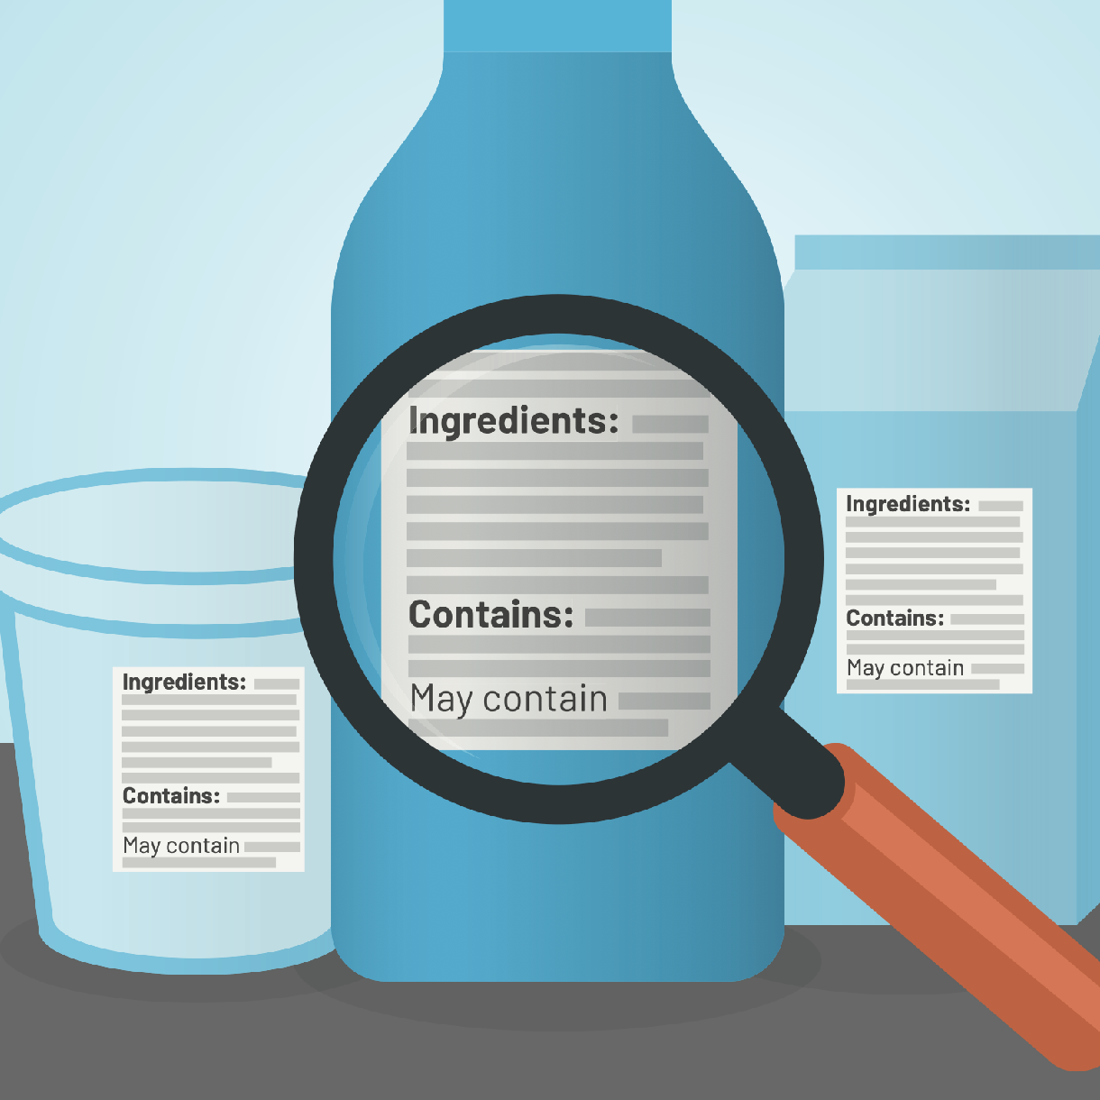
Know what is in the food you eat
Read food labels to understand ingredients
Food labels are on packages of food that list out the ingredients in that food – it is
not the same thing as the nutrition label
People with food allergy should avoid foods that “contain” and “may contain” what they are allergic to.
Notes:
When you have a food allergy, you can’t just look at a food and decide if it’s safe to eat, it’s necessary to check labels.
Reading food labels is an important part of managing your allergy day-to-day.
Pictured: this is an example of labels you will find on many pre-packaged foods, and you can see the ingredient list, a “contains” statement, and a “may contain” statement.
Priority food allergens, like milk, have to be called out and worded in a way that’s easy to understand.
It helps that Canada has good allergen labelling rules, making it easier to avoid allergens.
If you have a food allergy, it’s best to avoid eating products that “may contain” your allergen. There’s a chance that you can have an allergic reaction.

Slide 29

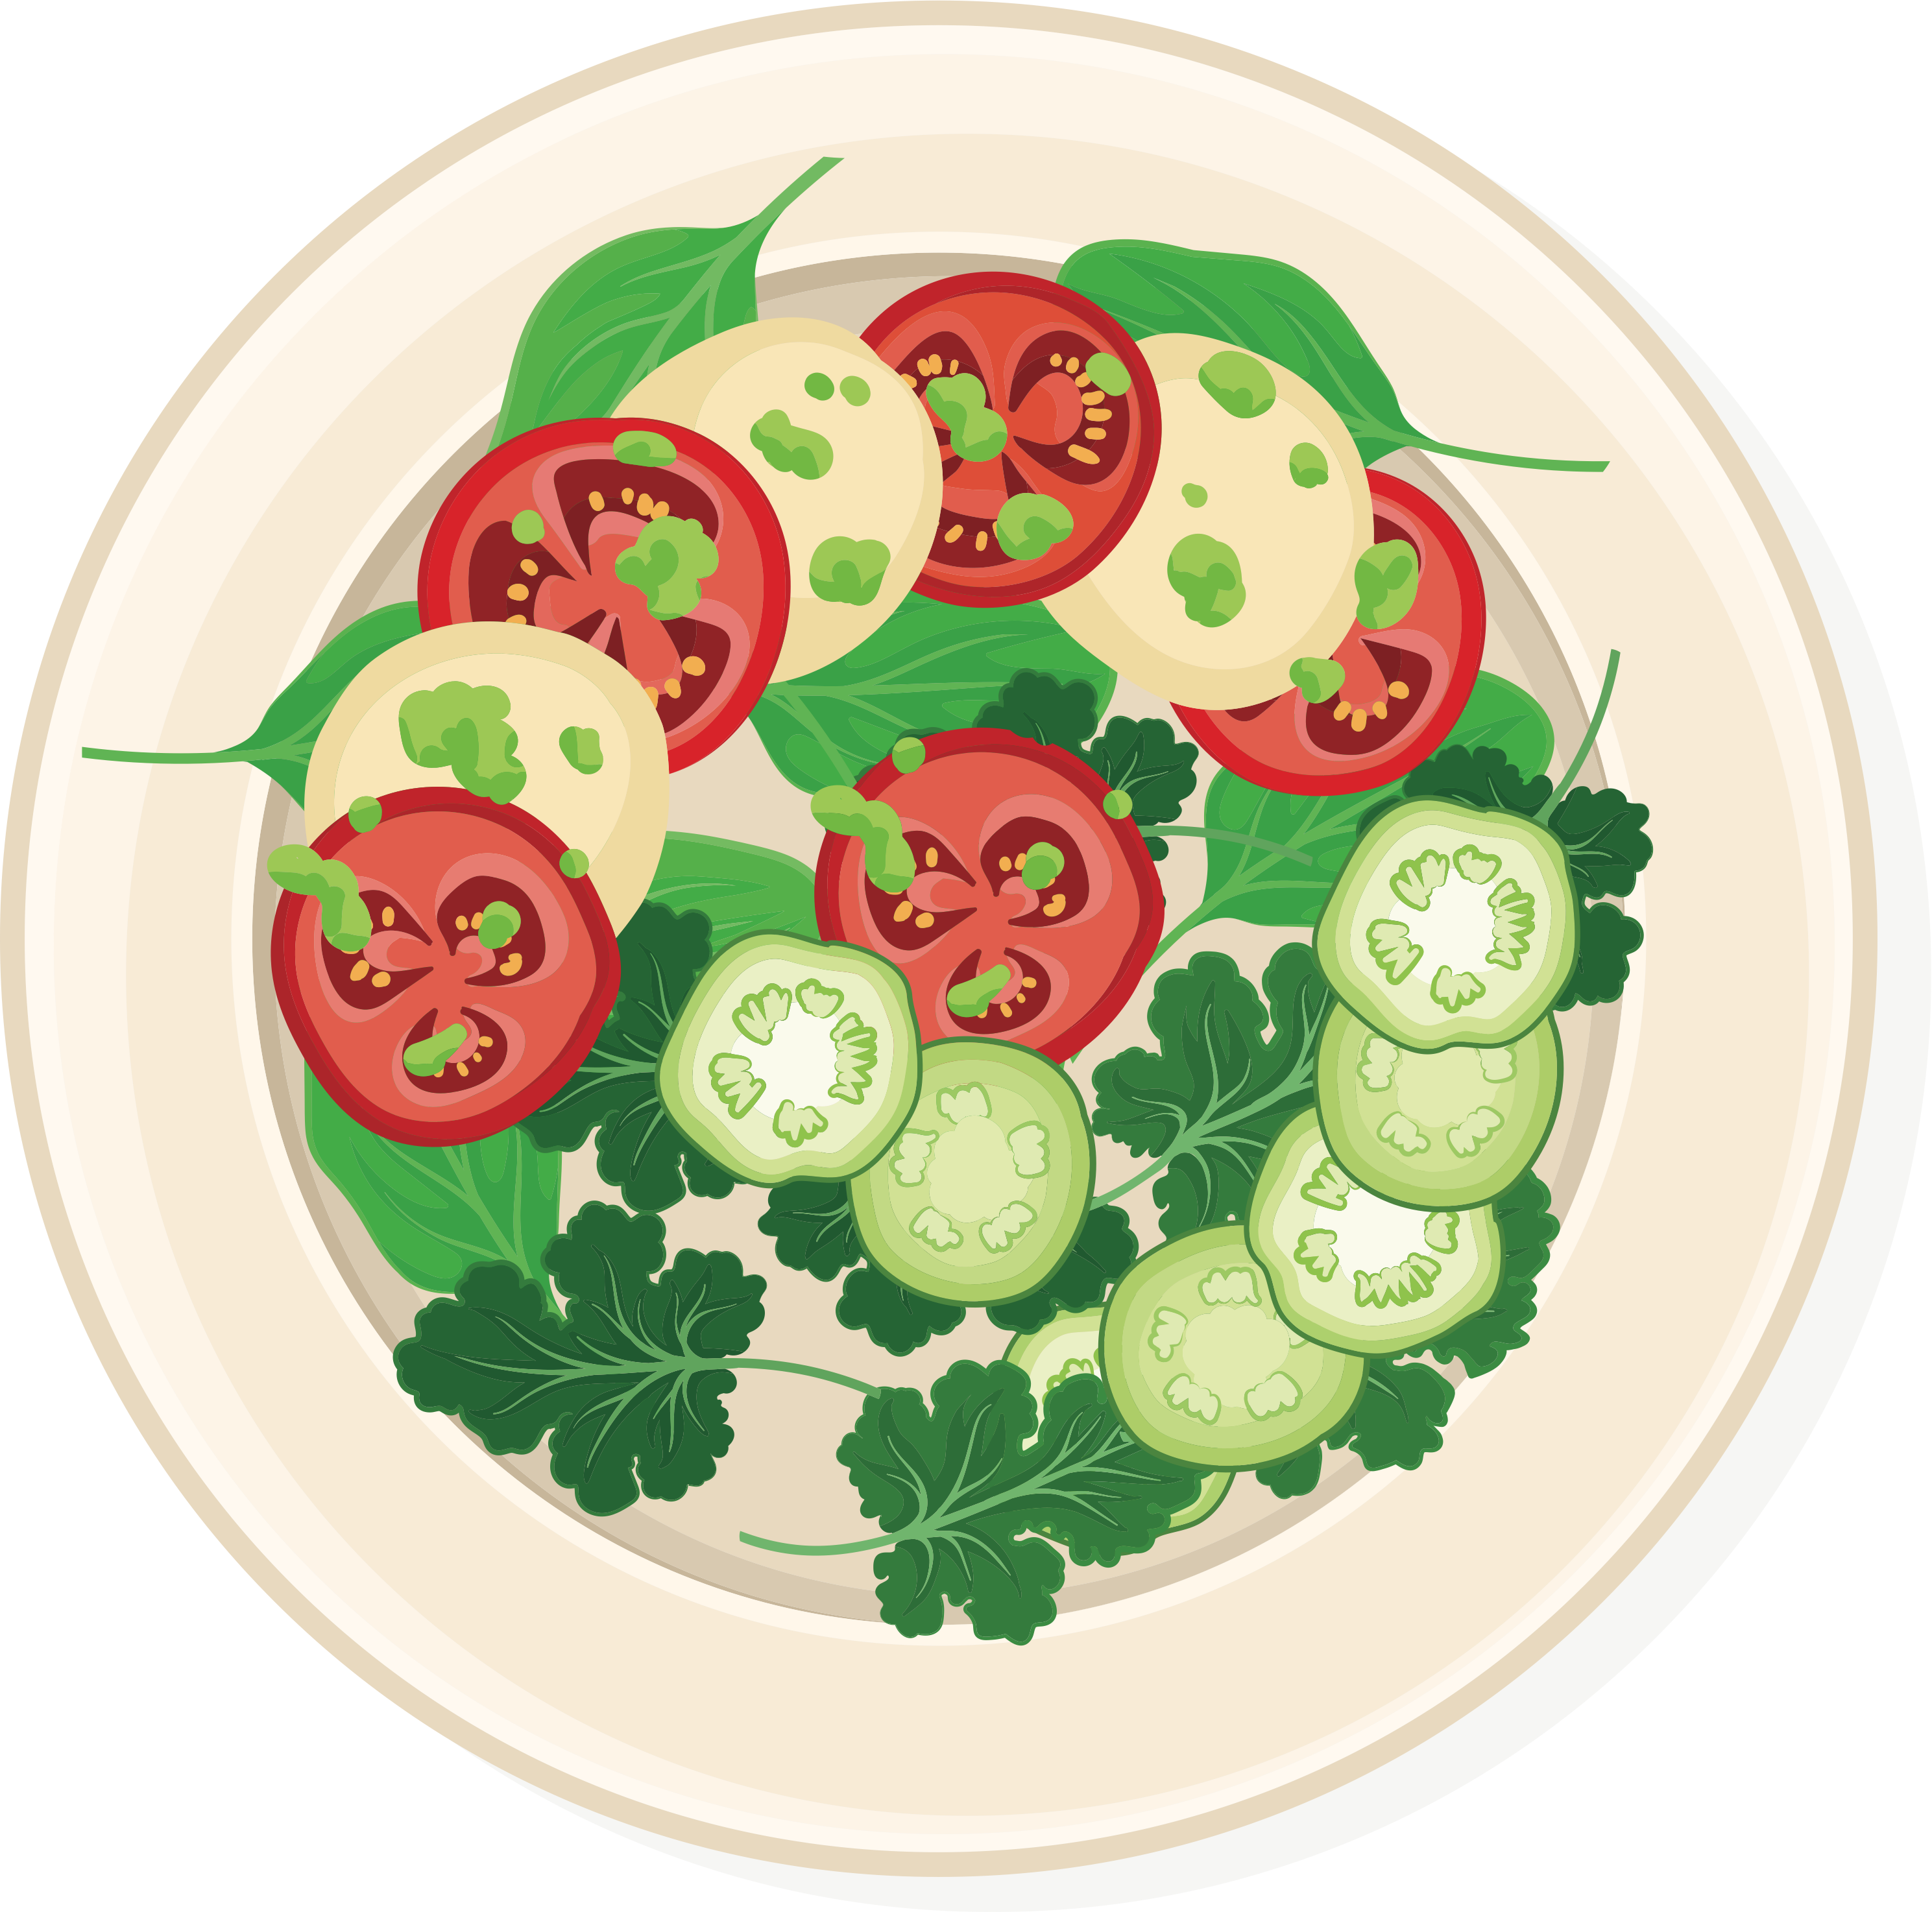





When making food
Reduce cross-contamination
when making or serving food
It can happen when a food allergen accidentally gets into another food
Allergen = the food your body
thinks is dangerous and reacts to.
Notes:
Have you heard the word “cross-contamination” before?
It can happen when a food allergen accidentally gets into another food. For example, if a knife used for cream cheese is put into a jar of jam, the jam is no longer safe for someone with a milk allergy to eat. It has been “contaminated” by the cream cheese which has milk as an ingredient.
Another example is using the same serving tong to serve fish from one dish and then vegetables from another dish. The vegetable dish would be cross-contaminated by the fish, and unsafe for someone with a fish allergy.
Whether you are making food on your own, or with a parent or your family, you need to be aware of cross-contamination and what you can do to help reduce the risk of it.
Cross-contamination can also happen in other ways, like when a food allergen gets onto a surface (not properly cleaning up food on a counter) or in saliva (getting a lick from a pet that’s eaten a person’s allergen).

Slide 30
Ask questions
Ask questions about ingredients and how food is prepared when eating out or when someone else is making food
Is this food
safe for
someone with
food allergy?
Did you use separate utensils?
Did you clean
the surfaces you used to make
the food?
What are the ingredients?
How was the food made?
Did you wash your hands?
Notes:
Besides reading labels, you also need to ask questions about the ingredients in a meal or snack and how it has been prepared, to know if it’s a safe option.
Ask if the allergen is in the list of ingredients.
Asking how the food was made is important as cross-contamination can happen when the same equipment or utensils (like spoons and knives) are used. For example, French fries may be made in the same fryer to deep-fry fish or shrimp, a knife that has been used to slice pizza with anchovies (fish) may also be used to cut a cheese pizza, or burgers and buns may be flipped on the grill using the same spatula.

Slide 31


Wash hands and clean up
Wash your hands with soap before and after eating
Clean up after yourself
after eating
Notes:
To help reduce the risk, wash your hands before and after eating.
After eating, you can also help by cleaning up after yourself.
Know that food crumbs can get on your hands, but also on desks, trays, and even on our faces.
Proper handwashing and cleaning are both important ways to help prevent cross-contamination.
Did you know that hand sanitizer does not effectively remove allergens, washing hands with soap and water is best.

Slide 32
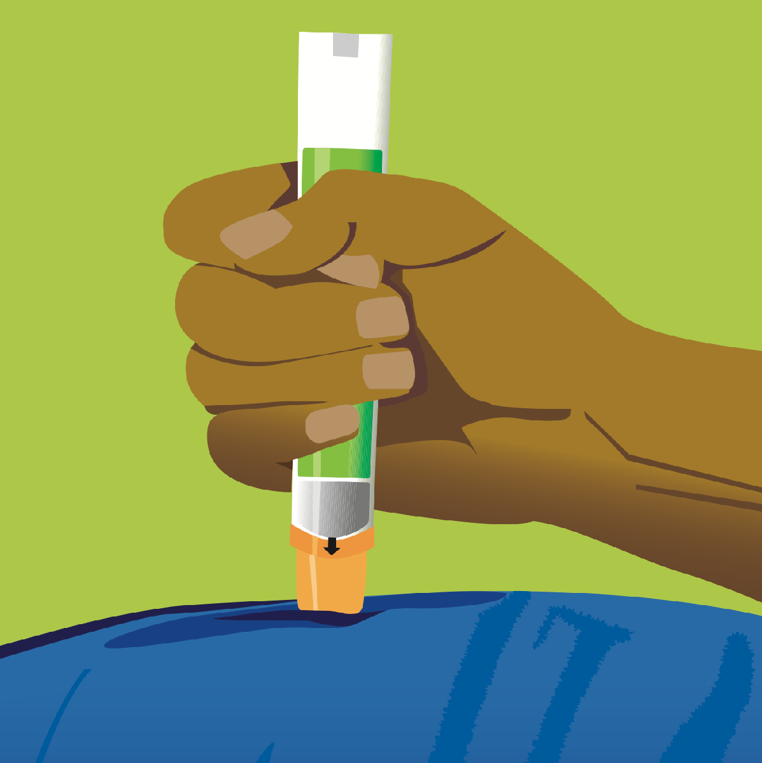
Be ready for a reaction
Be able to recognize the symptoms of a reaction
Know how to use an epinephrine auto-injector
Ask for help from an adult as needed
Every student with food
allergy has an anaphylaxis action plan that the school follows.
?
Do you remember what the symptoms of anaphylaxis are?
Notes:
Severe allergic reactions can happen despite best efforts, so it’s best to be prepared.
Be familiar with the symptoms of anaphylaxis, so that epinephrine can be used as soon as possible. (review module 2 if needed)
Know how to use an epinephrine auto-injector and ask for help from an adult as needed. (review module 2 if needed)
Optional: Have students watch a 5-minute video in which youth with food allergy share their reaction stories and lessons learned (link: https://www.youtube.com/watch?v=6ZiaRd23kVo)

Slide 33

Talk about it…
Talk to friends and classmates about their food allergy
Have them explain what they
do to stay safe
Ask how you can support them
Notes:
Talk to friends and classmates about their food allergy, it should not be a secret.
Have them explain the things they do to stay safe, like reading food labels, or bringing their own lunch or snacks from home.
Ask about how you can support them.

Slide 34
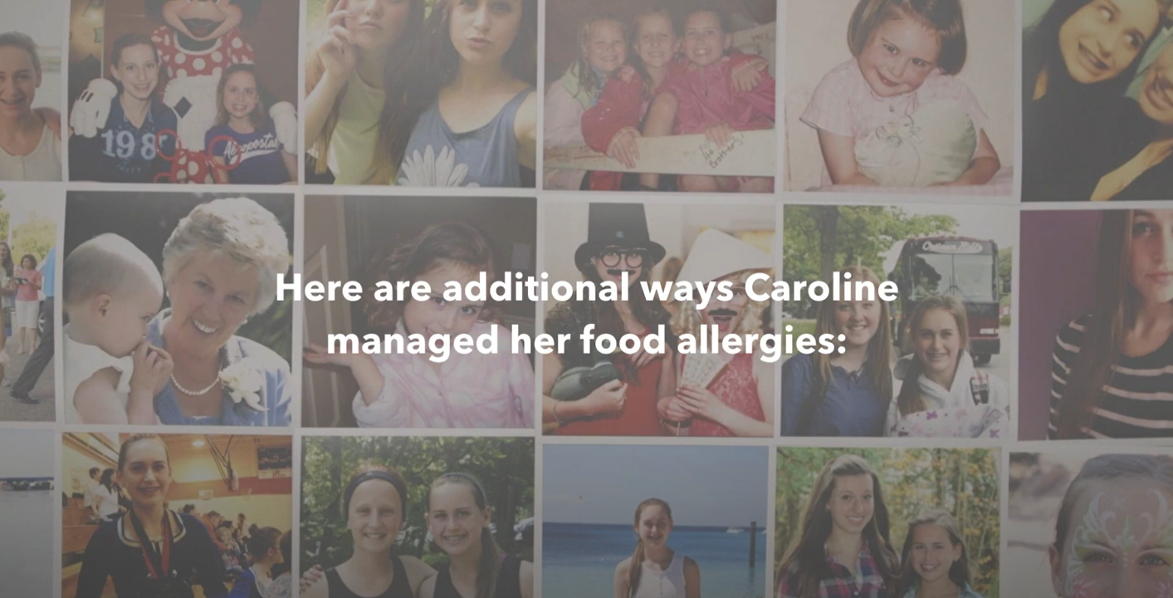
How Caroline managed food allergies
Watch this video to learn how Caroline managed her food allergies and how
others helped.
foodallergycanada.ca/Managing
Notes:
Prompt: Show the video

Slide 35

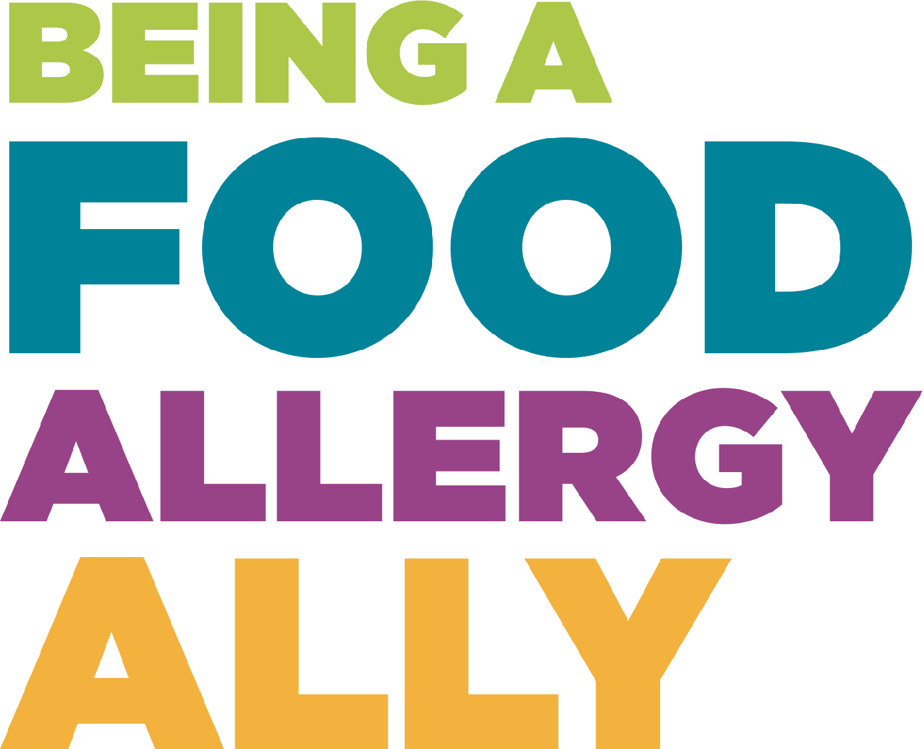
Module 4

Slide 36
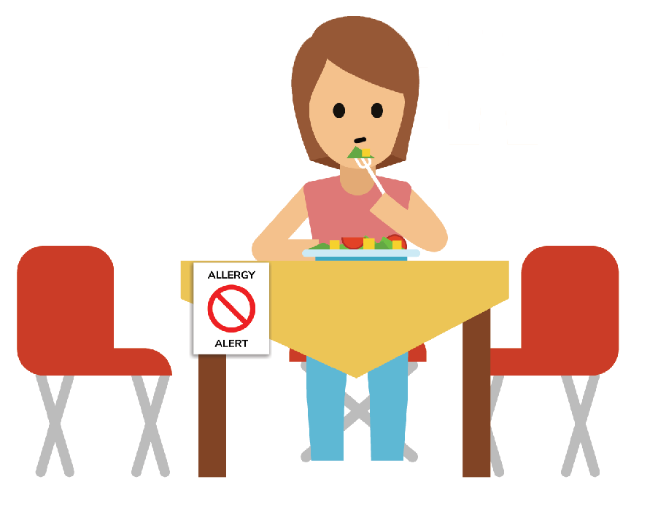
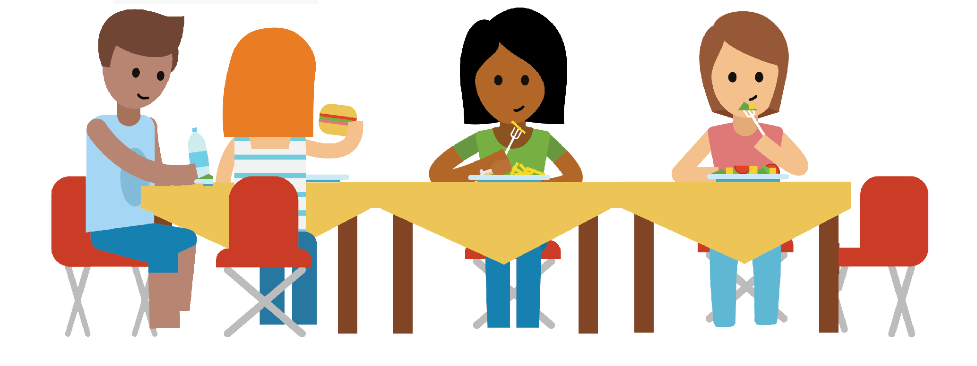
Imagine what it’s like
Imagine you had a food allergy, what do you think of – do you feel worried, scared, indifferent?
How might having a food allergy affect your life? Would it be any different for you at school, at team sports, going out to eat with friends, at birthday parties?

Slide 37
Take a listen
Here’s what kids with food allergy across Canada have said:
The kids on my team are having
a snack, I don’t know if it’s safe for me.
Nobody understands
my food allergy. They think it’s
a choice.
Kate from Ottawa
I’m scared about having an allergic reaction.
I don’t want
to carry my
auto-injector, it makes me feel different.
Everybody
gets to eat the birthday cake except me.
Ryan from Calgary
I’m getting teased about my food allergy.
Mei from Winnipeg
Ann from Moncton
Raj from Toronto
Jayleen from Regina
Notes:
These are thoughts from kids across the country on their feelings or situations they may have experienced.

Slide 38

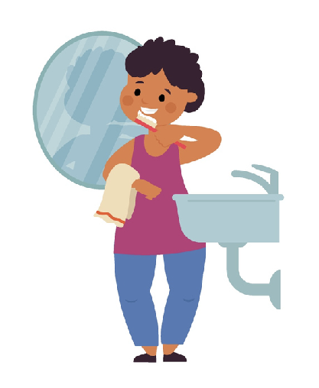

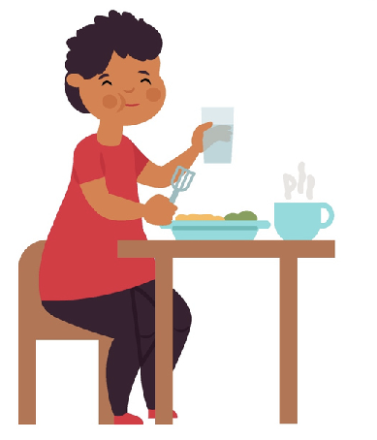

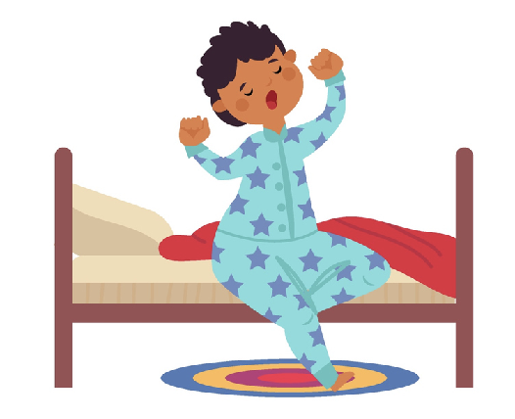



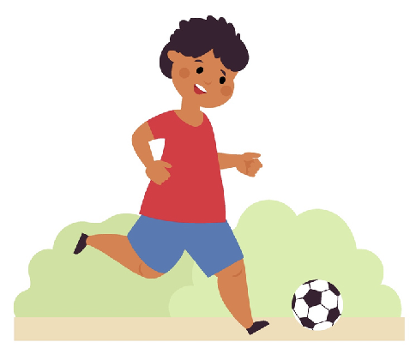
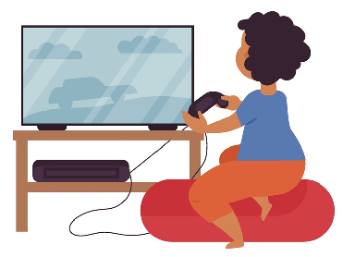
Activity: Walk in my shoes
How do you feel about this day if you don’t have food allergy.
How would you feel about this day if you have a milk, egg,
and peanut allergy?
Pizza lunch
Birthday cupcakes
Soccer snacks
Notes:
Activity prompt: Ask students to imagine a typical school day:
You wake up, get ready, eat breakfast and go to school.
At school, it is pizza lunch day, and a classmate brought in cupcakes for the whole class to celebrate their birthday.
After school, you have a soccer game and the snacks from the coach are homemade cookies.
How would you feel about this day if you don’t have food allergy?
How would you feel about this day if you have a milk, egg, and peanut allergy?

Slide 39
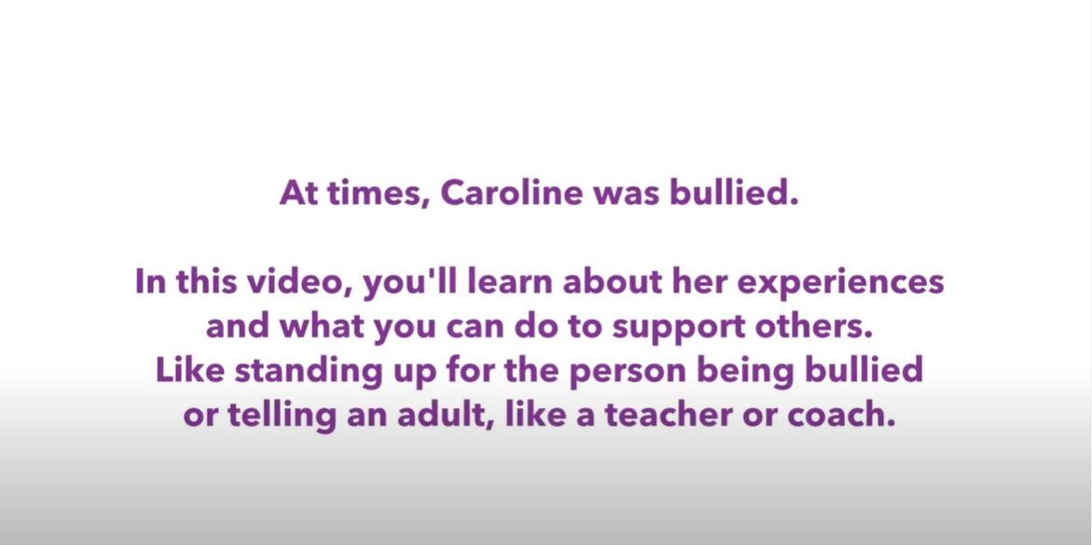
Bullying and food allergy
foodallergycanada.ca/Bullying
Notes:
Prompt: Show the video

Slide 40
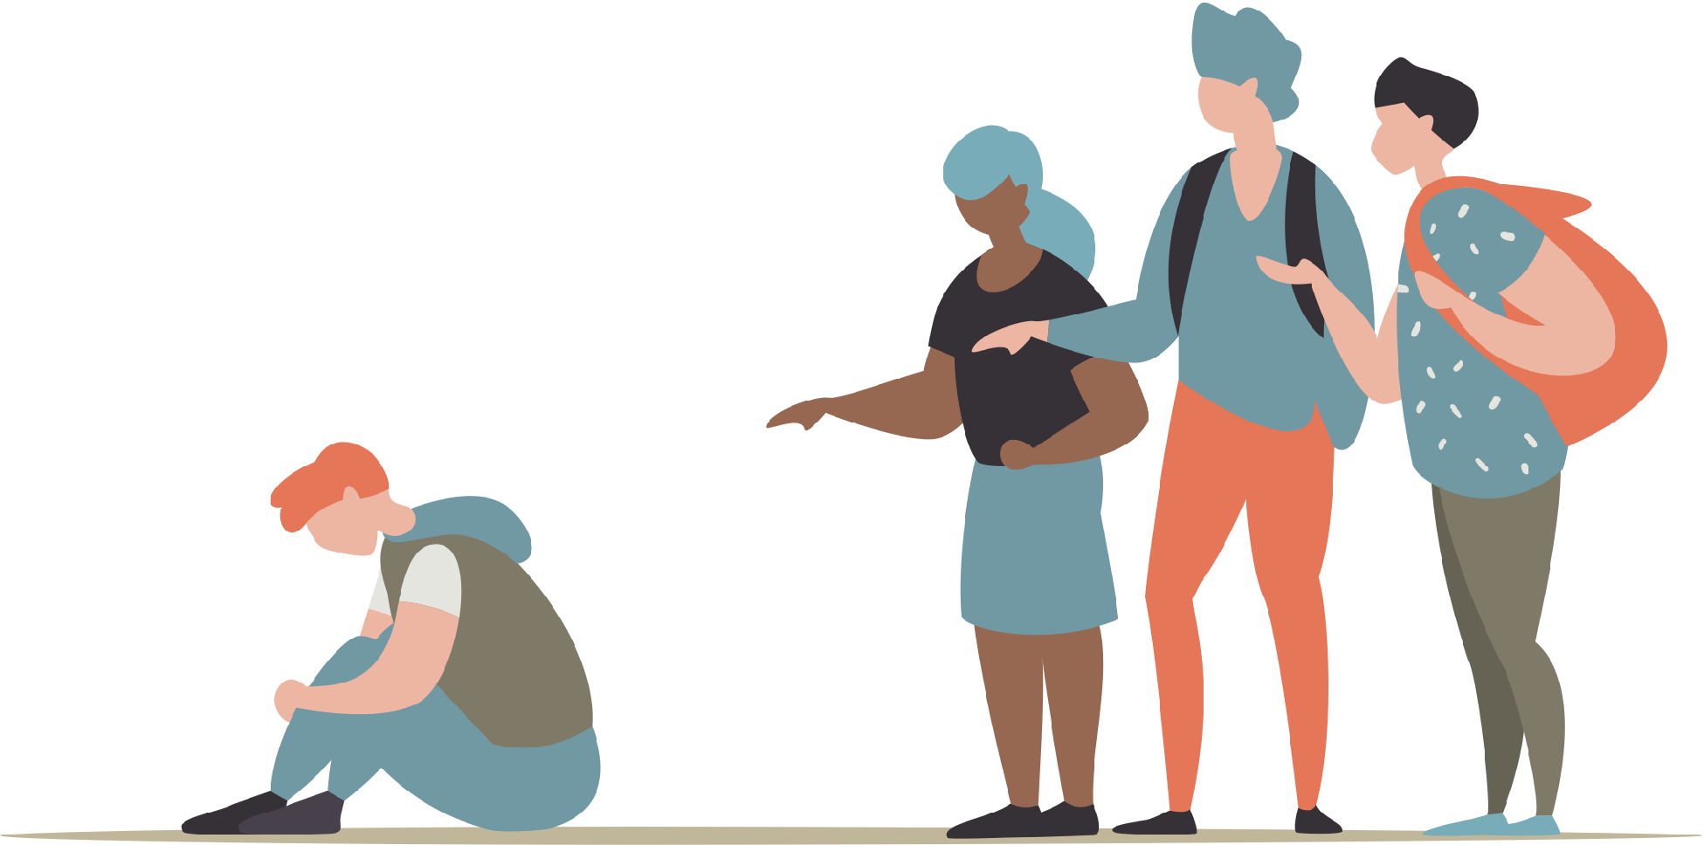
Think about it…
Have you ever experienced unwanted teasing, taunts, or bullying?
Why do you think people tease,
taunt, or bully about food allergies?
What should you do if you
see someone being bullied
because of their food allergy?
?
Did you know? According to research, 1-in-3 children with food
allergy report being bullied, specifically because of their food allergy!
Notes:
Activity prompt: classroom discussion
Note to teacher: Determine how you want students to think about these scenarios. Students can raise hands, or close their eyes and raise hands, or simply stay silent and think, for example. Choose whatever works best for your classroom.
With this topic, ensure that students understand that they are in a safe space. Remind them not to use names if they are describing someone who has bullied them, and to connect with you/teacher if they need to talk about it.
Information to support the discussion from bullyingcanada.ca:
For Victims: Walk away, tell someone you trust – a teacher/coach/guidance counsellor/parent, ask for help, say something complimentary to the bully to distract him/her, stay in groups to avoid confrontation, use humour to throw off or connect with your bully, pretend that the bully isn’t affecting you, keep reminding yourself that you are a good person and are worthy of respect
For Bystanders: Instead of ignoring a bullying incident, try to: Tell a teacher, coach or counsellor, move toward or next to the victim, use your voice – say “stop”, befriend the victim, lead the victim away from the situation
For Bullies: Talk to a teacher or counsellor, think about how you would feel if someone bullied you, consider your victim’s feelings – think before you act

Slide 41
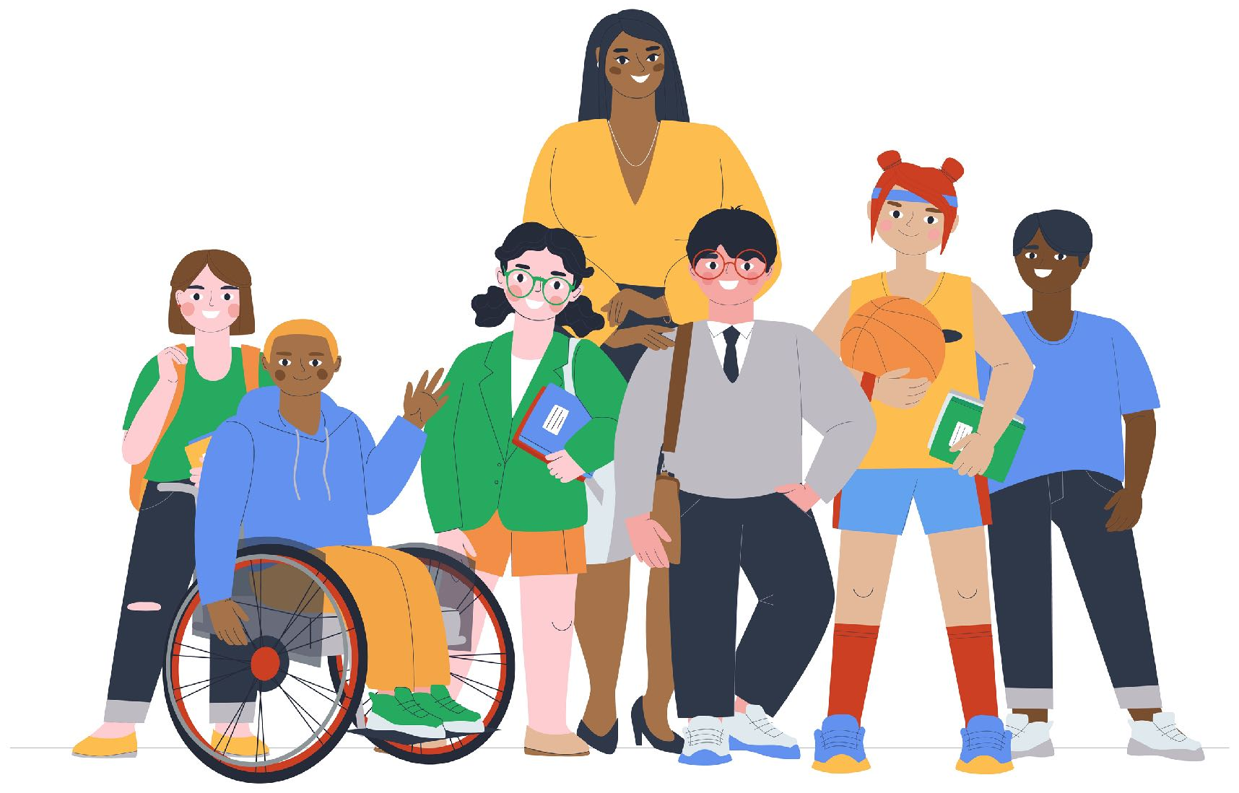
Be a food allergy ally
What does it mean to be an ally?
“A person or group that provides assistance and support to others in an ongoing effort or activity.”
You can help someone with food allergy feel safer, less anxious, and more included!

Slide 42







How to be a food allergy ally
Be inclusive
Reduce risks
Advocate
Be a food allergy ally!
Support
Know
Notes:
Know what food allergies your friends and classmates have, understand that food allergy is a serious medical condition and not a choice.
Reduce risks of someone having an allergic reaction – for example, do not share food, straws, utensils or food containers with them; wash your hands and eating surfaces after eating.
Find ways to be supportive, sometimes just understanding and accepting is all a friend needs.
Be inclusive, just because someone has a food allergy, doesn’t mean they should be excluded by separate lunch tables or from fun events like birthday parties. With precautions in place (like no sharing foods, reducing cross-contamination, and handwashing), everyone can stay safe and have fun.
School days involve food, like lunches and snacks, class and school celebrations as well as math lessons, science experiments and crafts involving food.
Think about what can be done so everyone feels safe and included. For example, what about celebrating with an allergy-friendly food that everyone can eat, or non-food treats like stickers?
Be an advocate – share what you know with others so more people are aware of food allergy and how to help those with them!

Slide 43
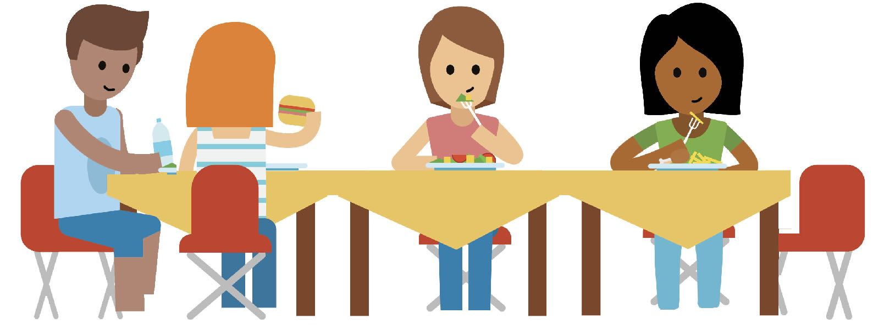
What can you do to help?
What can you do to help change the picture?
from this
Everyone has a seat at the table!
to this

Slide 44


Program developed by:
Endorsed by:
Supporters of this program:

Slide 45


Thanks for learning
about food allergy!
Notes:
The more you understand about food allergy, the better you can support your friends or classmates with one. You can make a difference!
Remember, having a food allergy is not a choice but you can choose to be supportive of your friend/classmate with one.

