Slide 1
All about food allergy
School program for grades 4-6
Notes:
Today, we’re going to spend some time talking about food allergy.

Slide 2
Modules
Module 1: About food allergy
Module 2: About allergic reactions and anaphylaxis
Module 3: Managing food allergy
Module 4: Being a food allergy ally

Slide 3
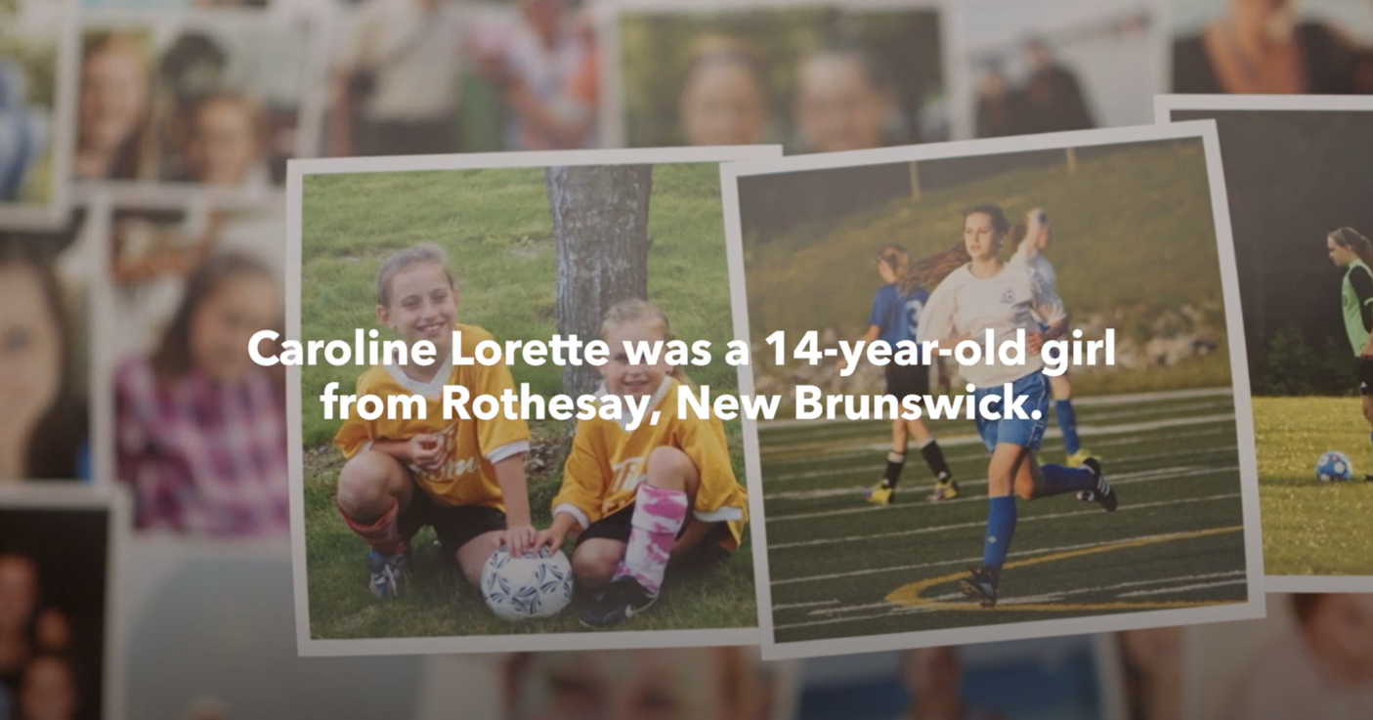
Meet Caroline
Link: https://youtu.be/_WZkdElABGw
Notes:
Prompt: Show the video – the notes below are for the teacher, you don’t need to read them as the video explains all of this.
Caroline Lorette was a sweet, happy girl who lived in New Brunswick.
She loved to play sports, dance, and spend time with her friends and family; she had food allergies too.
At age 14, Caroline passed away because she accidentally ate something that she was allergic to.
Her family wants to make sure everybody knows more about food allergy.
This is a good idea, as people of all ages are living with food allergy. And while fatality is rare, it can happen.

Slide 4
Module 1: About food allergy

Slide 5
Let’s talk about food allergy
Famous Canadians with food allergies:
Alex Tagliani (NASCAR star)
Alexis Lafrenière (NHL player)
Steve Omischl (Olympic freestyle skier)
Joshua Jackson (actor from Dawson’s Creek)
Others you may know!
Ariana Grande (singer/actor)
Serena Williams (tennis star)
Malia Obama (former US president’s daughter)
Kenton Duty (Disney star on “Shake It Up”)
Cree Cicchino (Disney star on “Game Shakers”)
Food allergy affects more than 3 million people in our country (about 500,000 are kids)
And 1-in-2 Canadian households are impacted by food allergy!
Do you know someone with food allergy?
What are they allergic to? What does it mean to have one?
Notes:
Food allergy affects more than 3 million people in Canada, and about 500,000 are kids.
1-in-2 households in Canada are impacted, including teachers and childcare workers, restaurant employees, coaches, parents, and others caring for or working with people with food allergy.
Prompt: Raise your hand if you know someone with a food allergy – it could be a classmate, a friend, someone in your family, a relative, or maybe you have one.
People with food allergies are just like everybody else, they just have to avoid certain foods so they don’t have an allergic reaction.
What is it like living with food allergy and what does it mean to have one?

Slide 6
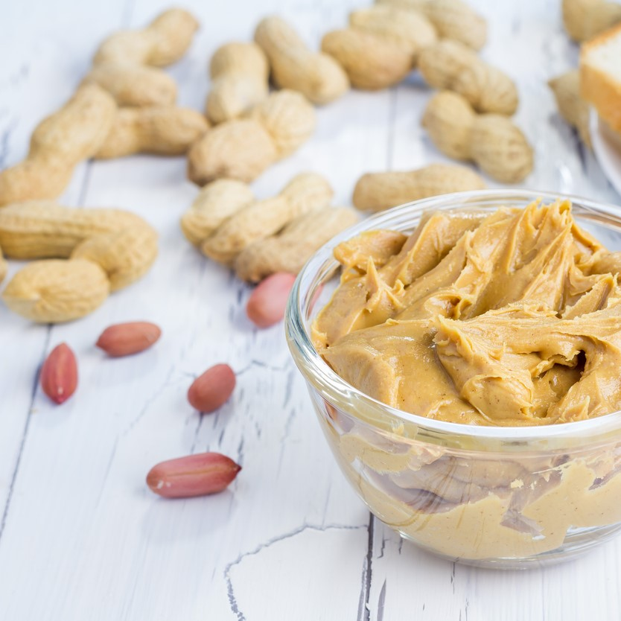
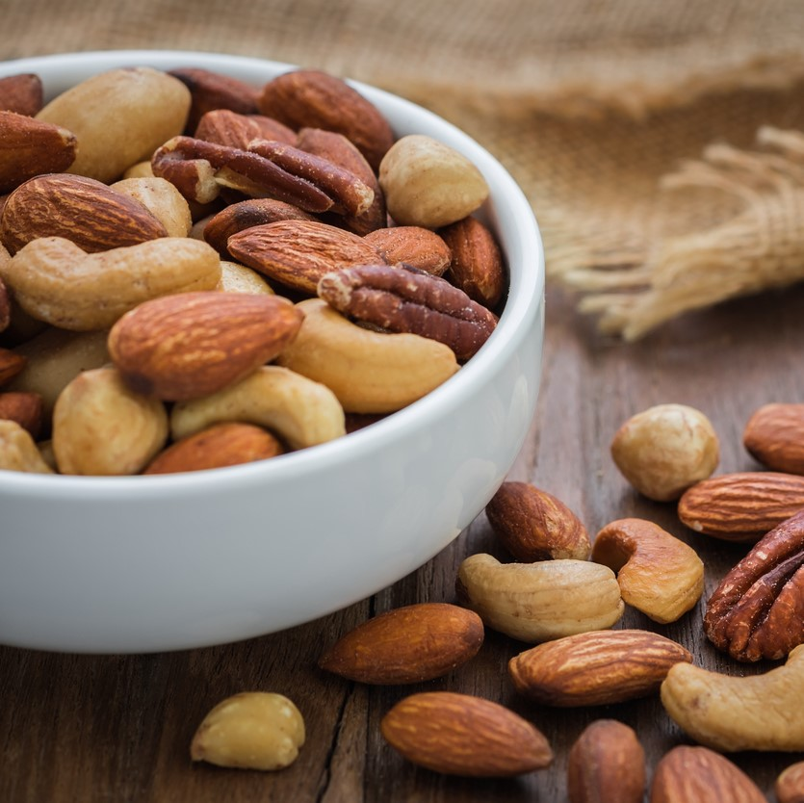
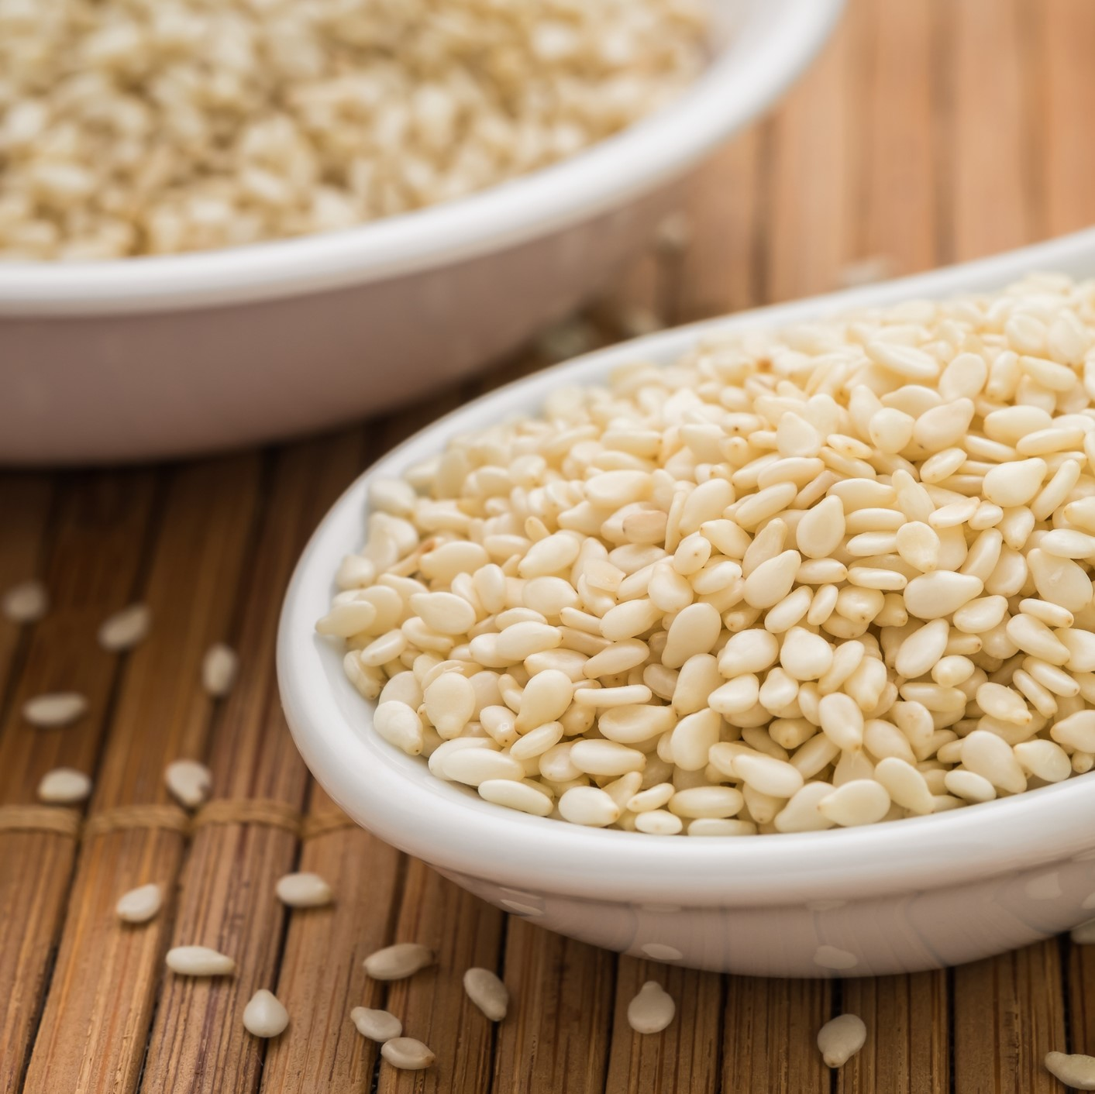
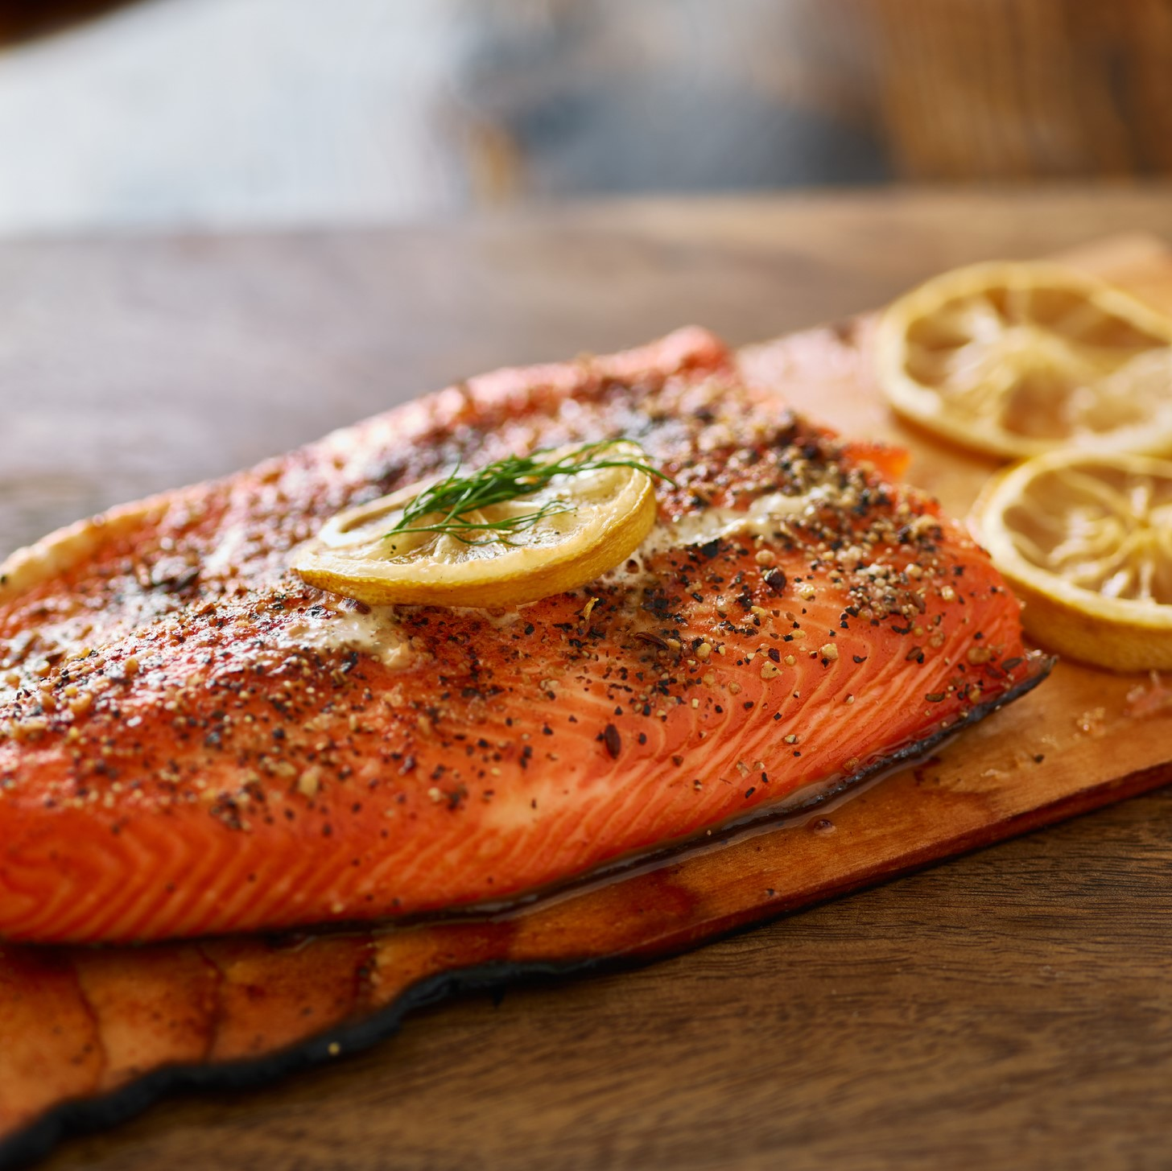
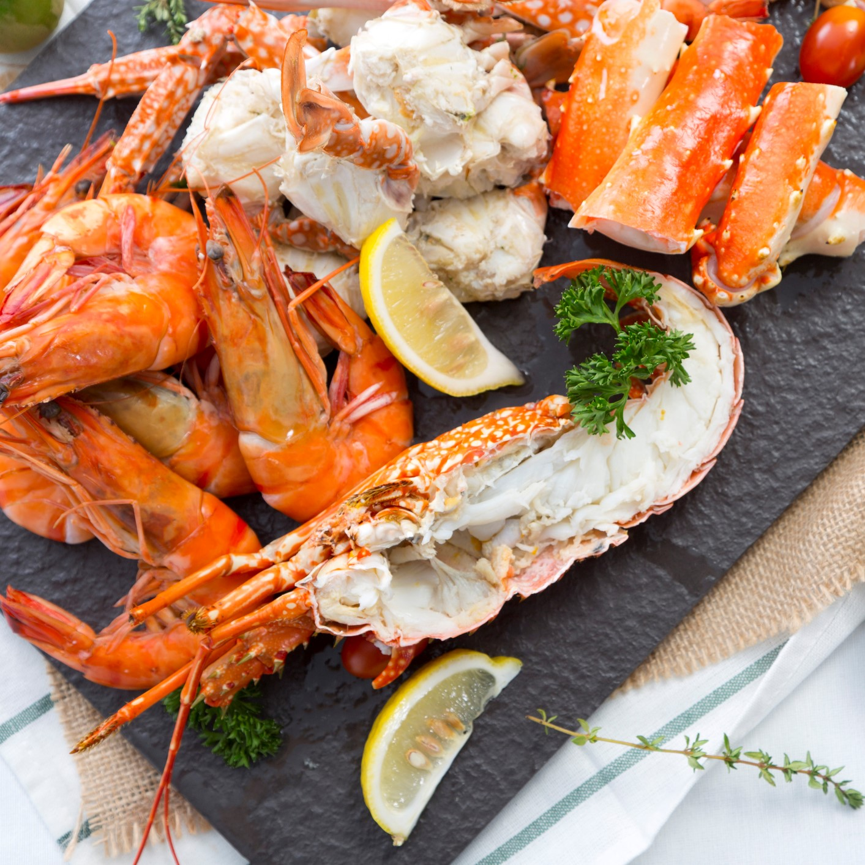
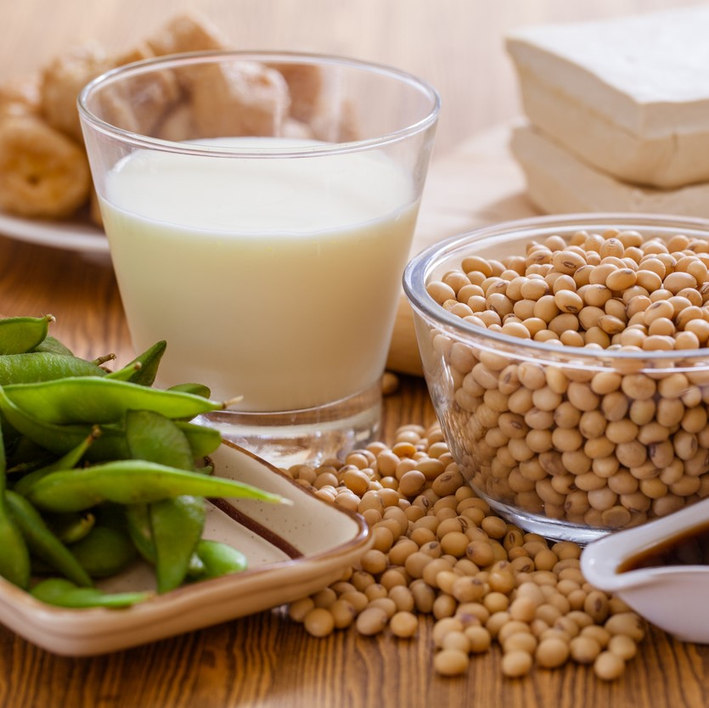
Most common food allergens
Peanut
Tree nuts
Sesame
Milk
Egg
Fish
Crustaceans and Molluscs (shellfish)
Soy
Wheat and Triticale
Mustard
Notes:
Note to teacher: The food allergens appear one by one, click to reveal them.
These are the most common food allergens in our country: peanut, tree nuts, sesame, milk, egg, fish, crustaceans (like lobster, shrimp) and molluscs (like scallops, clams), soy, wheat and triticale, and mustard.
Health Canada refers to them as “priority food allergens” and there are rules around how they are labelled on a product.
For example, if a pre-packaged product like a box of cereal or a can of soup has one of these priority allergens as an ingredient, the priority allergen must be clearly labelled.
It is not true that only certain foods cause an allergic reaction. Certain foods cause the majority of allergic reactions, however, almost any food can cause a reaction. And you can be allergic to more than one food.

Slide 7
Caroline’s food allergies
Peanut
Tree nuts
Crustaceans and Molluscs (shellfish)
Milk
Egg
Caroline had multiple food allergies, meaning she was allergic to more than one food.

Slide 8
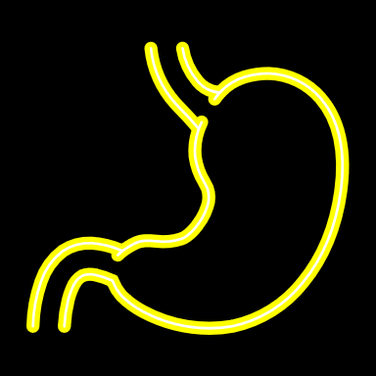
Food allergy vs food intolerance
Your body can react to a food in different ways.
Food allergy involves your immune system
Food intolerance more commonly involves your digestive system
These are not the same.
Notes:
Before we talk more about food allergy, do you know the difference between food allergy and food intolerance?
These are often confused, but they are different ways that your body can react to a food.
Food allergy involves your immune system, which is your body’s defense system and people with food allergy are at risk of having a severe allergic reaction.
It’s not the same as food intolerance which more commonly involves your digestive system, the system that helps your body get the nutrients and energy from the food you eat.
For example, you may know someone with lactose intolerance – this means they’re unable to fully digest lactose, a sugar found in dairy products like milk, cheese and yogurt.
People with food intolerances are not at risk of having a severe allergic reaction, however, they may also manage their intolerance by avoiding certain foods.

Slide 9
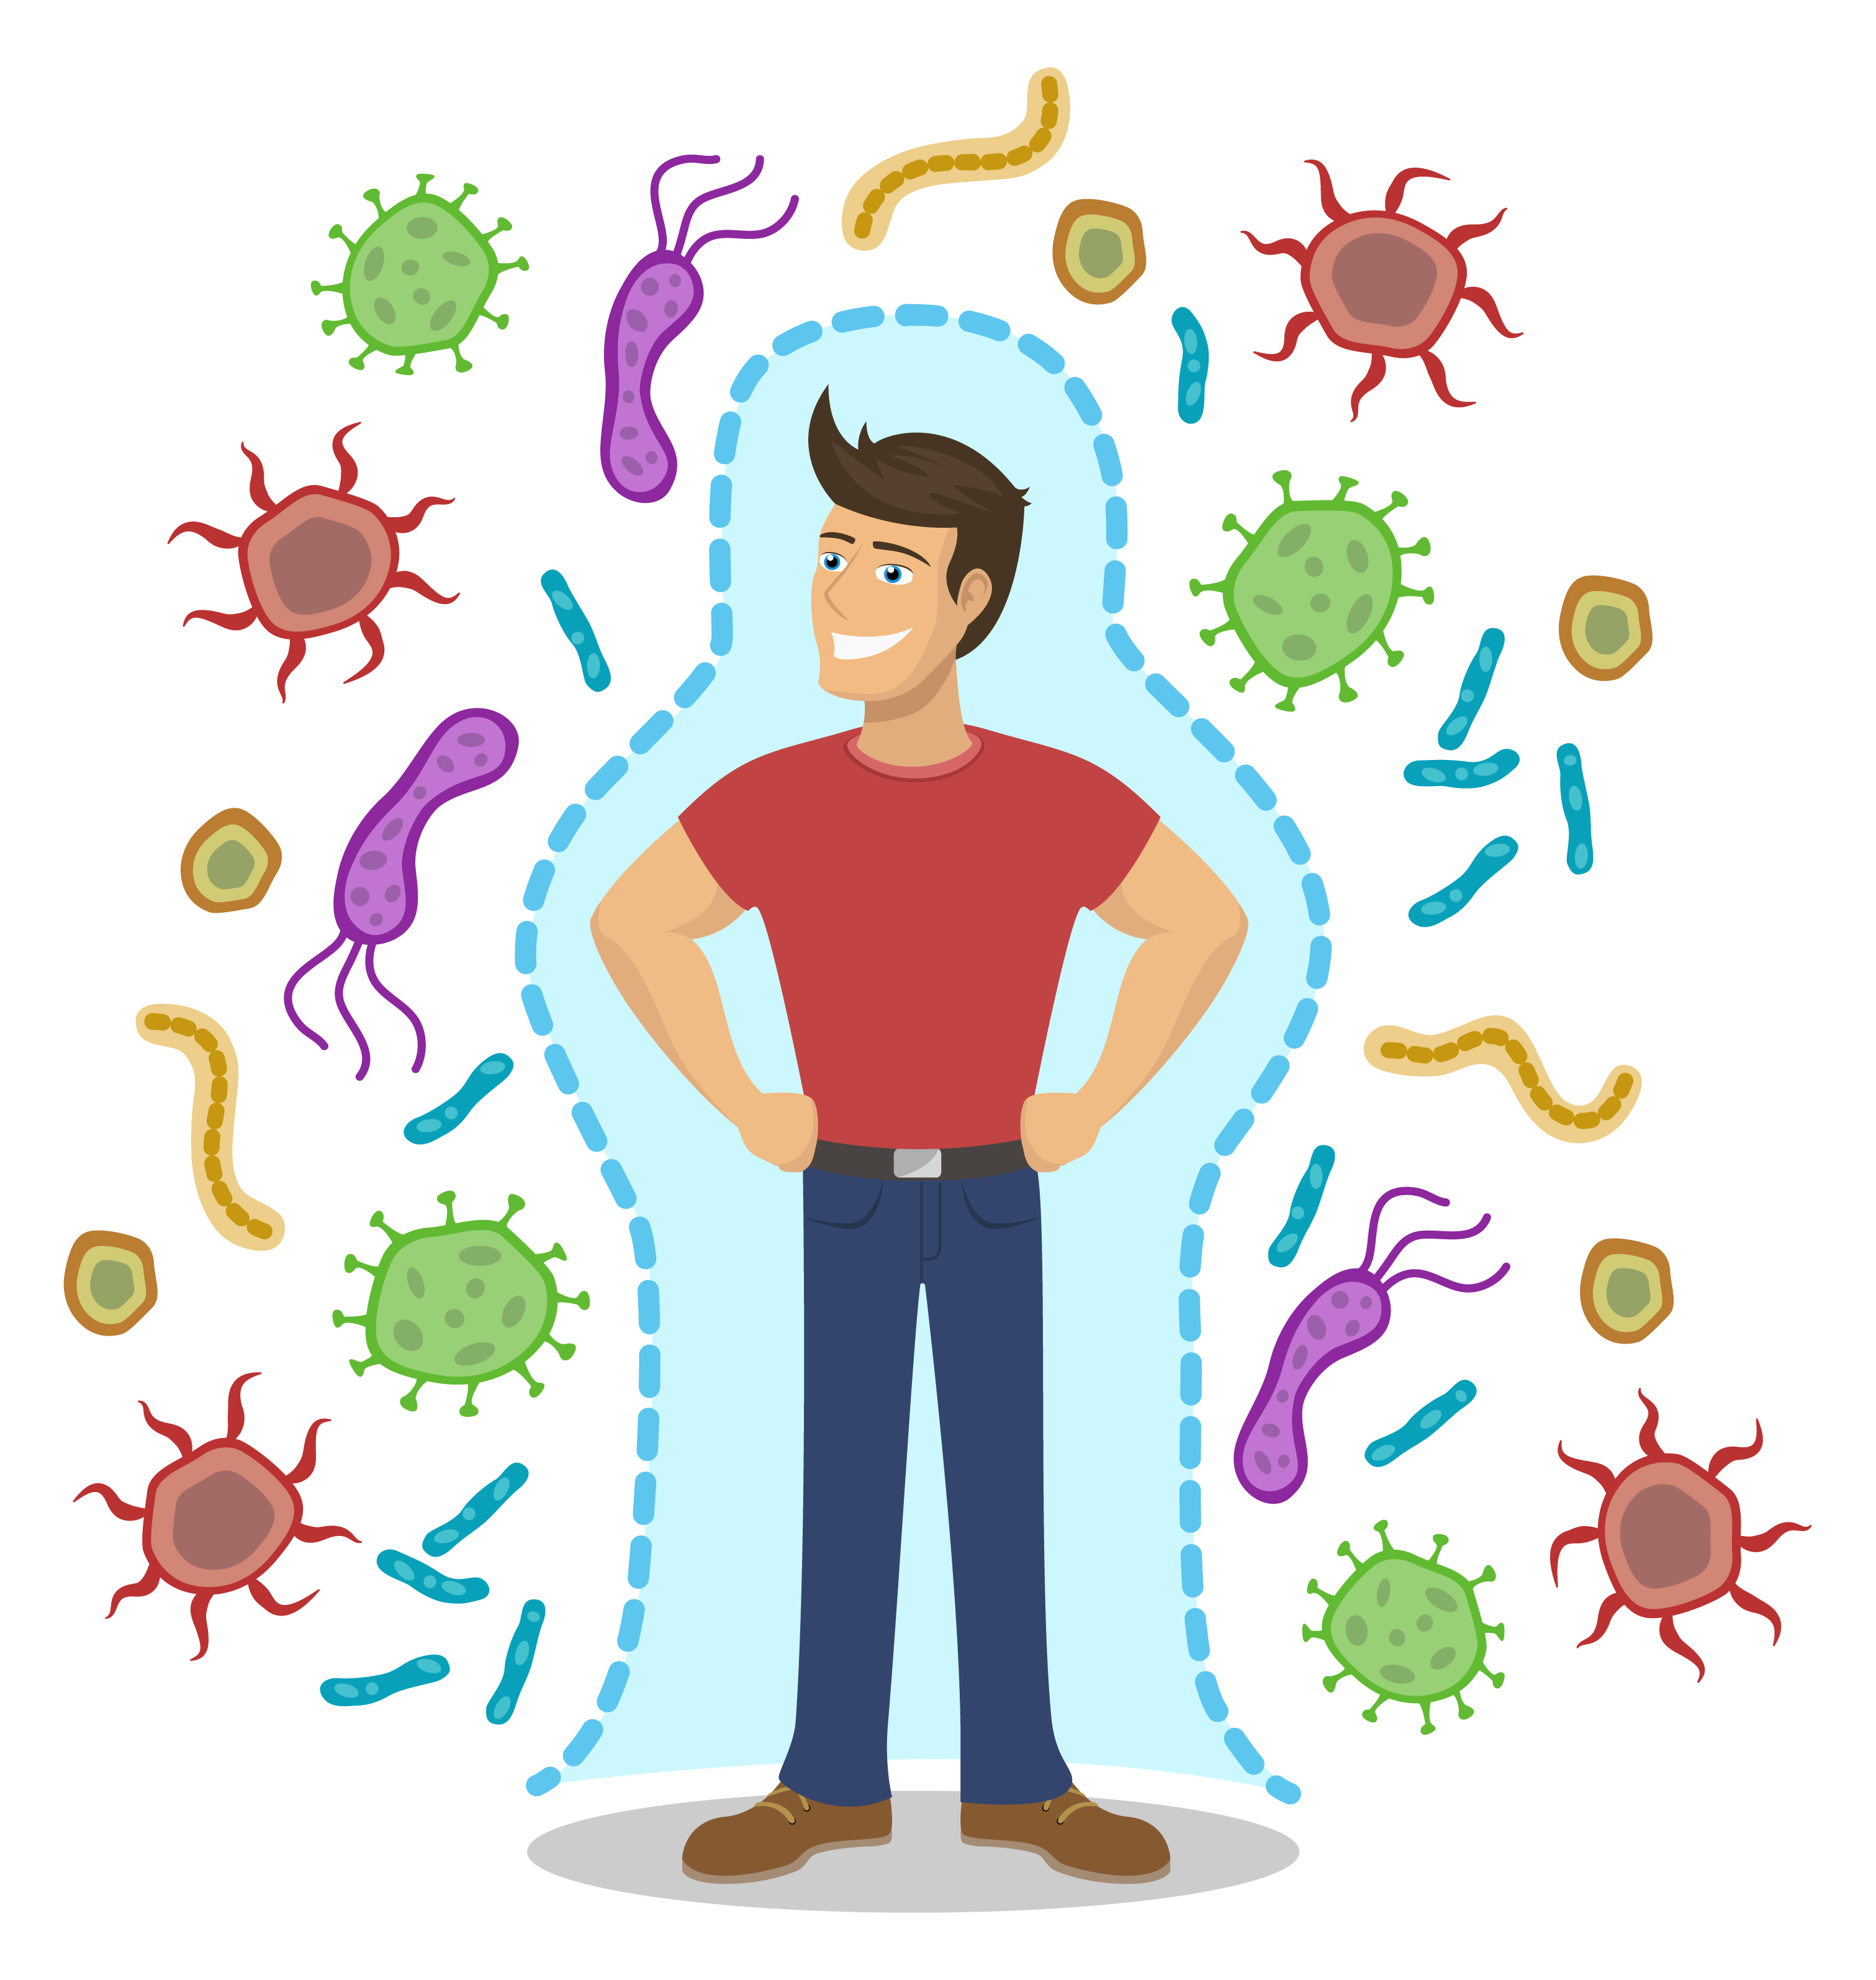
Your immune system
To be immune means to be protected
Immune system = cells, tissues and organs working together to help protect you against invaders that seem harmful
Notes:
To be immune means to be protected against something.
Your body’s immune system is amazing!
It’s made up of different cells, tissues and organs that work together to help protect against invaders that seem harmful, like bacteria and parasites.

Slide 10
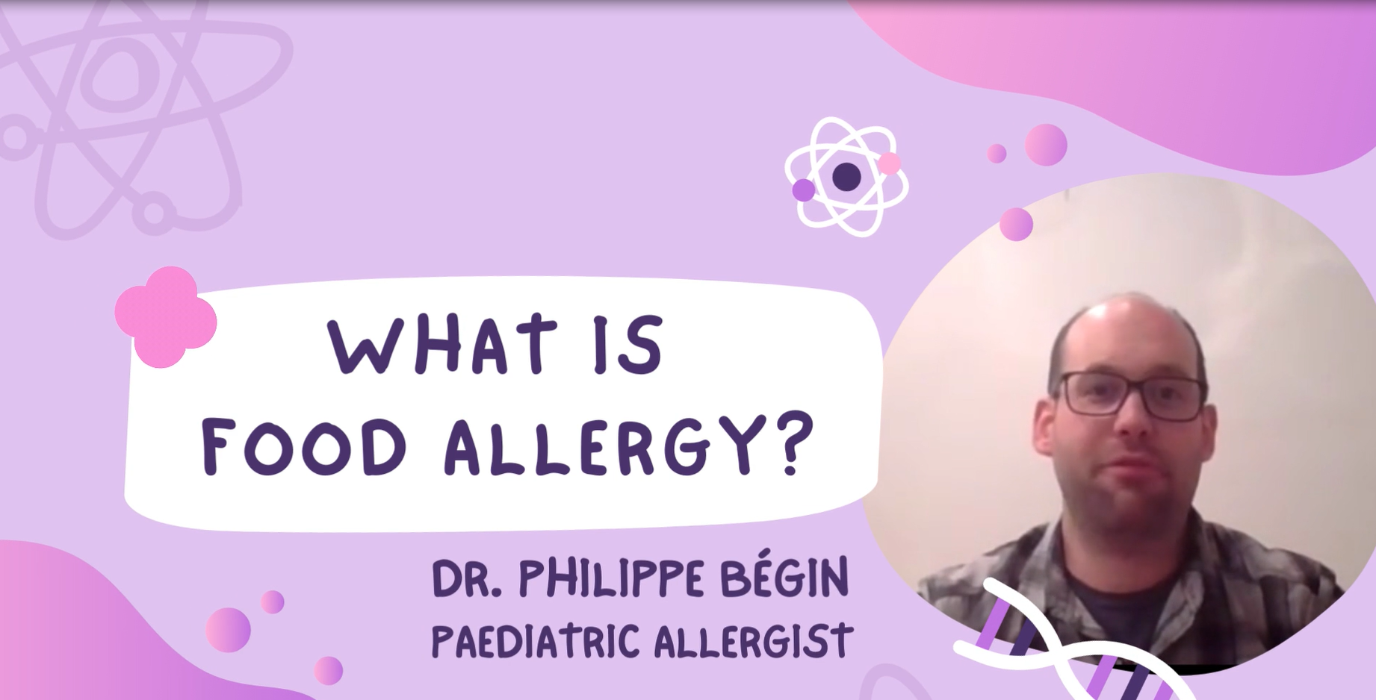
Watch the video
Link: https://youtu.be/JrfGgeoddjI
Notes:
Prompt: Show the video

Slide 11
How IgE antibodies work
The immune system thinks a food is dangerous
The body makes IgE antibodies to protect itself
This leads to symptoms of an allergic reaction
IgE causes mast cells to release chemicals
Notes:
The video you watched explains how your immune system acts when you have a food allergy.
When your body is trying to protect itself from a food it thinks is dangerous, it makes antibodies called Immunoglobulin E or IgE.
This is where the mast cells that you’ve learned about come into play.
The IgE antibodies cause the mast cells to release chemicals (like histamine) into the bloodstream to defend against the food that’s causing the problem.
And this is what leads to the symptoms of an allergic reaction.

Slide 12
Module 2: About allergic reactions and anaphylaxis

Slide 13
When an allergic reaction happens
You can have different symptoms
Symptoms can range from mild to severe (anaphylaxis)
Severe allergic reactions need to be treated.
Notes:
When you accidentally eat something you’re allergic to, or a food that’s been contaminated with a food you are allergic to, you may experience an allergic reaction.
You might have mild symptoms, like a little bit of itching, or more severe symptoms such as trouble breathing or feeling like you’re going to faint.
Severe allergic reactions can be dangerous, so they always need to be treated quickly.
Is it okay for someone to eat a little bit of their food allergen? If you have a food allergy, it’s not okay to eat even a small amount as it can cause an allergic reaction. You should always assume it’s not okay unless your allergist or doctor tells you it is.

Slide 14
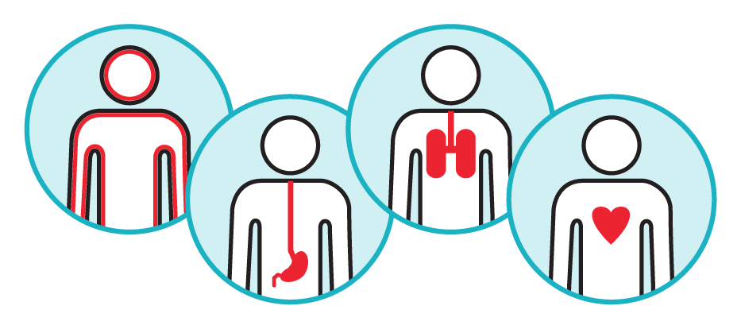
What is anaphylaxis?
The most serious type of allergic reaction
Can affect different parts of the body
Can happen quickly
Can be life-threatening
Anaphylaxis is a medical emergency.
Notes:
Anaphylaxis is the most serious type of allergic reaction, it can:
affect different parts of the body like the lungs, stomach, and heart
take place quickly – within minutes and sometimes it takes longer – within a few hours of eating a food
be very dangerous, even life-threatening
For all these reasons, anaphylaxis is considered a medical emergency.

Slide 15
Can smelling a food cause a reaction?
No! The smell of a food alone does not cause an allergic reaction
Food odour does not contain protein – which is what causes an allergic reaction
If someone smells the food they are allergic to, like peanut butter, it may make them feel anxious or uncomfortable.
Notes:
Did you know the smell of a food alone does not cause an allergic reaction? Reactions are caused by specific food proteins.
Since food smells or odours do not contain protein, they cannot cause allergic reactions.
However, if someone smells the food they are allergic to, it may make them feel very anxious or uncomfortable.
Note to teacher: Smelling a food odour is not the same as inhaling airbourne proteins. In some cases, the inhalation of airbourne proteins can cause allergic reactions. For example, proteins can be transferred in the vapour or steam of sizzling fish or shellfish. Usually these reactions are mild, but sometimes people have had severe reactions.

Slide 16
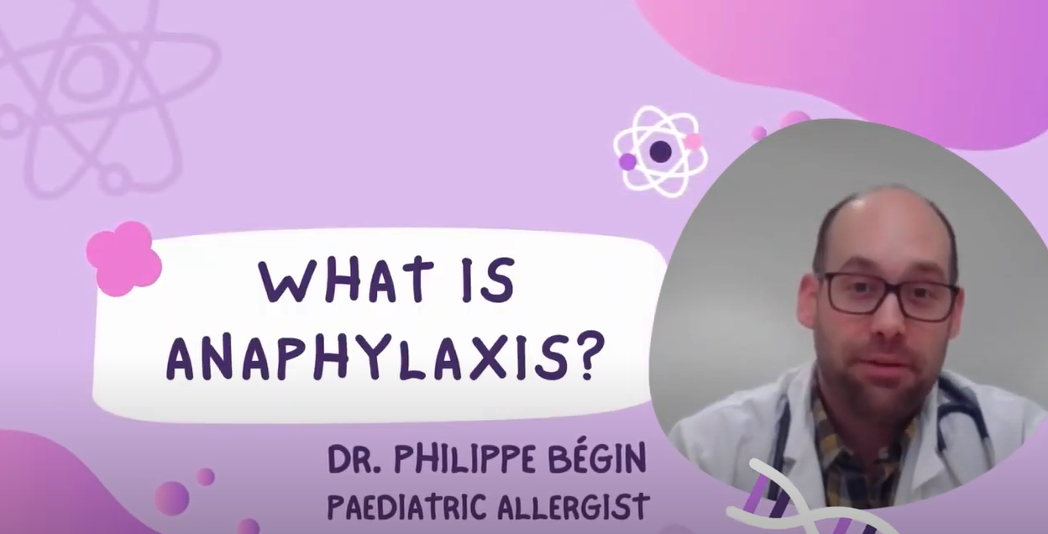
Watch the video
Link: https://youtu.be/jEUTdUwph7w
Notes:
Prompt: Show the video

Slide 17
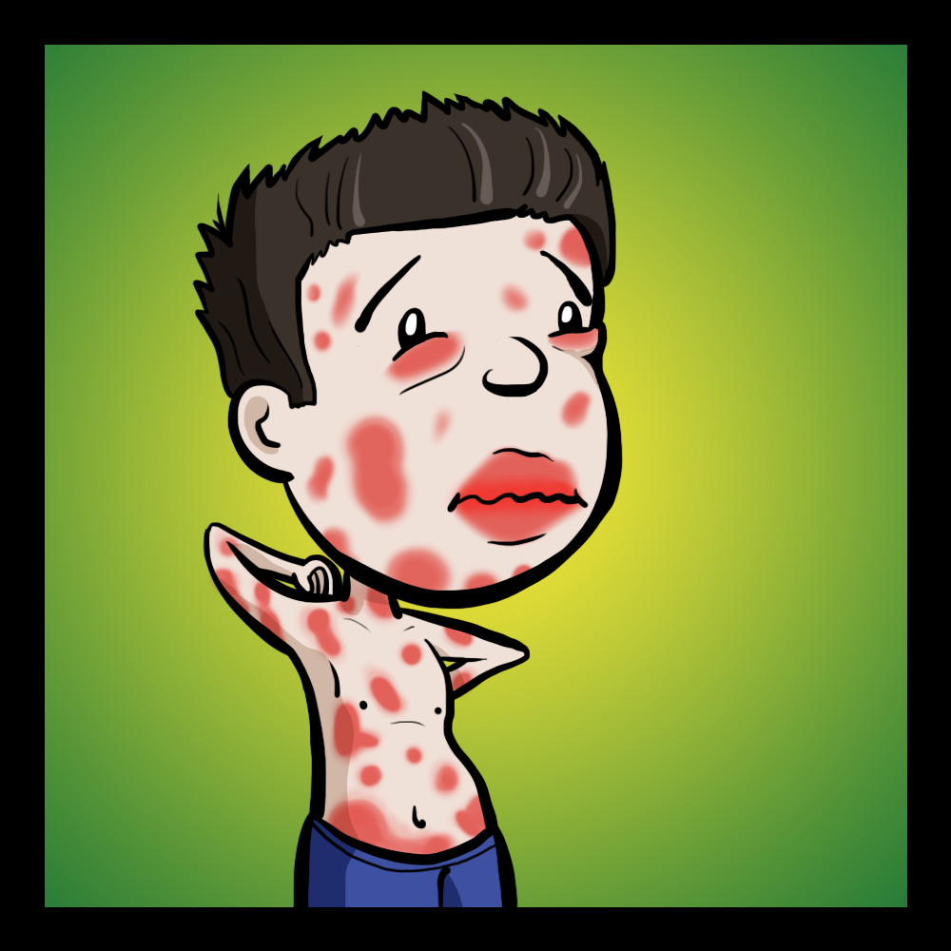
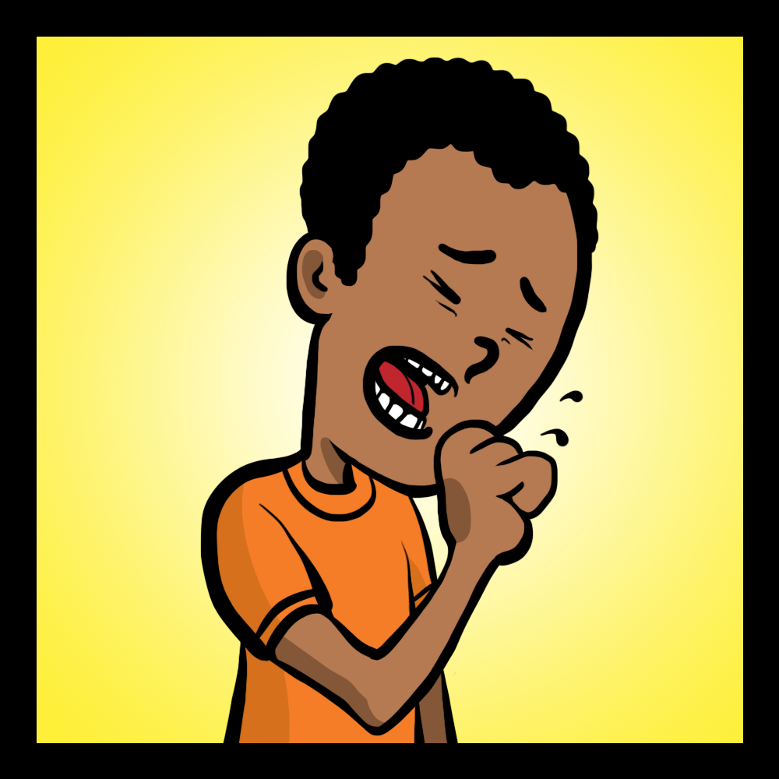
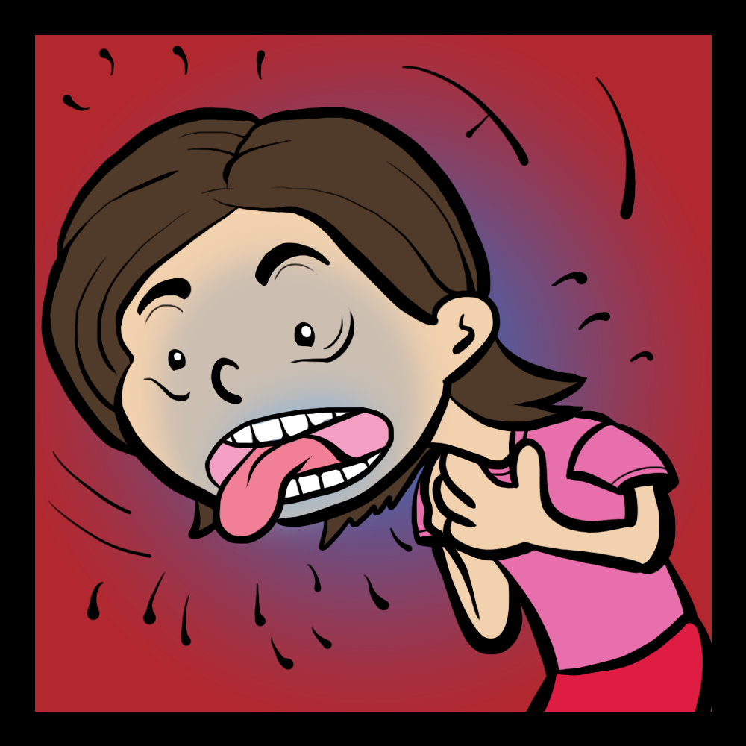
Signs and symptoms
Images courtesy of Kids’ CAP
Skin: hives, swelling, itching, warmth, redness
Breathing: coughing, wheezing,
shortness of breath, chest pain or tightness, throat tightness, hoarse voice, nasal congestion or hay fever-like symptoms, (runny, itchy nose and watery eyes, sneezing), trouble swallowing, choking feeling
Stomach: nausea,
pain or cramps,
vomiting, diarrhea
Heart: paler than normal skin colour/ blue colour, weak
pulse, passing out, dizziness or
lightheadedness
Did you know?
Hives don’t always appear during anaphylactic reactions.
Breathing or heart symptoms alone can be anaphylaxis.
Notes:
You can have different signs and symptoms with anaphylaxis.
Symptoms generally include two or more body systems: skin, breathing, stomach and heart. Breathing or heart symptoms alone can be anaphylaxis.
With anaphylaxis, your skin may be swollen or red, it may feel itchy or warm, or there may be lots of hives on your body. Hives look like red bumpy spots.
If your breathing system is affected, you may cough, wheeze (a whistling sound when you breathe), or feel like you cannot breathe. You may feel tightness or a pain in your chest. Your throat may feel tight or you may have trouble swallowing, or your voice may sound different.
If your stomach system is affected, you may feel sick to your stomach or nauseous or have stomach pain or cramps.
If your heart system is affected, your skin colour may look paler than normal or look “blue”, or you may feel lightheaded or dizzy.

Slide 18
Treating anaphylaxis
Epinephrine is the best medicine to treat anaphylaxis – and should be used right away, don’t delay!
It reverses the symptoms of a reaction
Do not use antihistamines like Benadryl® instead of epinephrine
Epinephrine is the medicine form of the hormone adrenaline made by your body.
Notes:
A medicine called epinephrine is the best one to treat anaphylaxis.
It is the medicine form of the hormone adrenaline, which is made by your body and released when you are faced with an exciting or stressful situation.
Adrenaline helps to protect you by increasing your heart rate and giving you a boost of energy.
Epinephrine helps your body respond by reversing the symptoms of an allergic reaction.

Slide 19
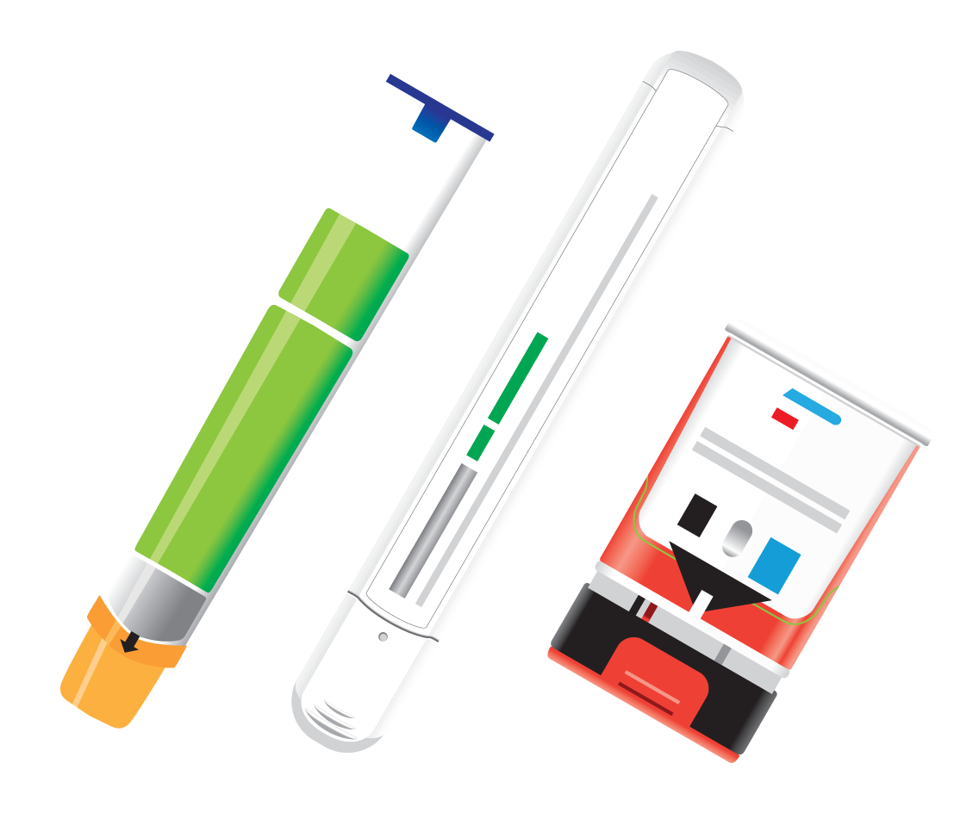
Epinephrine auto-injector
Device that contains epinephrine
Anyone can use them
They are safe to use
Must go to hospital afterwards
Did you know?
There are 3 epinephrine auto-injectors available in Canada
Notes:
An epinephrine auto-injector is a hand-held device that contains a dose of epinephrine.
It’s designed to be given by anyone, including people who are not medically trained.
Epinephrine is safe to use. Even if you’re unsure about a reaction, the best choice is to use the epinephrine auto-injector.
After someone receives epinephrine, they need to go to the hospital to get checked out for their reaction (not because epinephrine was used).

Slide 20
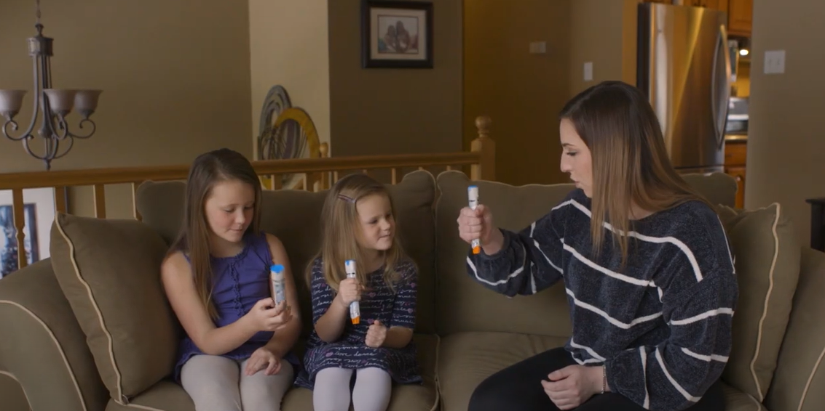
Let’s practice: watch this video
Link: https://youtu.be/dlSXzb1dDL4
Notes:
Prompt: Show the video

Slide 21
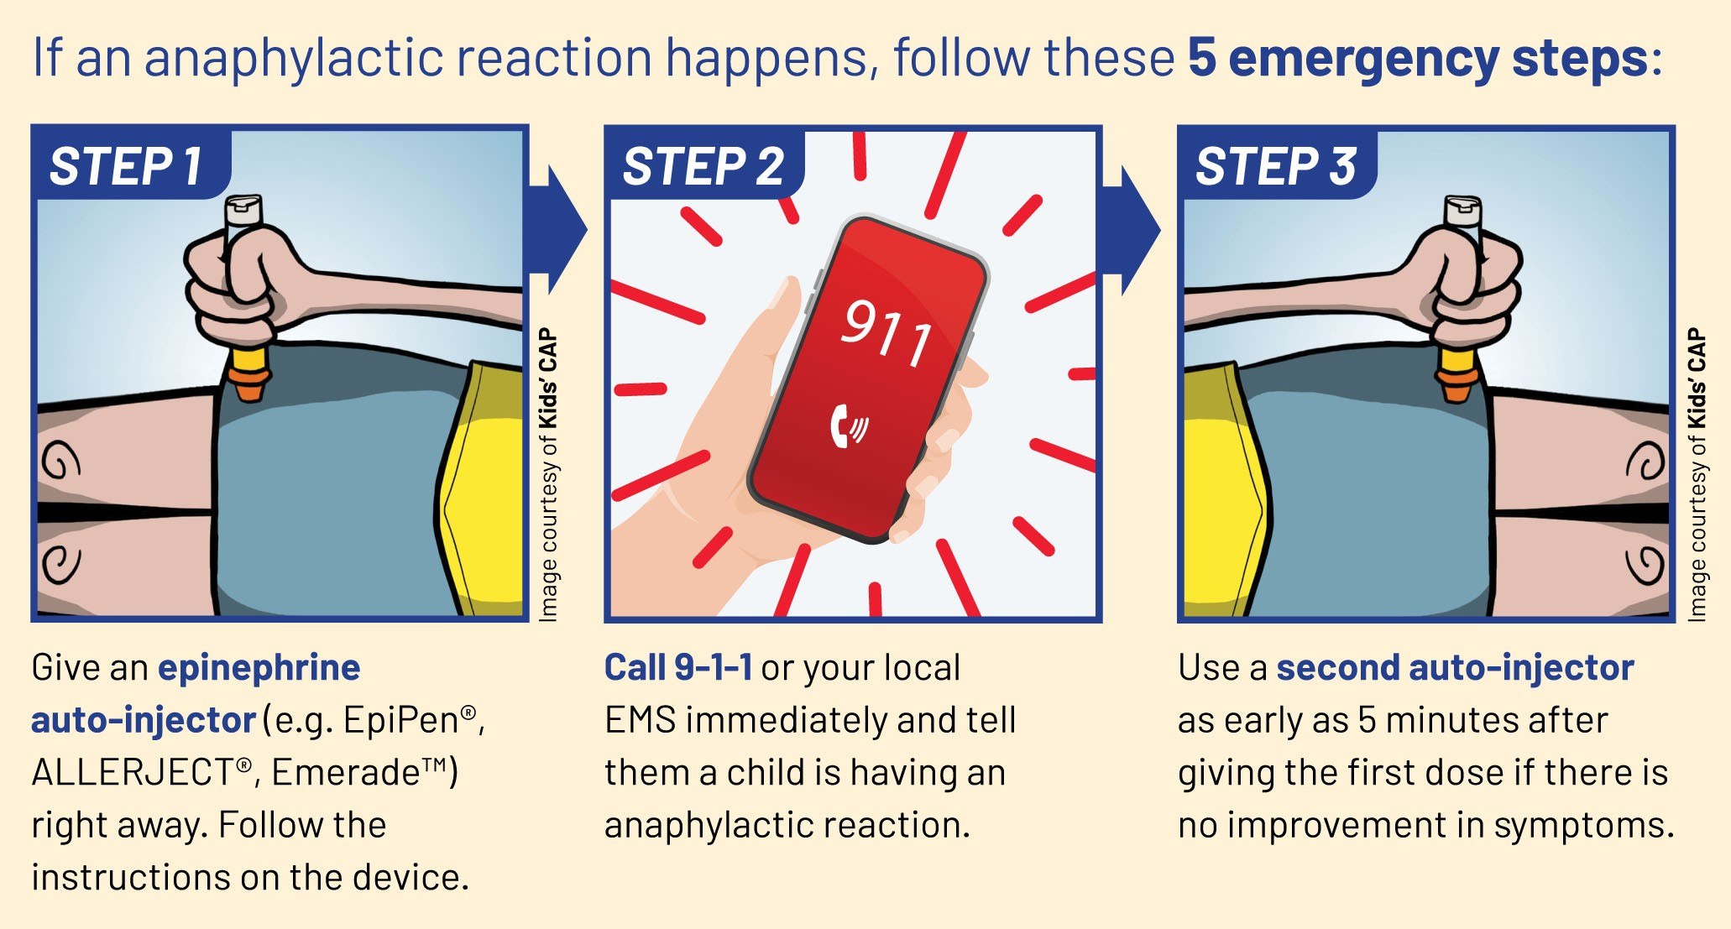
5 steps for treating anaphylaxis
Notes:
While one person is using an epinephrine auto-injector, another person can be calling 9-1-1.

Slide 22
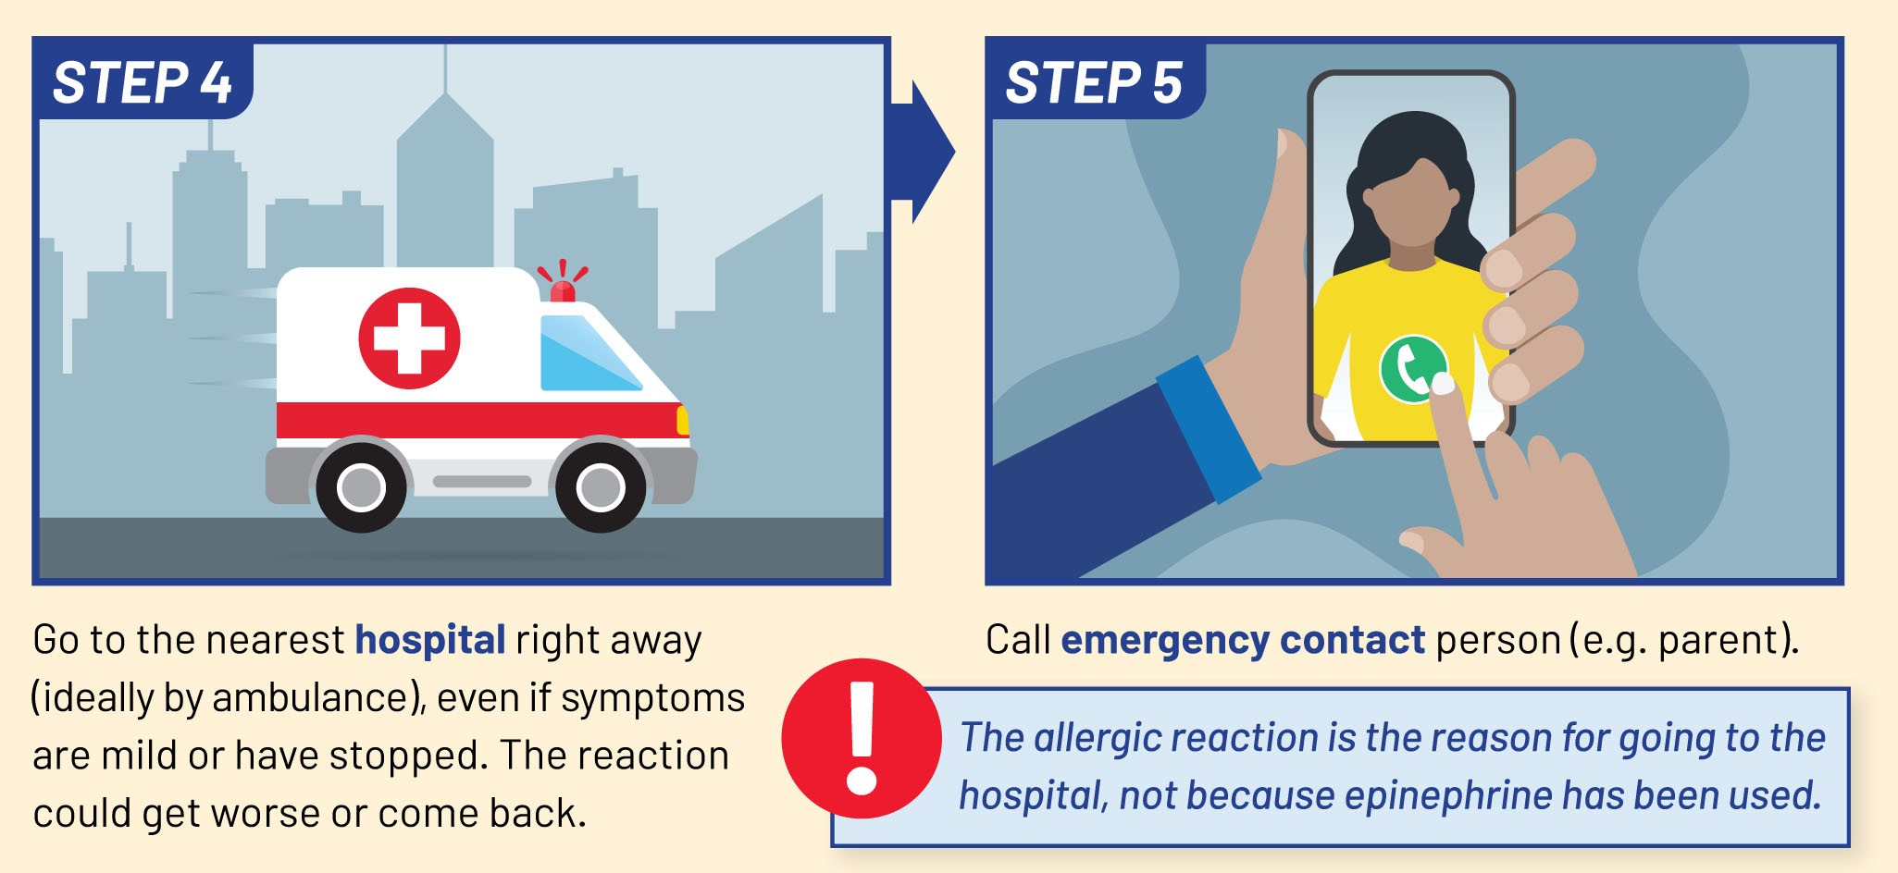
5 steps for treating anaphylaxis
Notes:
It’s important to go to the hospital after receiving epinephrine.
There is a chance of a second reaction or symptoms that may not have completely gone away. Sometimes more epinephrine or other medicine is needed.
The allergic reaction is the reason for going to the hospital, not because epinephrine has been used.

Slide 23
Module 3: Managing food allergy

Slide 24
How does someone manage food allergy?
Avoid eating what they are allergic to
Knowing what is in their food
Being careful when making food
Properly washing hands and cleaning up after eating
Notes:
To help prevent a reaction, a person needs to avoid consuming what they are allergic to.
They can do this by knowing the ingredients in the food they plan to eat and drink.
Other safety steps are important, like being careful when making food, washing hands well before and after eating, and cleaning up after eating.

Slide 25
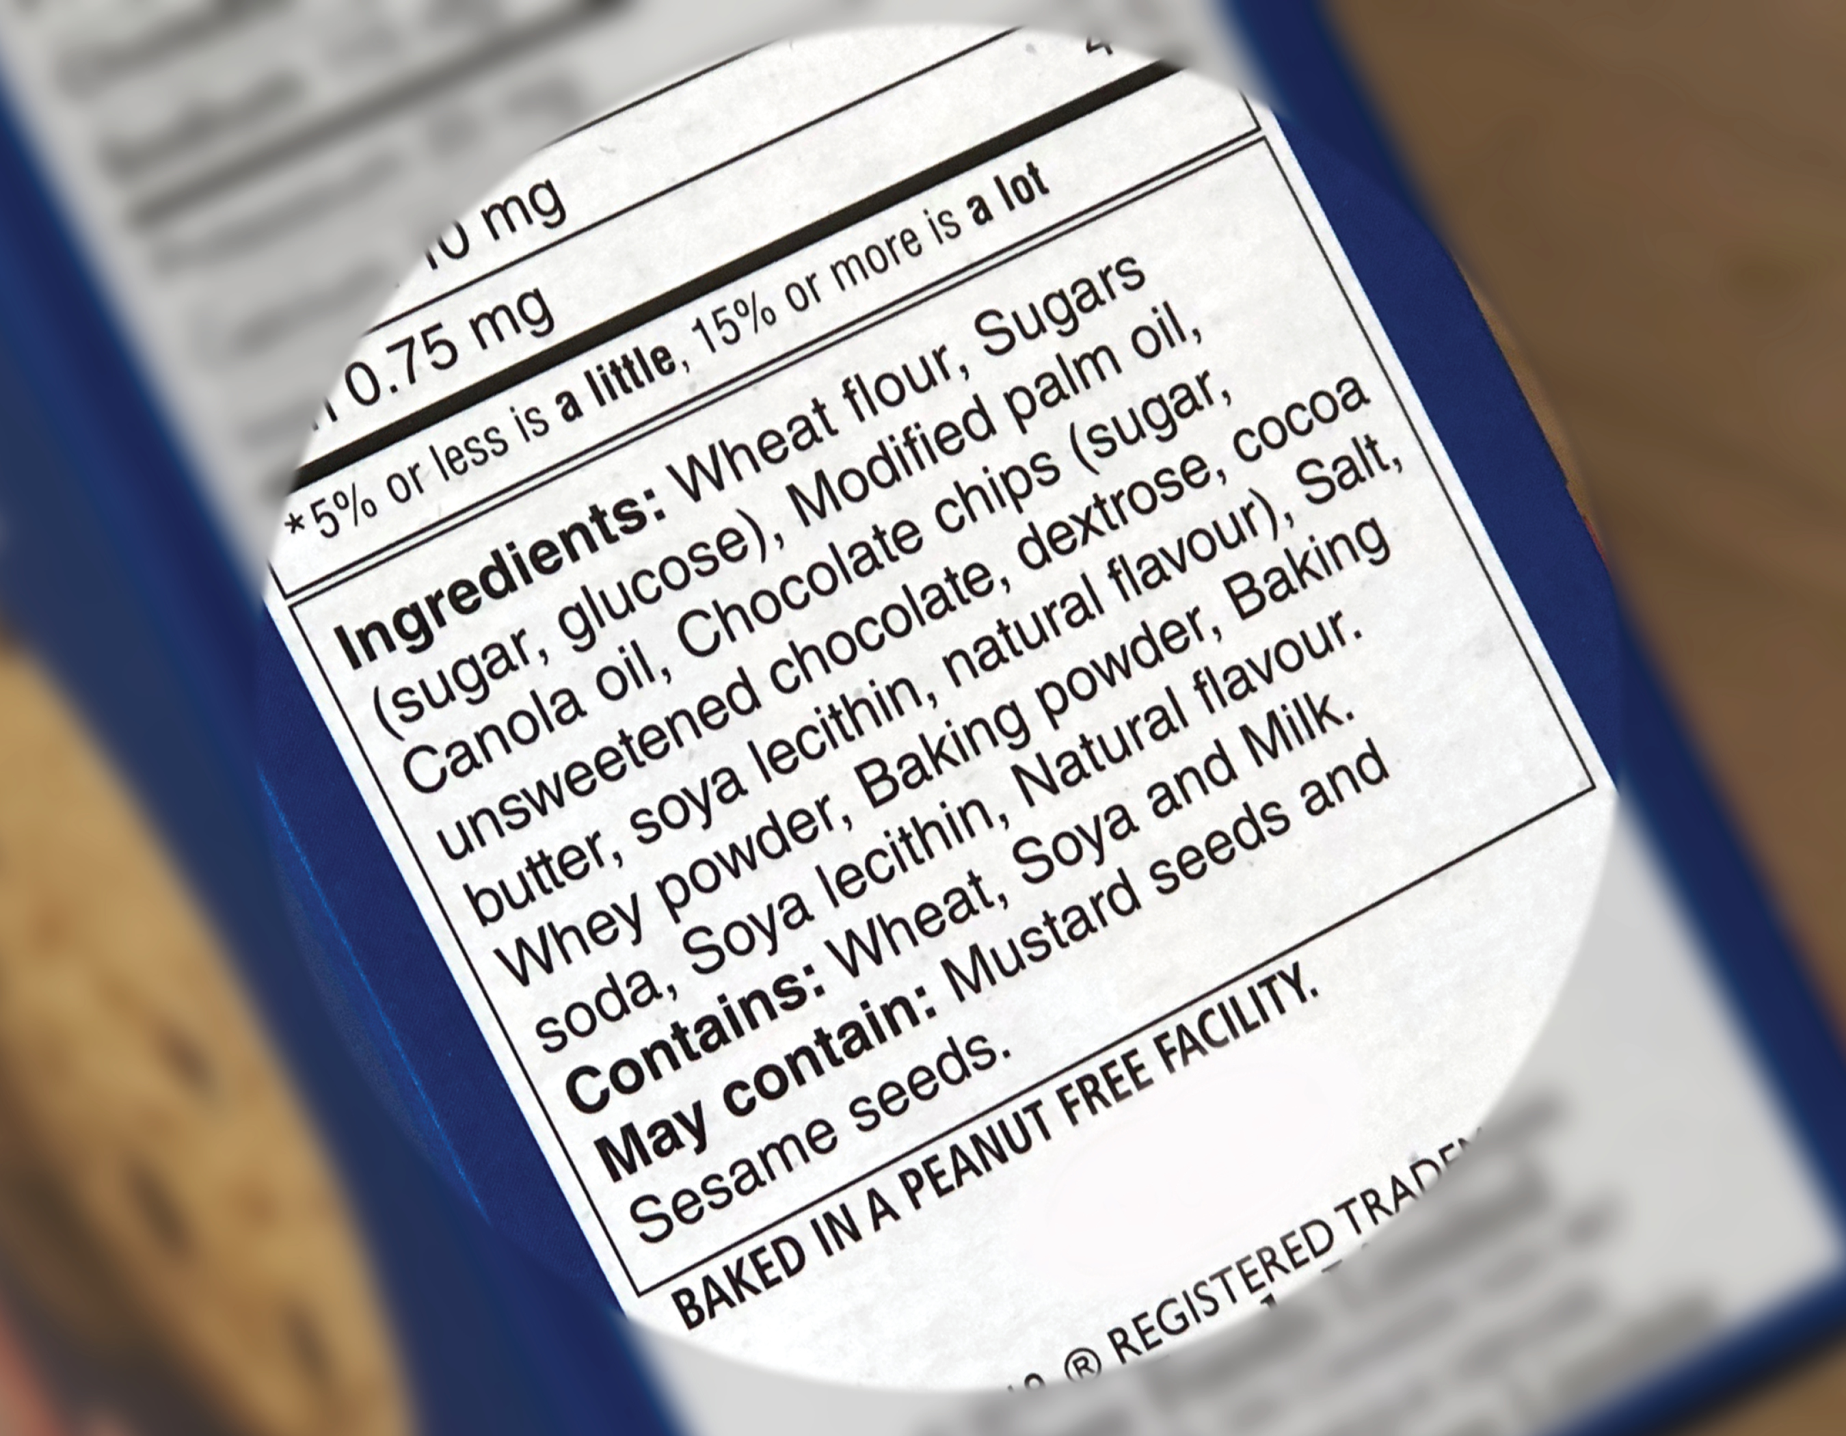
Know what is in the food you eat
Read food labels to understand ingredients
Food labels are on packages of food that list out the ingredients in that food – it is not the same thing as the nutrition label
People with food allergy should avoid foods that “contain” and “may contain” what they are allergic to.
Notes:
When you have a food allergy, you can’t just look at a food and decide if it’s safe to eat, it’s necessary to check labels.
Reading food labels is an important part of managing your allergy day-to-day.
Pictured: this is an example of labels you will find on many pre-packaged foods, and you can see the ingredient list, a “contains” statement, and a “may contain” statement.
Priority food allergens, like milk, have to be called out and worded in a way that’s easy to understand.
It helps that Canada has good allergen labelling rules, making it easier to avoid allergens.
If you have a food allergy, it’s best to avoid eating products that “may contain” your allergen. There’s a chance that you can have an allergic reaction.

Slide 26
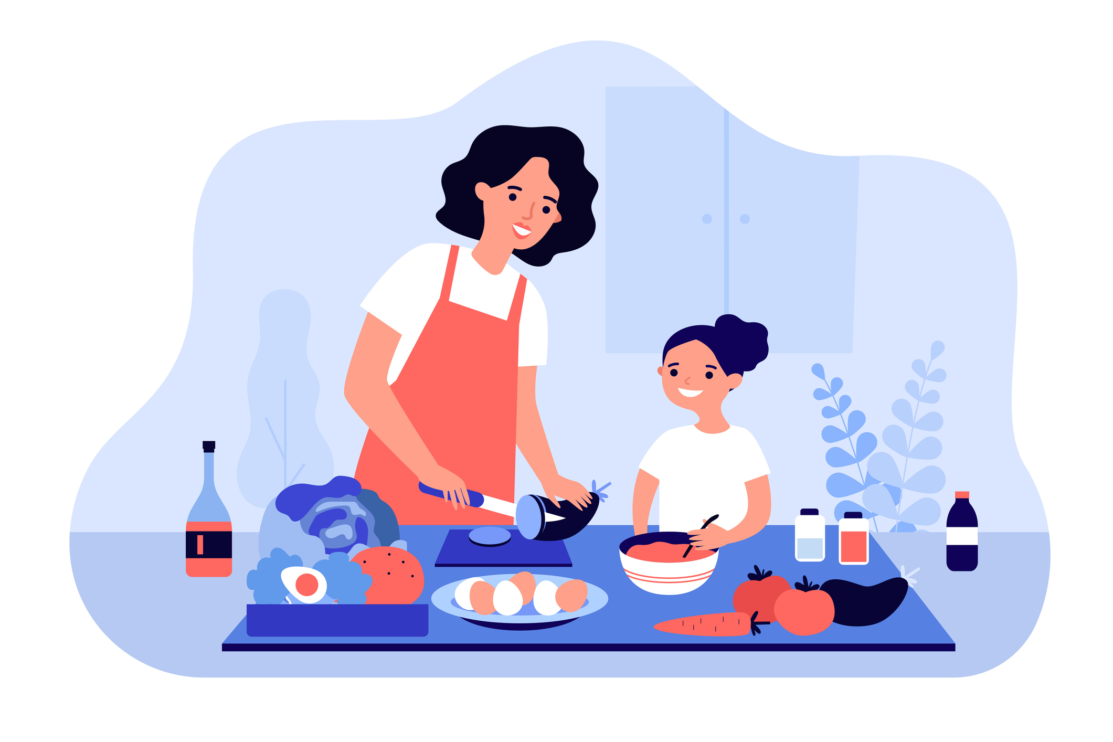
When making food
Reduce cross-contamination when making or serving food
It can happen when a food allergen accidentally gets into another food, onto a surface, or in saliva
allergen = the food your body thinks is dangerous and reacts to
Notes:
Have you heard the word “cross-contamination” before?
It can happen when a food allergen accidentally gets into another food, onto a surface or object, or even in saliva.
For example, if a knife used for cream cheese is put into a jar of jam, the jam is no longer safe for someone with a milk allergy to eat. It has been “contaminated” by the cream cheese which has milk as an ingredient.
Another example is using the same serving tong to serve fish from one dish and then vegetables from another dish. The vegetable dish would be cross-contaminated by the fish, and unsafe for someone with a fish allergy.
Whether you are making food on your own, or with a parent or your family, you need to be aware of cross-contamination and what you can do to help reduce the risk of it.

Slide 27
Know what is in the food you eat
Ask questions about ingredients and how food is prepared when eating out or when someone else is making food
What are the ingredients?
Did you wash your hands?
Is this food safe for someone with a food allergy?
How was the food made?
Did you clean
the surfaces you used to make
the food?
Did you use separate utensils?
Notes:
Besides reading labels, you also need to ask questions about the ingredients in a meal or snack and how it has been prepared, to know if it’s a safe option.
Ask if the allergen is in the list of ingredients.
Asking how the food was made is important as cross-contamination can happen when the same equipment or utensils (like spoons and knives) are used. For example, French fries may be made in the same fryer to deep-fry fish or shrimp, a knife that has been used to slice pizza with anchovies (fish) may also be used to cut a cheese pizza, or burgers and buns may be flipped on the grill using the same spatula.

Slide 28
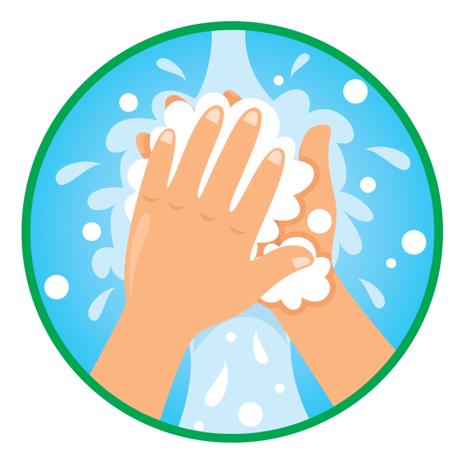
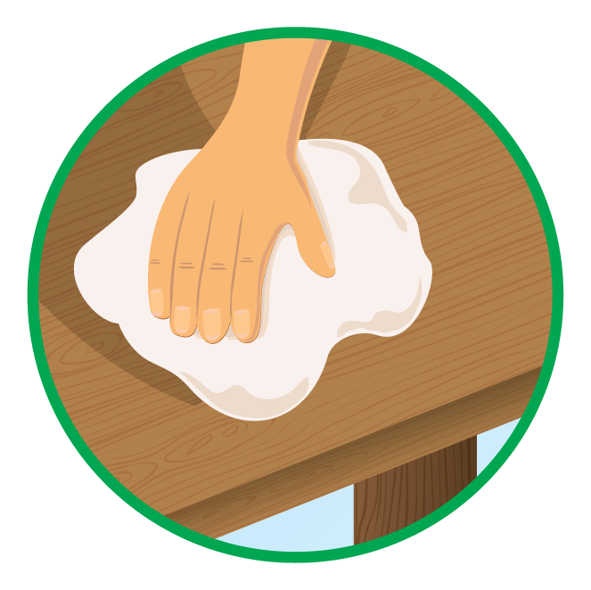
Wash hands and clean up
Wash your hands with soap before and after eating
Clean up after yourself after eating
Notes:
To help reduce the risk, wash your hands before and after eating.
After eating, you can also help by cleaning up after yourself.
Know that food crumbs can get on your hands, but also on desks, trays, and even on our faces.
Proper handwashing and cleaning are both important ways to help prevent cross-contamination.
Did you know that hand sanitizer does not effectively remove allergens, washing hands with soap and water is best.

Slide 29
Be ready for a reaction
Be able to recognize the symptoms of a reaction
Know how to use an epinephrine auto-injector
Ask for help from an adult as needed
Notes:
Severe allergic reactions can happen despite best efforts, so it’s best to be prepared.
Be familiar with the symptoms of anaphylaxis, so that epinephrine can be used as soon as possible. (review module 2 if needed)
Know how to use an epinephrine auto-injector and ask for help from an adult as needed. (review module 2 if needed)
Optional: Have students watch a 5-minute video in which youth with food allergy share their reaction stories and lessons learned (link: https://www.youtube.com/watch?v=6ZiaRd23kVo)

Slide 30
Talk about it
Talk to friends and classmates about their food allergy
Have them explain what they do to stay safe
Ask how you can support them
Notes:
Talk to friends and classmates about their food allergy, it should not be a secret.
Have them explain the things they do to stay safe, like reading food labels, or bringing their own lunch or snacks from home.
Ask about how you can support them.

Slide 31
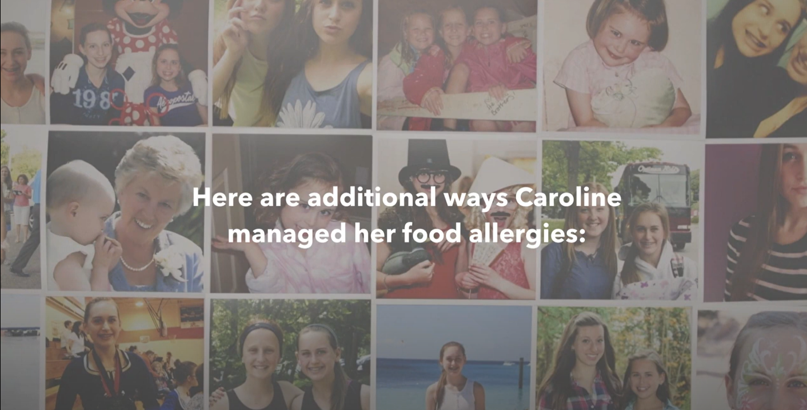
How Caroline managed food allergies
Watch this video to learn how Caroline managed her food allergies and how others helped.
Link: https://youtu.be/JT3d2tUs0Fc
Notes:
Prompt: Show the video

Slide 32
Module 4: Being a food allergy ally

Slide 33
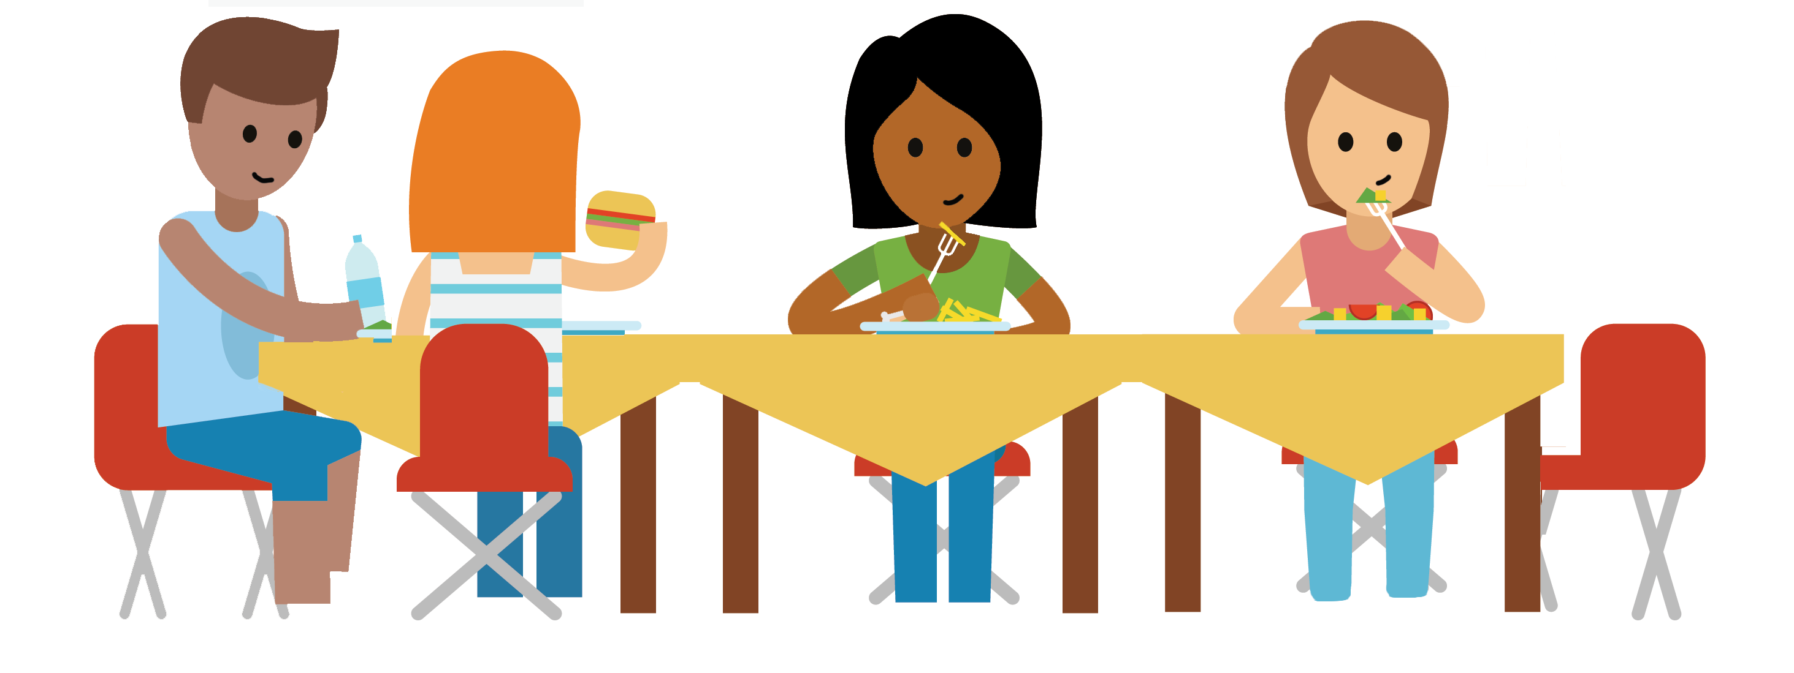
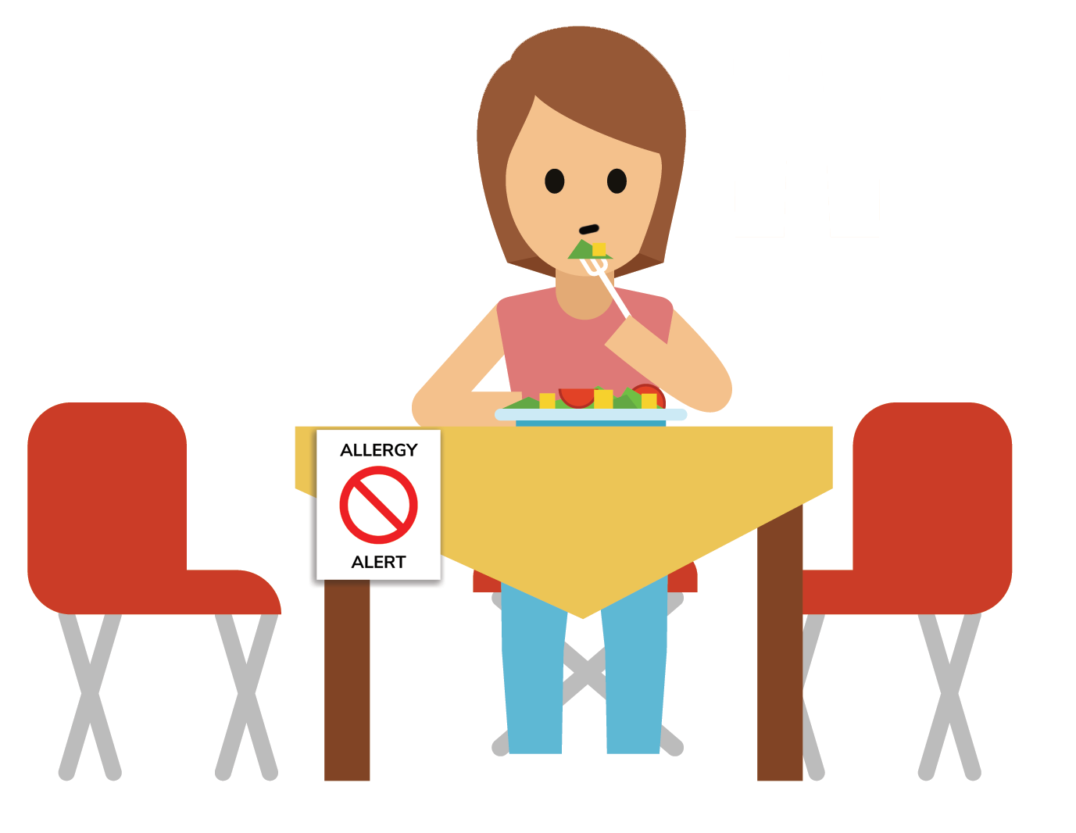
Imagine what it’s like
Imagine you had a food allergy, what do you think of – do you feel worried, scared, indifferent?
How might having a food allergy affect your life? Would it be any different for you at school, at team sports, going out to eat with friends, at birthday parties?

Slide 34
Here’s what kids with food allergy across Canada have said
Ryan from Calgary
I’m getting teased about my food allergy.
Everybody gets to eat the birthday cake except me.
I’m scared about having an allergic reaction.
Raj from Toronto
Ann from Moncton
The kids on my team are having a snack, I don’t know if it’s safe for me.
Nobody understands my food allergy. They think it’s a choice.
I don’t want to carry my auto-injector, it makes me feel different.
Mei from Winnipeg
Kate from Ottawa
Jayleen from Regina
Notes:
These are thoughts from kids across the country on their feelings or situations they may have experienced.

Slide 35
Activity: Walk in my shoes
Birthday cupcakes
How do you feel about this day if you don’t have food allergy.
How would you feel about this day if you have a milk, egg, and peanut allergy?
Pizza lunch
Soccer snacks
Notes:
Activity prompt: Ask students to imagine a typical school day:
You wake up, get ready, eat breakfast and go to school.
At school, it is pizza lunch day, and a classmate brought in cupcakes for the whole class to celebrate their birthday.
After school, you have a soccer game and the snacks from the coach are homemade cookies.
How would you feel about this day if you don’t have food allergy?
How would you feel about this day if you have a milk, egg, and peanut allergy?

Slide 36
Bullying and food allergy
Link: https://youtu.be/2xhfIUueDmg
Notes:
Prompt: Show the video

Slide 37
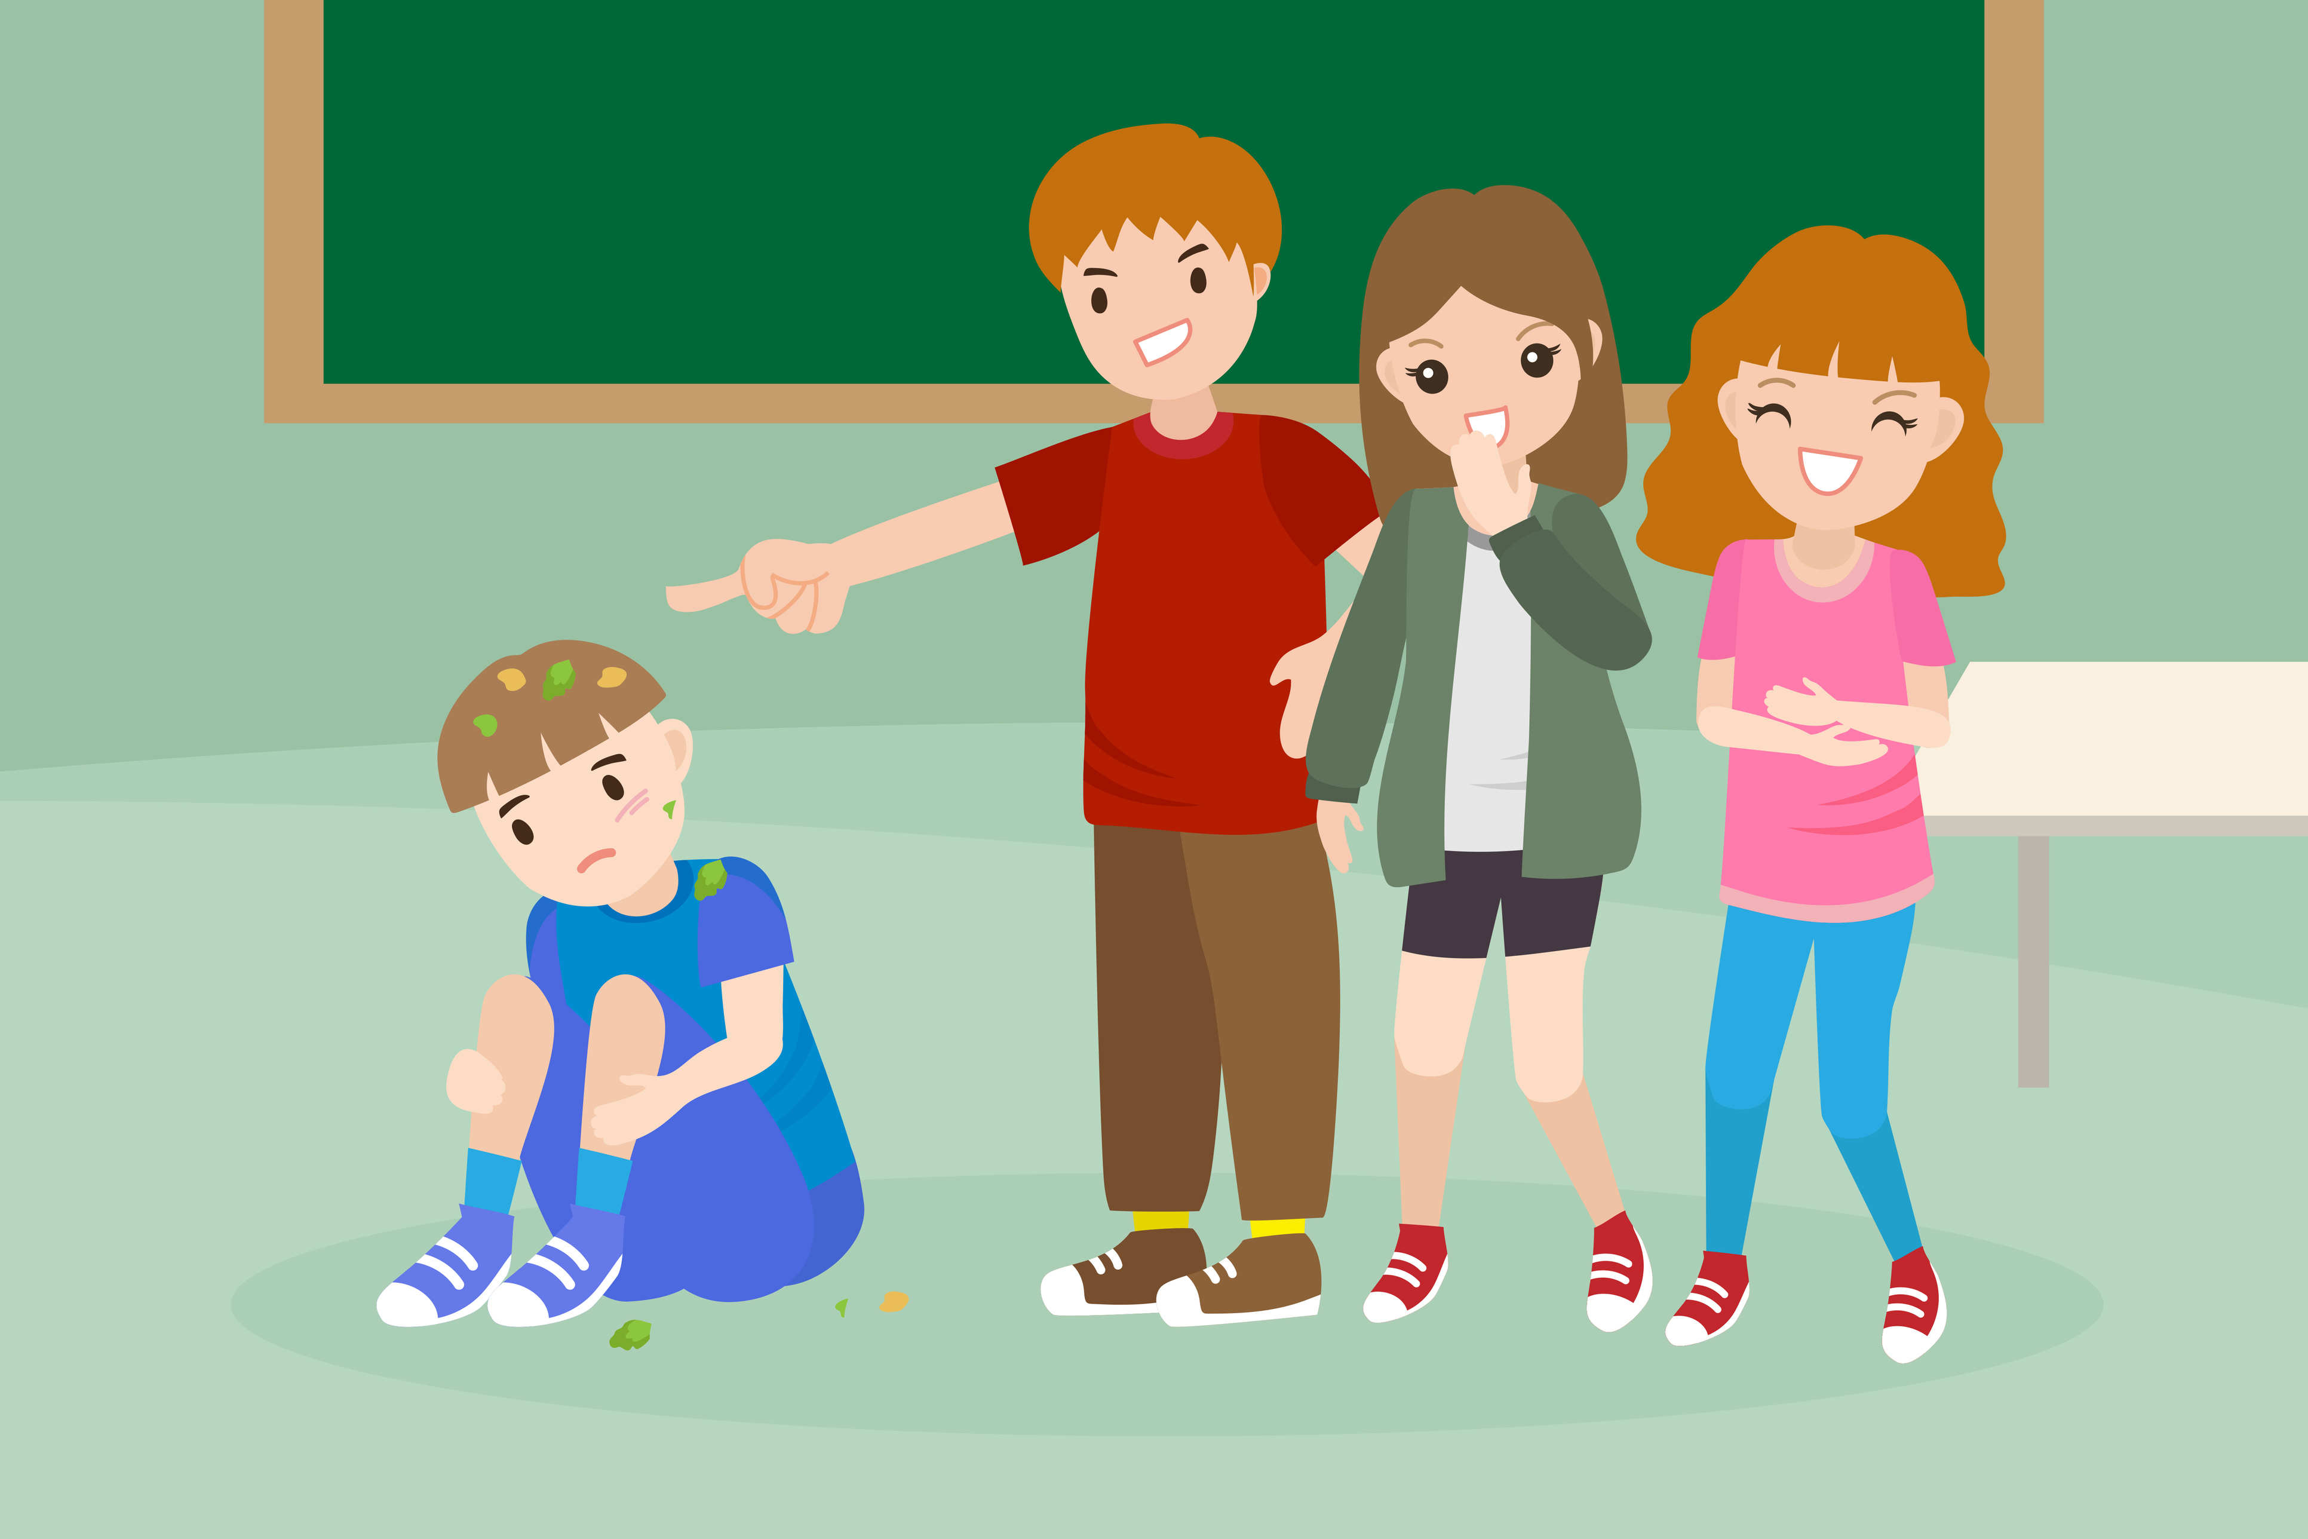
Think about it…
Have you ever experienced unwanted teasing, taunts, or bullying?
Why do you think people tease, taunt, or bully about food allergies?
What should you do if you see someone being bullied because of their food allergy?
Did you know
According to research, 1-in-3 children with food allergy report being bullied, specifically because of their food allergy!
Notes:
Activity prompt: classroom discussion
Note to teacher: Determine how you want students to think about these scenarios. Students can raise hands, or close their eyes and raise hands, or simply stay silent and think, for example. Choose whatever works best for your classroom.
With this topic, ensure that students understand that they are in a safe space. Remind them not to use names if they are describing someone who has bullied them, and to connect with you/teacher if they need to talk about it.
Information to support the discussion from bullyingcanada.ca:
For Victims: Walk away, tell someone you trust – a teacher/coach/guidance counsellor/parent, ask for help, say something complimentary to the bully to distract him/her, stay in groups to avoid confrontation, use humour to throw off or connect with your bully, pretend that the bully isn’t affecting you, keep reminding yourself that you are a good person and are worthy of respect
For Bystanders: Instead of ignoring a bullying incident, try to: Tell a teacher, coach or counsellor, move toward or next to the victim, use your voice – say “stop”, befriend the victim, lead the victim away from the situation
For Bullies: Talk to a teacher or counsellor, think about how you would feel if someone bullied you, consider your victim’s feelings – think before you act

Slide 38
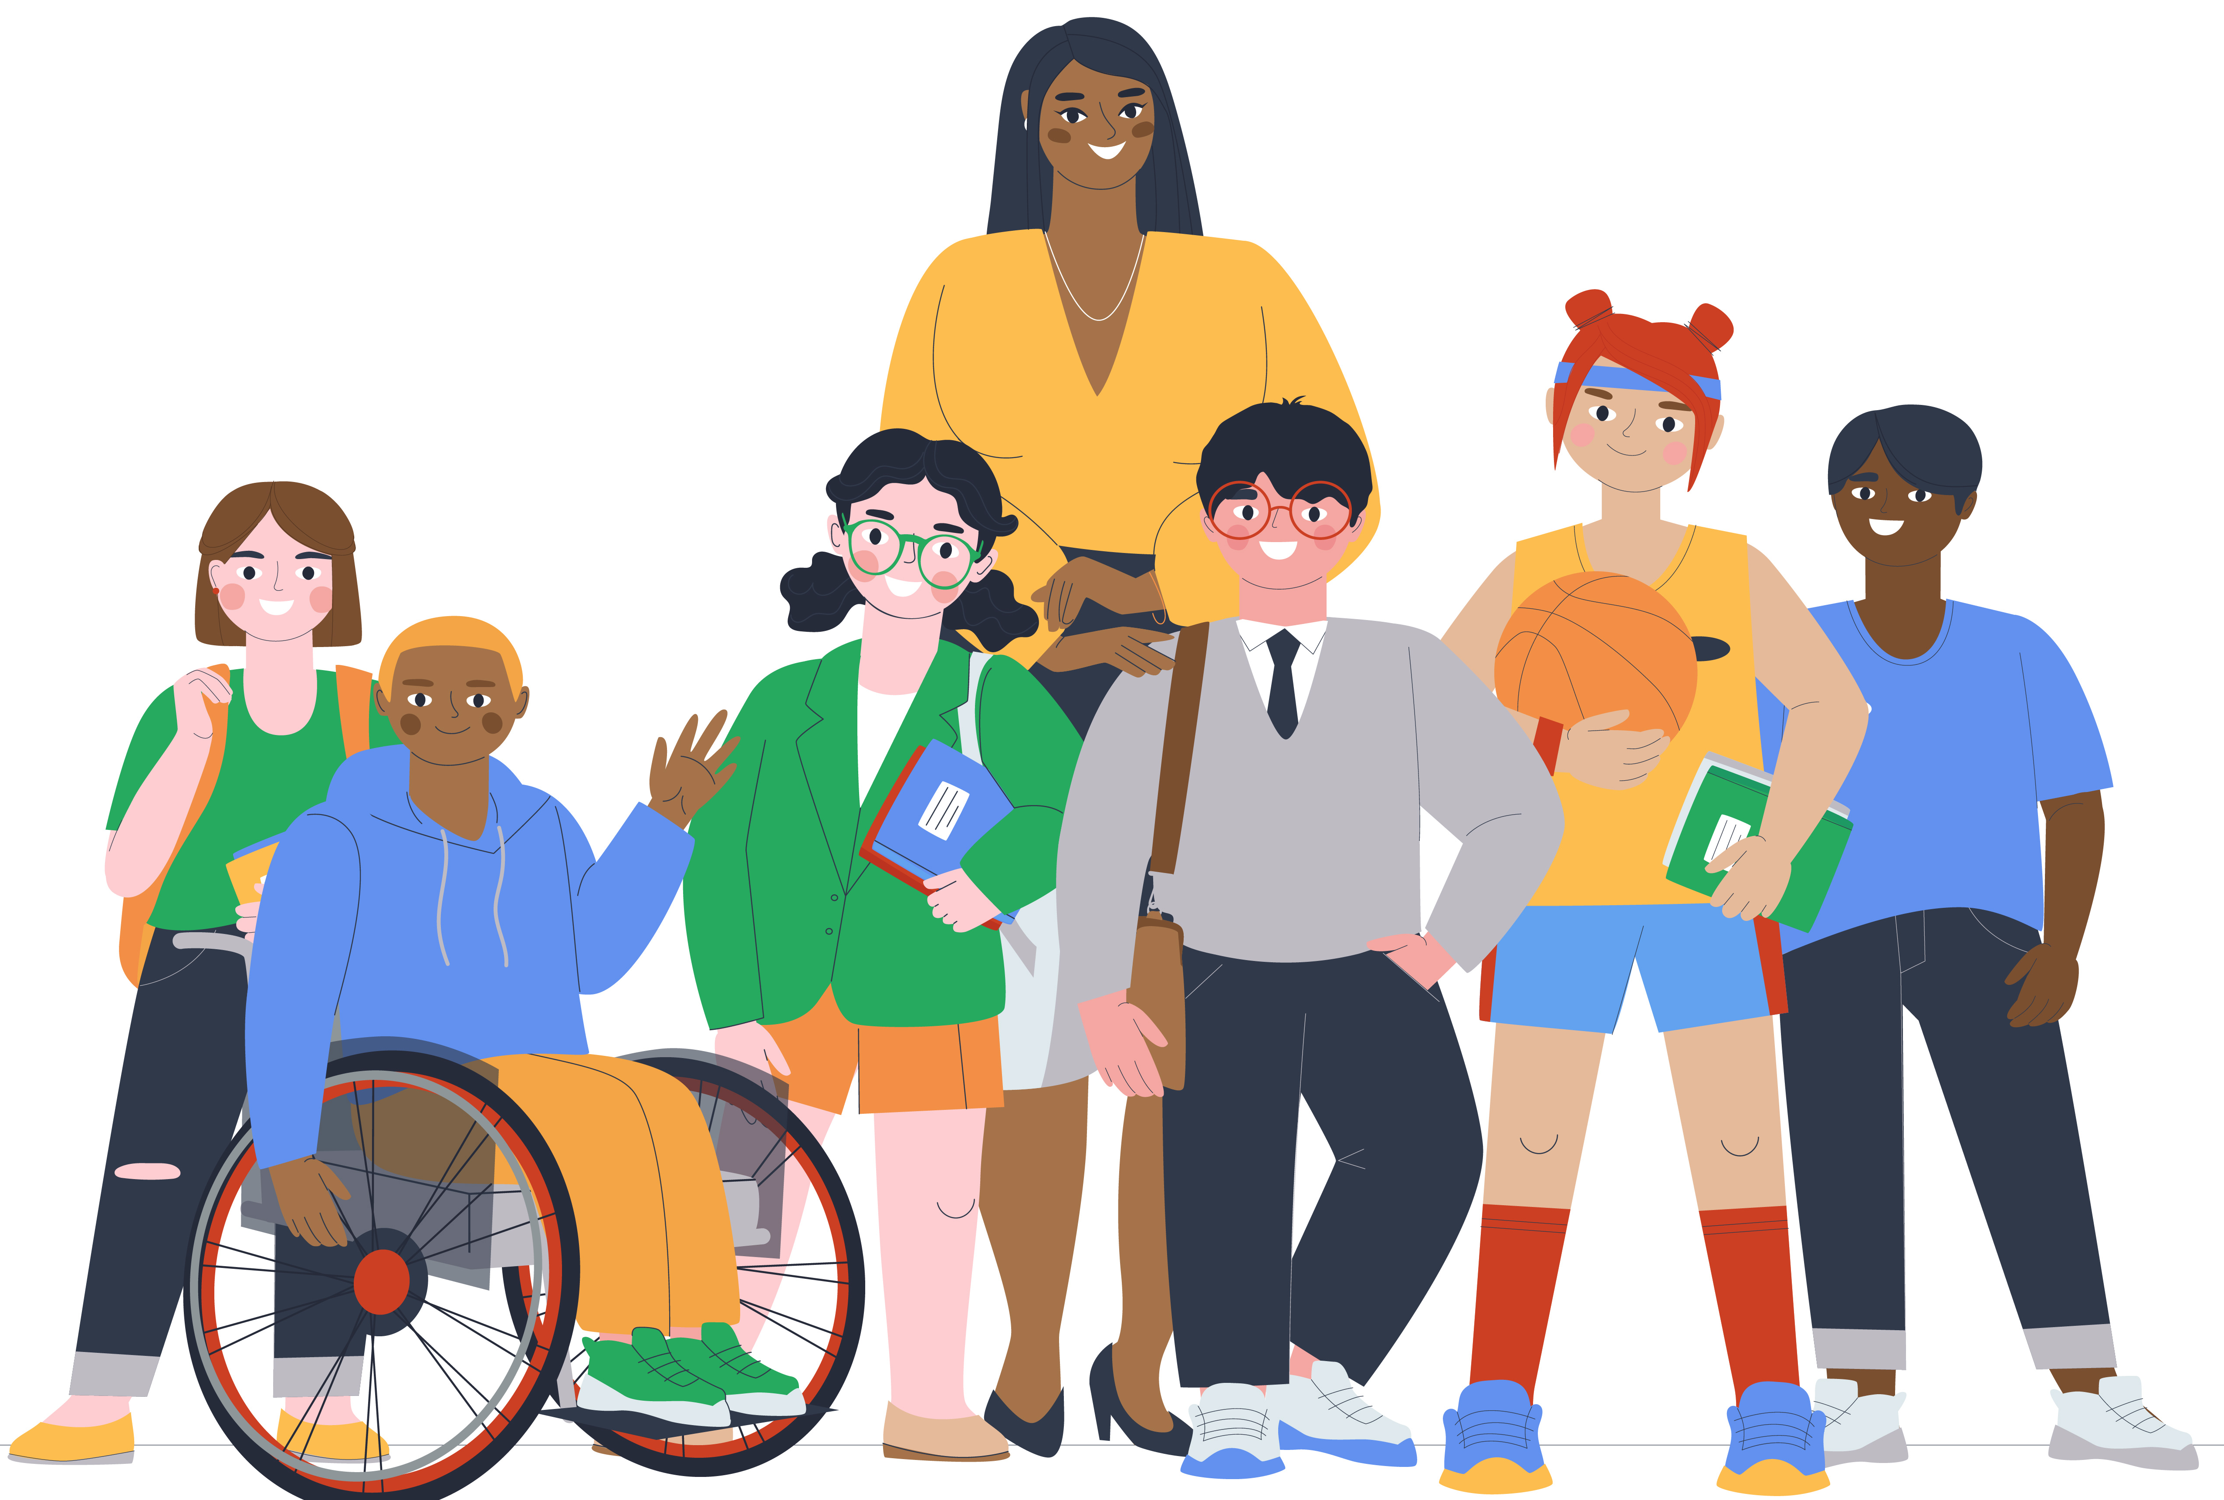
Be a food allergy ally
What does it mean to be an ally?
“A person or group that provides assistance and support to others in an ongoing effort or activity.”
You can help someone with food allergy feel safer, less anxious, and more included!

Slide 39
How to be a food allergy ally
Food allergy ally!
Know
Support
Be inclusive
Advocate
Reduce risks
Notes:
Know what food allergies your friends and classmates have, understand that food allergy is a serious medical condition and not a choice.
Reduce risks of someone having an allergic reaction – for example, do not share food, straws, utensils or food containers with them; wash your hands and eating surfaces after eating.
Find ways to be supportive, sometimes just understanding and accepting is all a friend needs.
Be inclusive, just because someone has a food allergy, doesn’t mean they should be excluded by separate lunch tables or from fun events like birthday parties. With precautions in place (like no sharing foods, reducing cross-contamination, and handwashing), everyone can stay safe and have fun.
School days involve food, like lunches and snacks, class and school celebrations as well as math lessons, science experiments and crafts involving food.
Think about what can be done so everyone feels safe and included. For example, what about celebrating with an allergy-friendly food that everyone can eat, or non-food treats like stickers?
Be an advocate – share what you know with others so more people are aware of food allergy and how to help those with them!

Slide 40
What can you do to help change the picture?
From this
to this
Everyone has a seat at the table!

Slide 41
Supporters of this program

Slide 42
Thanks for learning about food allergy!
Notes:
The more you understand about food allergy, the better you can support your friends or classmates with one. You can make a difference!
Remember, having a food allergy is not a choice but you can choose to be supportive of your friend/classmate with one.

